Slide 1
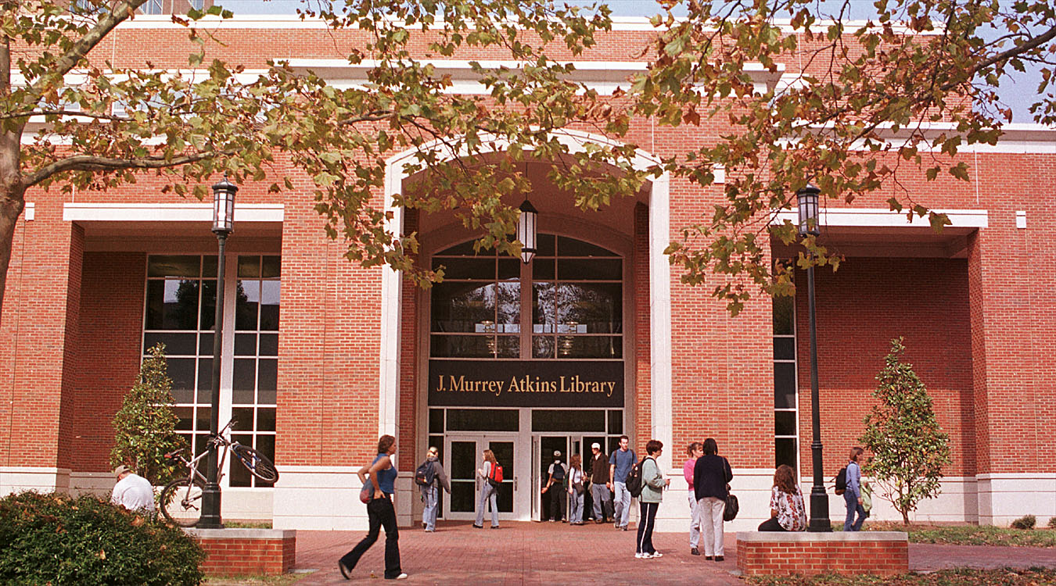
TECHNOLOGY MEETS ANTHROPOLOGY
Improving Student Learning Spaces
WEST/SOUTHWEST EDUCAUSE • February 2013
Bridgette Sanders, Social Sciences Librarian
Judy Walker, Education/Psychology Librarian
J. Murrey Atkins Library • UNC Charlotte
Charlotte, North Carolina
Notes:
In order to provide the best learning environment for our students, J. Murrey Atkins Library at the the University of North Carolina Charlotte has established a continuous feedback process based on techniques borrowed from the field of Anthropology. This power point is a brief ‘case study’ of the process which has been unfolding over the past two and a half years. It will include the challenges and what was learned.

Slide 2
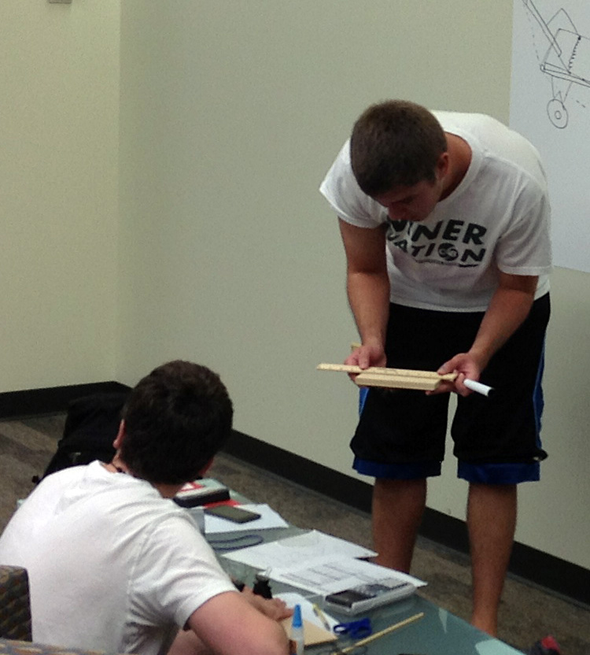
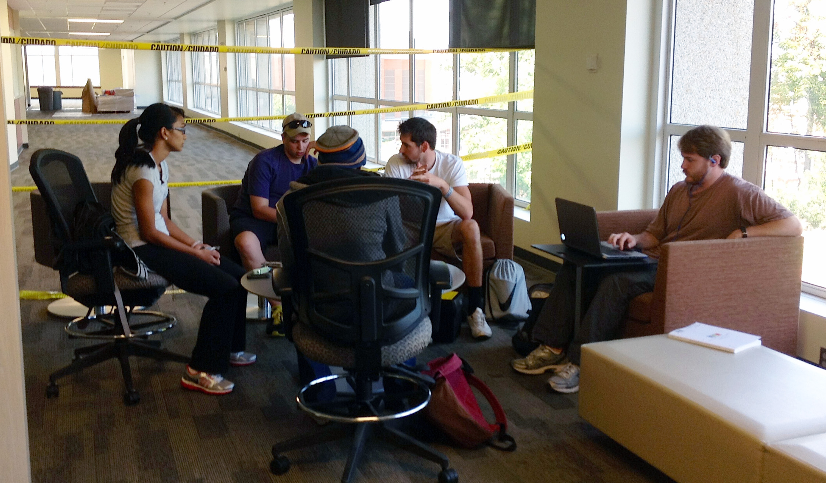
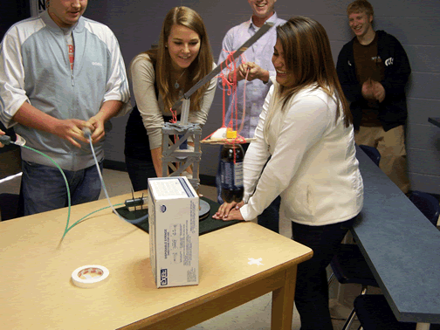
The 21st Century Learner
Social
Team Orientation
Multitaskers
Hands-on
Experimenters
Entrepreneurs
Notes:
The majority of traditional students ages eighteen to twenty-two entering college have grown up in a world awash with technologies. These “students are social and team oriented, comfortable with multitasking, and generally positive in their outlook, and have a hands-on, “let’s build it” approach—all encouraged by the IT resources at their disposal.” (Brown, 2005) ‘‘They expect to be engaged by their environment, with participatory, sensory-rich, experiential activities (either physical or virtual) and opportunities for input. They are more oriented to visual media than previous generations – and prefer to learn by doing rather than by telling or reading.” (Becta Research Report, 2008, p. 13) The skills needed to succeed in the modern workplace no longer revolve solely around content knowledge but rather stress critical thinking, communication, collaboration and creativity. In response to these changes higher education teaching has shifted from professor-centered lectures to student-centered learning. The curriculum now includes more collaborative, inquiry-based learning with students expected to produce multidimensional presentations.
With the core mission of higher education being education, learning and the spaces where it takes place are critical. To provide the best service to a university’s community, these spaces should be designed to optimize the integration of student needs, current learning theory and emerging information technology. (Brown, 2005)
In respond to these paradigm shifts J. Murrey Atkins Library at the University of North Carolina Charlotte has had to rethink how the spaces in the library are used. We wanted to move away from having the building seen as a repository and instead create an environment where collaborative, interactive learning could take place. In other words we wanted to “provide an atmosphere in which social and academic interests can easily intersect.” (Lippincott, 2005).
Becta. (2008). Research report: Emerging technologies for learning (Vol. 3). http://www.mmiweb.org.uk/publications/ict/emerging_tech03.pdf
Brown, Malcolm. (2005). Learning Spaces. In D. G. Oblinger and J. L. Oblinger, Eds. Educating the Net Generation: An EDUCAUSE E-Book. http://www.educause.edu/educatingthenetgen
Lippincott, J. (2005). Net Generation Students and Libraries. In D. G. Oblinger and J. L. Oblinger, Eds. Educating the Net Generation: An EDUCAUSE E-Book. http://www.educause.edu/educatingthenetgen

Slide 3
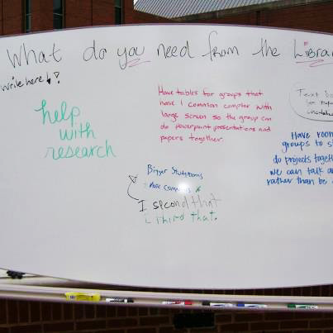
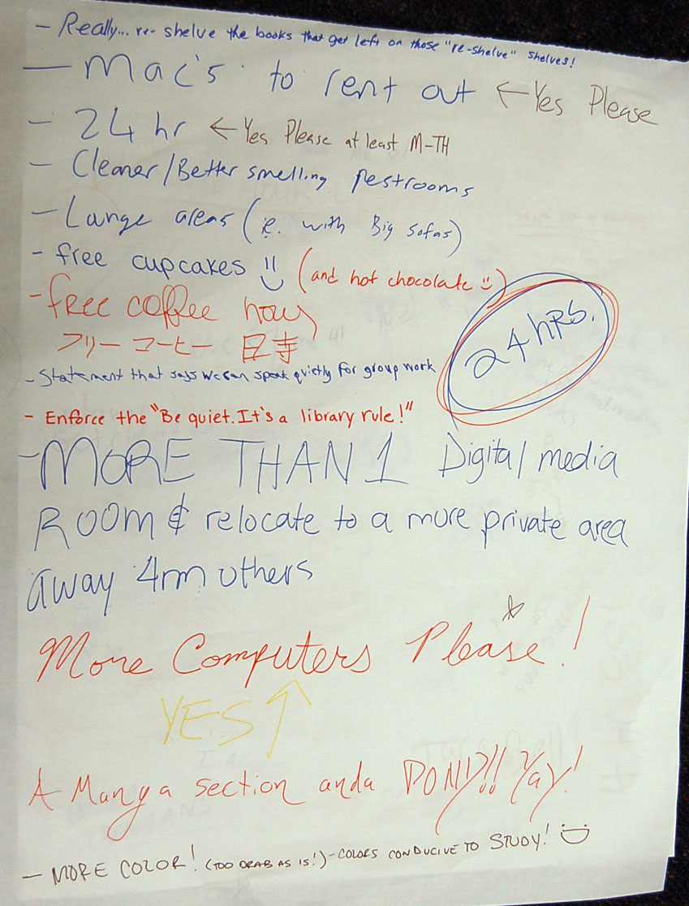
Ethnographic Studies
Feedback Boards/Charts
Interviews
Usability studies
Observation
Student journals
Card sorting
NO surveys!
Notes:
The library decided to break from the traditional methods of assessment/evaluation – circulation statistics, body counts and surveys. Instead we hired a full time anthropologist to assist the staff in conducting ethnographic studies of how students went about studying and how they used the library. Although not the only technique used the feedback boards/charts proved to the most entertaining and interesting. Whiteboards and paper flip charts were place throughout the library with a variety of different questions such as Where do you like to study? What can the library do for you? Where do you go to get help with research?

Slide 4
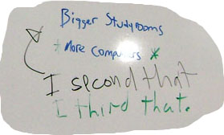
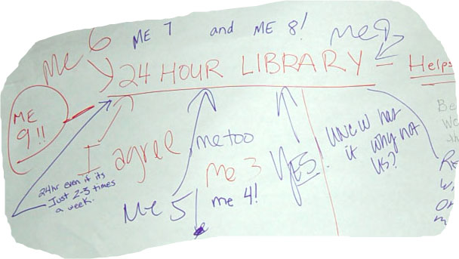
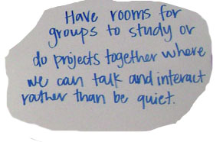
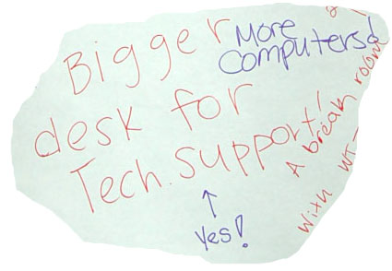
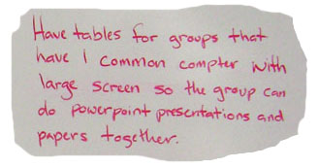
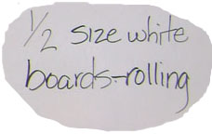
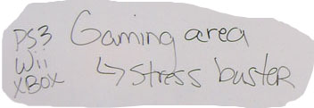
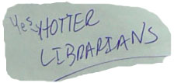
Ethnographic Studies
Notes:
Of course there was a wide range of responses, but interestingly very, very few rude comments. This is just a sampling of comments. The staff definitely agreed that we needed ‘hotter librarians’. The feedback from the boards, interviews, observations and journals that students kept for us, was sorted into categories and reviewed.

Slide 5
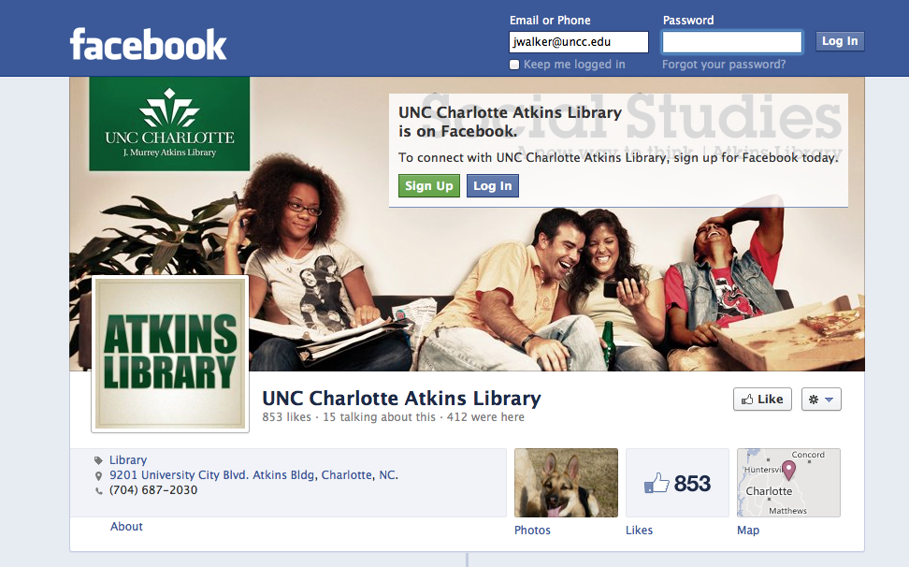
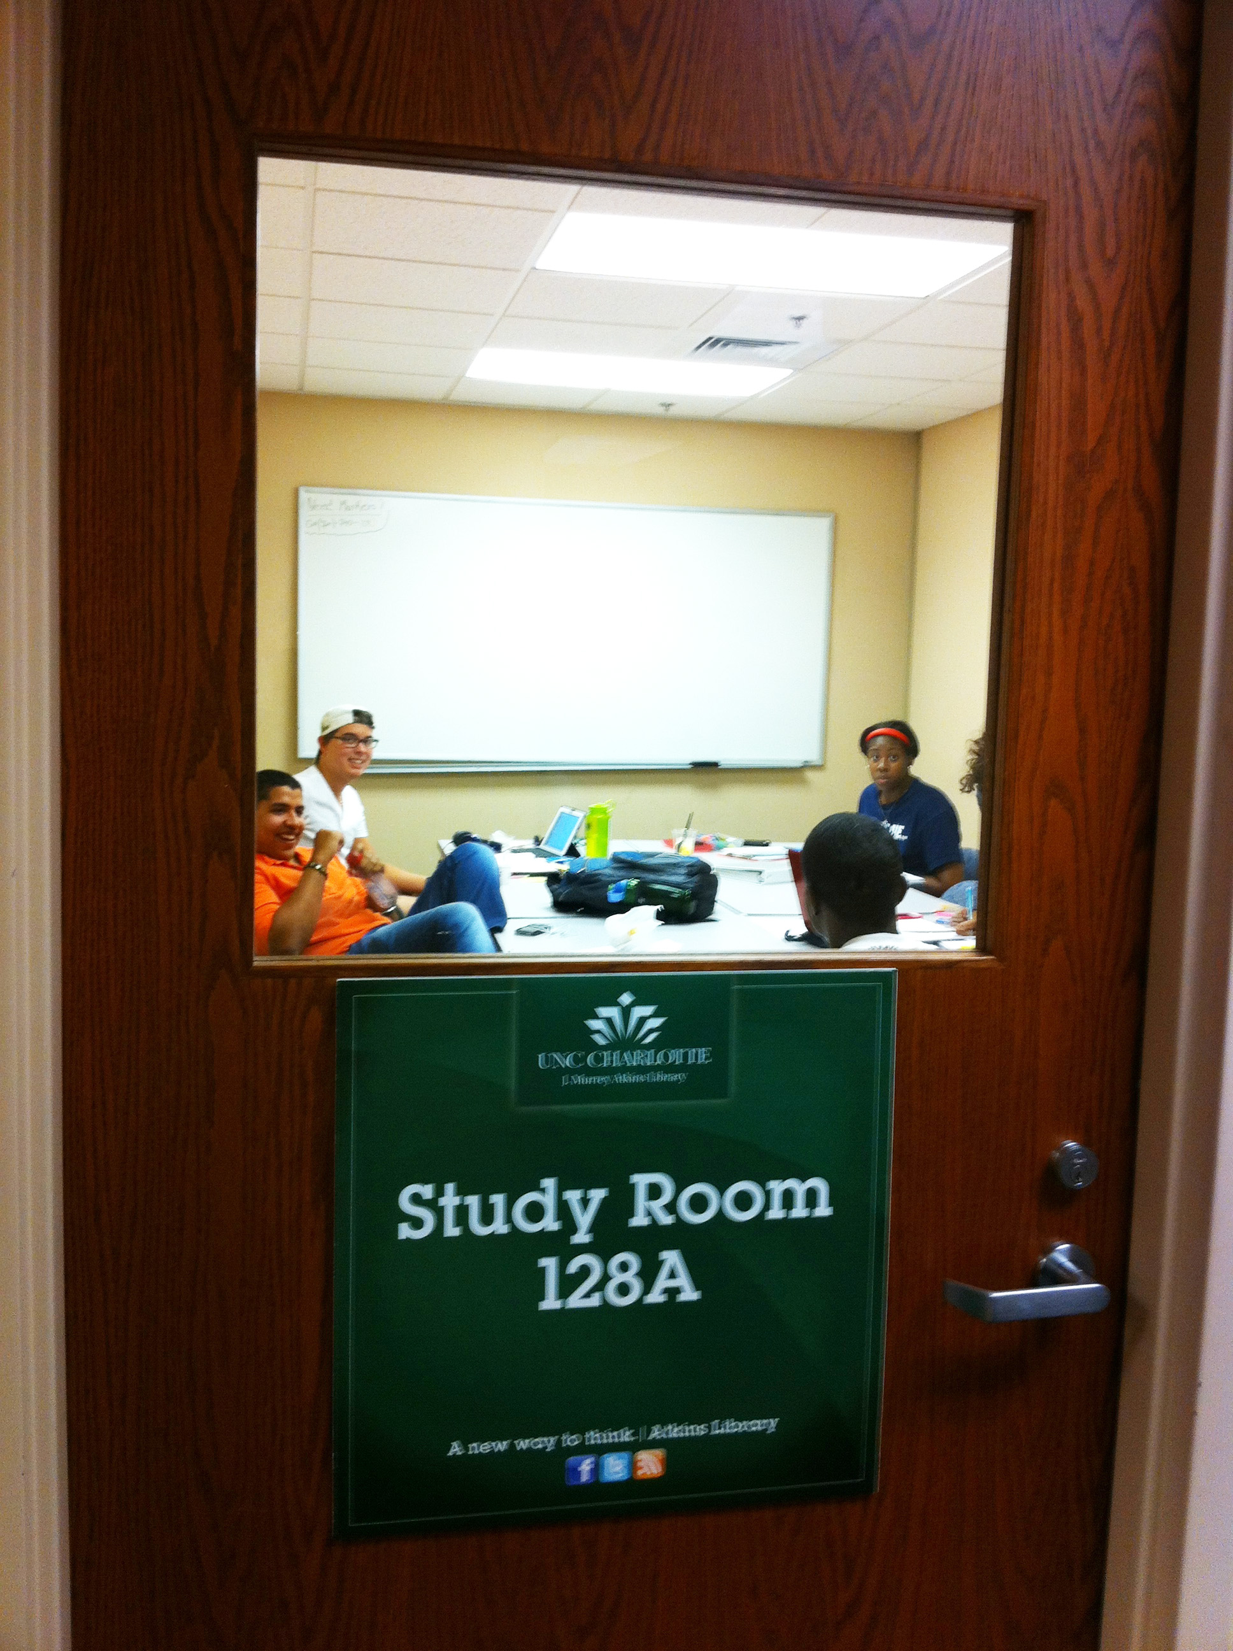
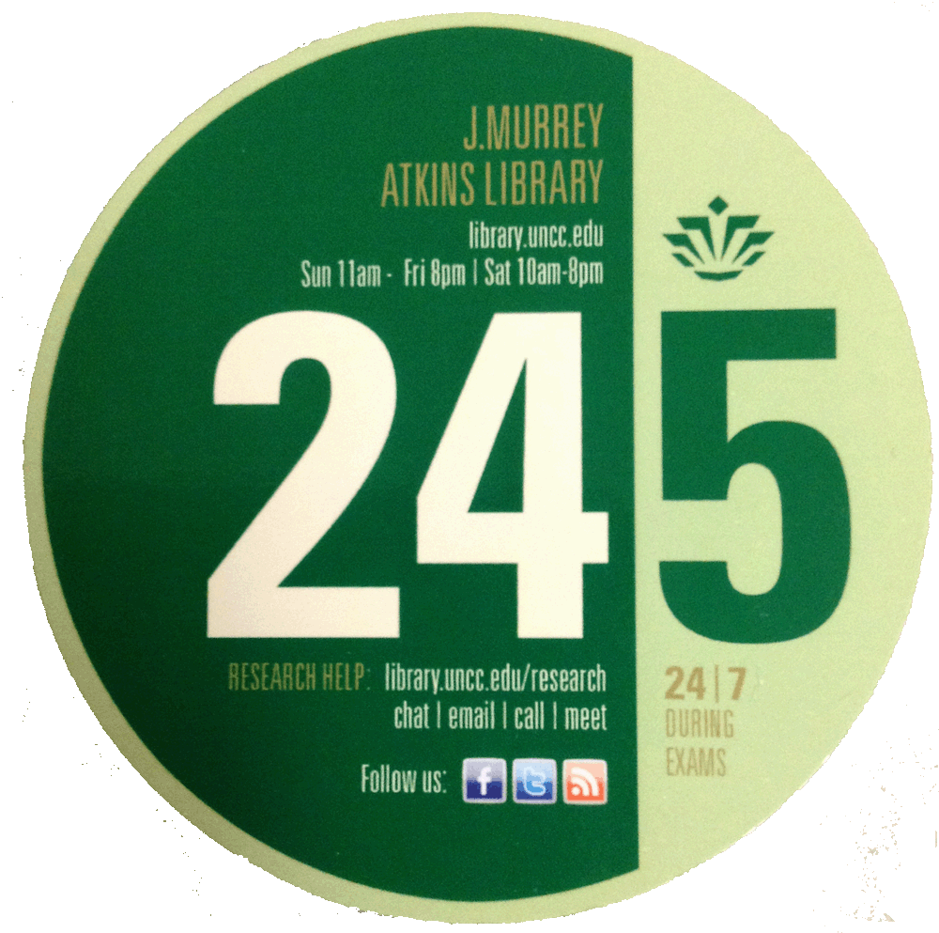
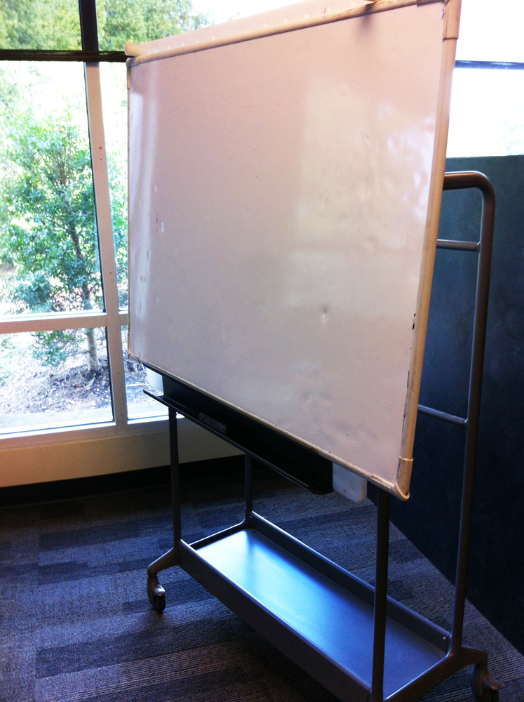
Quick, Easy Responses
Notes:
We were able to address some of the issues fairly quickly and at a relatively low cost. We upgraded the 11 existing study rooms with whiteboards and computers. A Facebook page and Twitter feed was established, and is now being maintained with the help of students. The issue of hours has been around for a number of years. With the addition of surveillance equipment we felt it safe to begin a 24/5 schedule during the semester and a 24/7 schedule during exams.

Slide 6
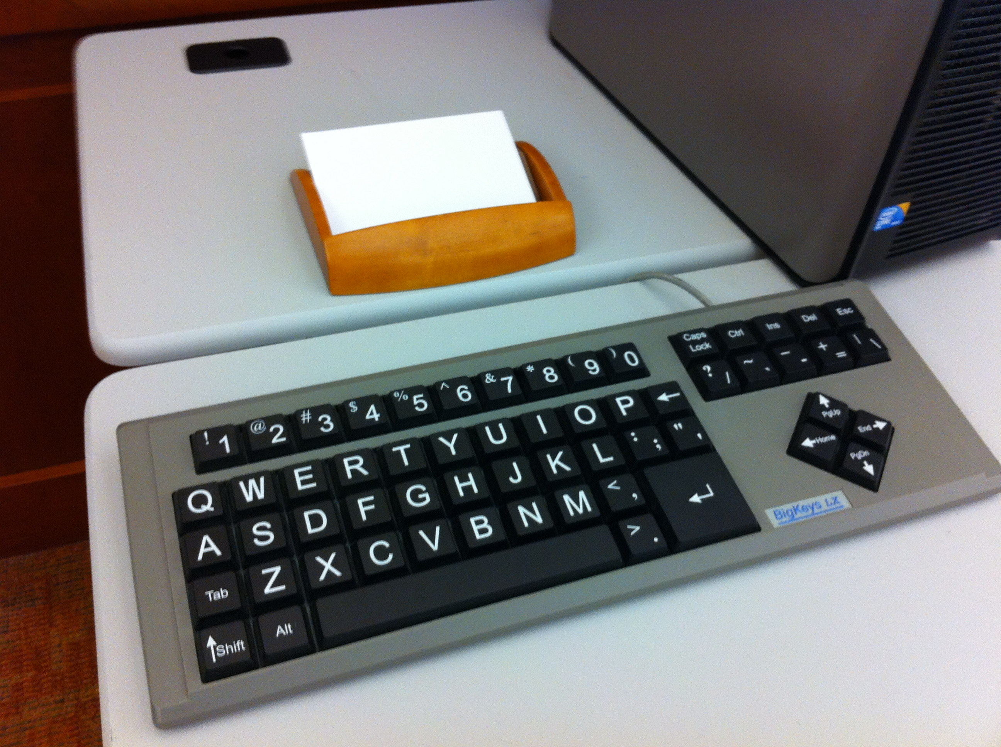
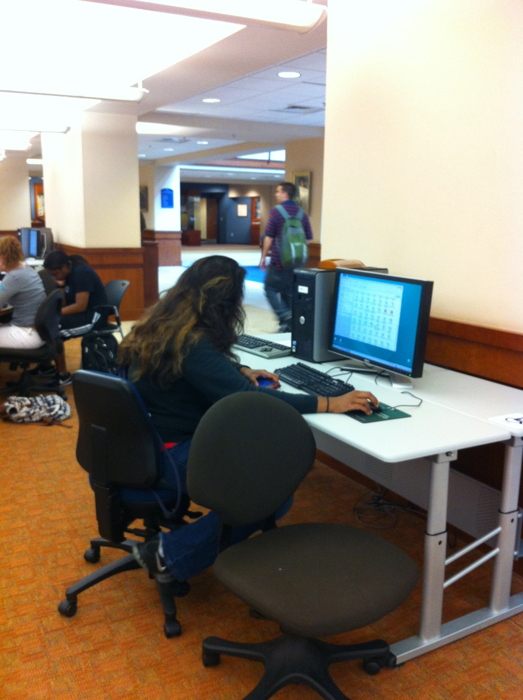
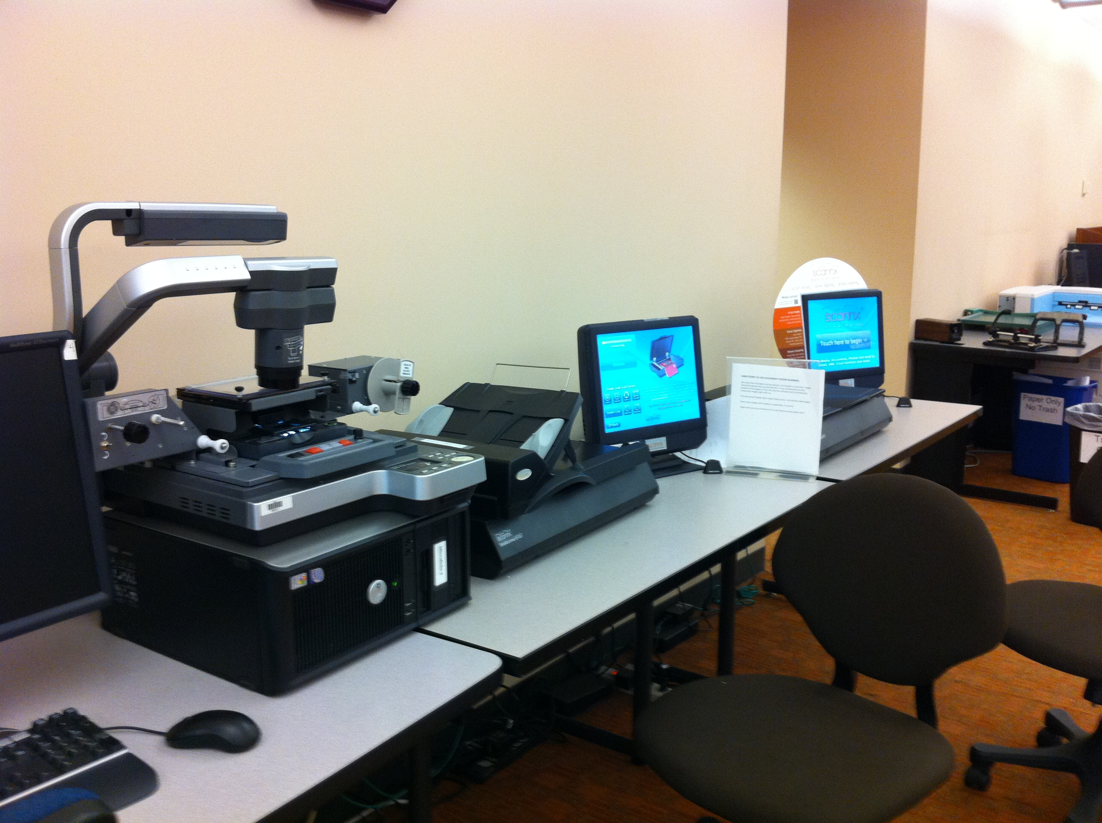
Quick, Easy Responses
Equipment Upgrades
Notes:
We were also able to upgrade accessibility equipment which now includes adjustable tables, extra large screens and keyboards and a Kurzweil Reader. We do not limit the use of this equipment to disabled students although they have priority over non-disabled students. The equipment is used heavily by our older, nontraditional students. The addition of two scanners operated by touch screen has been a huge hit with the students.

Slide 7
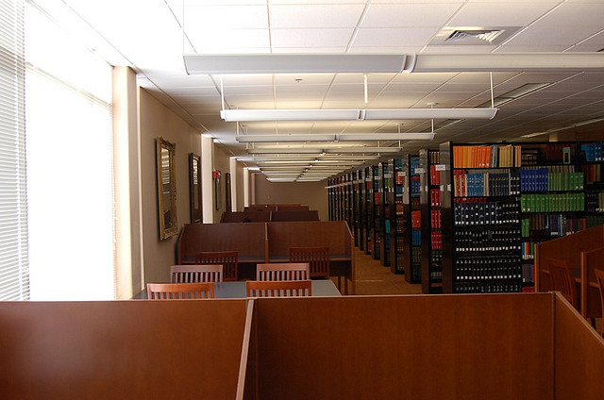
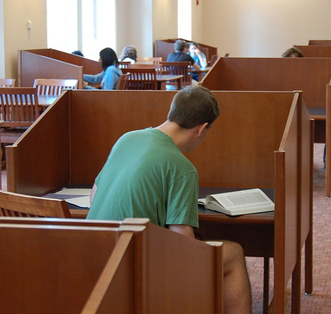
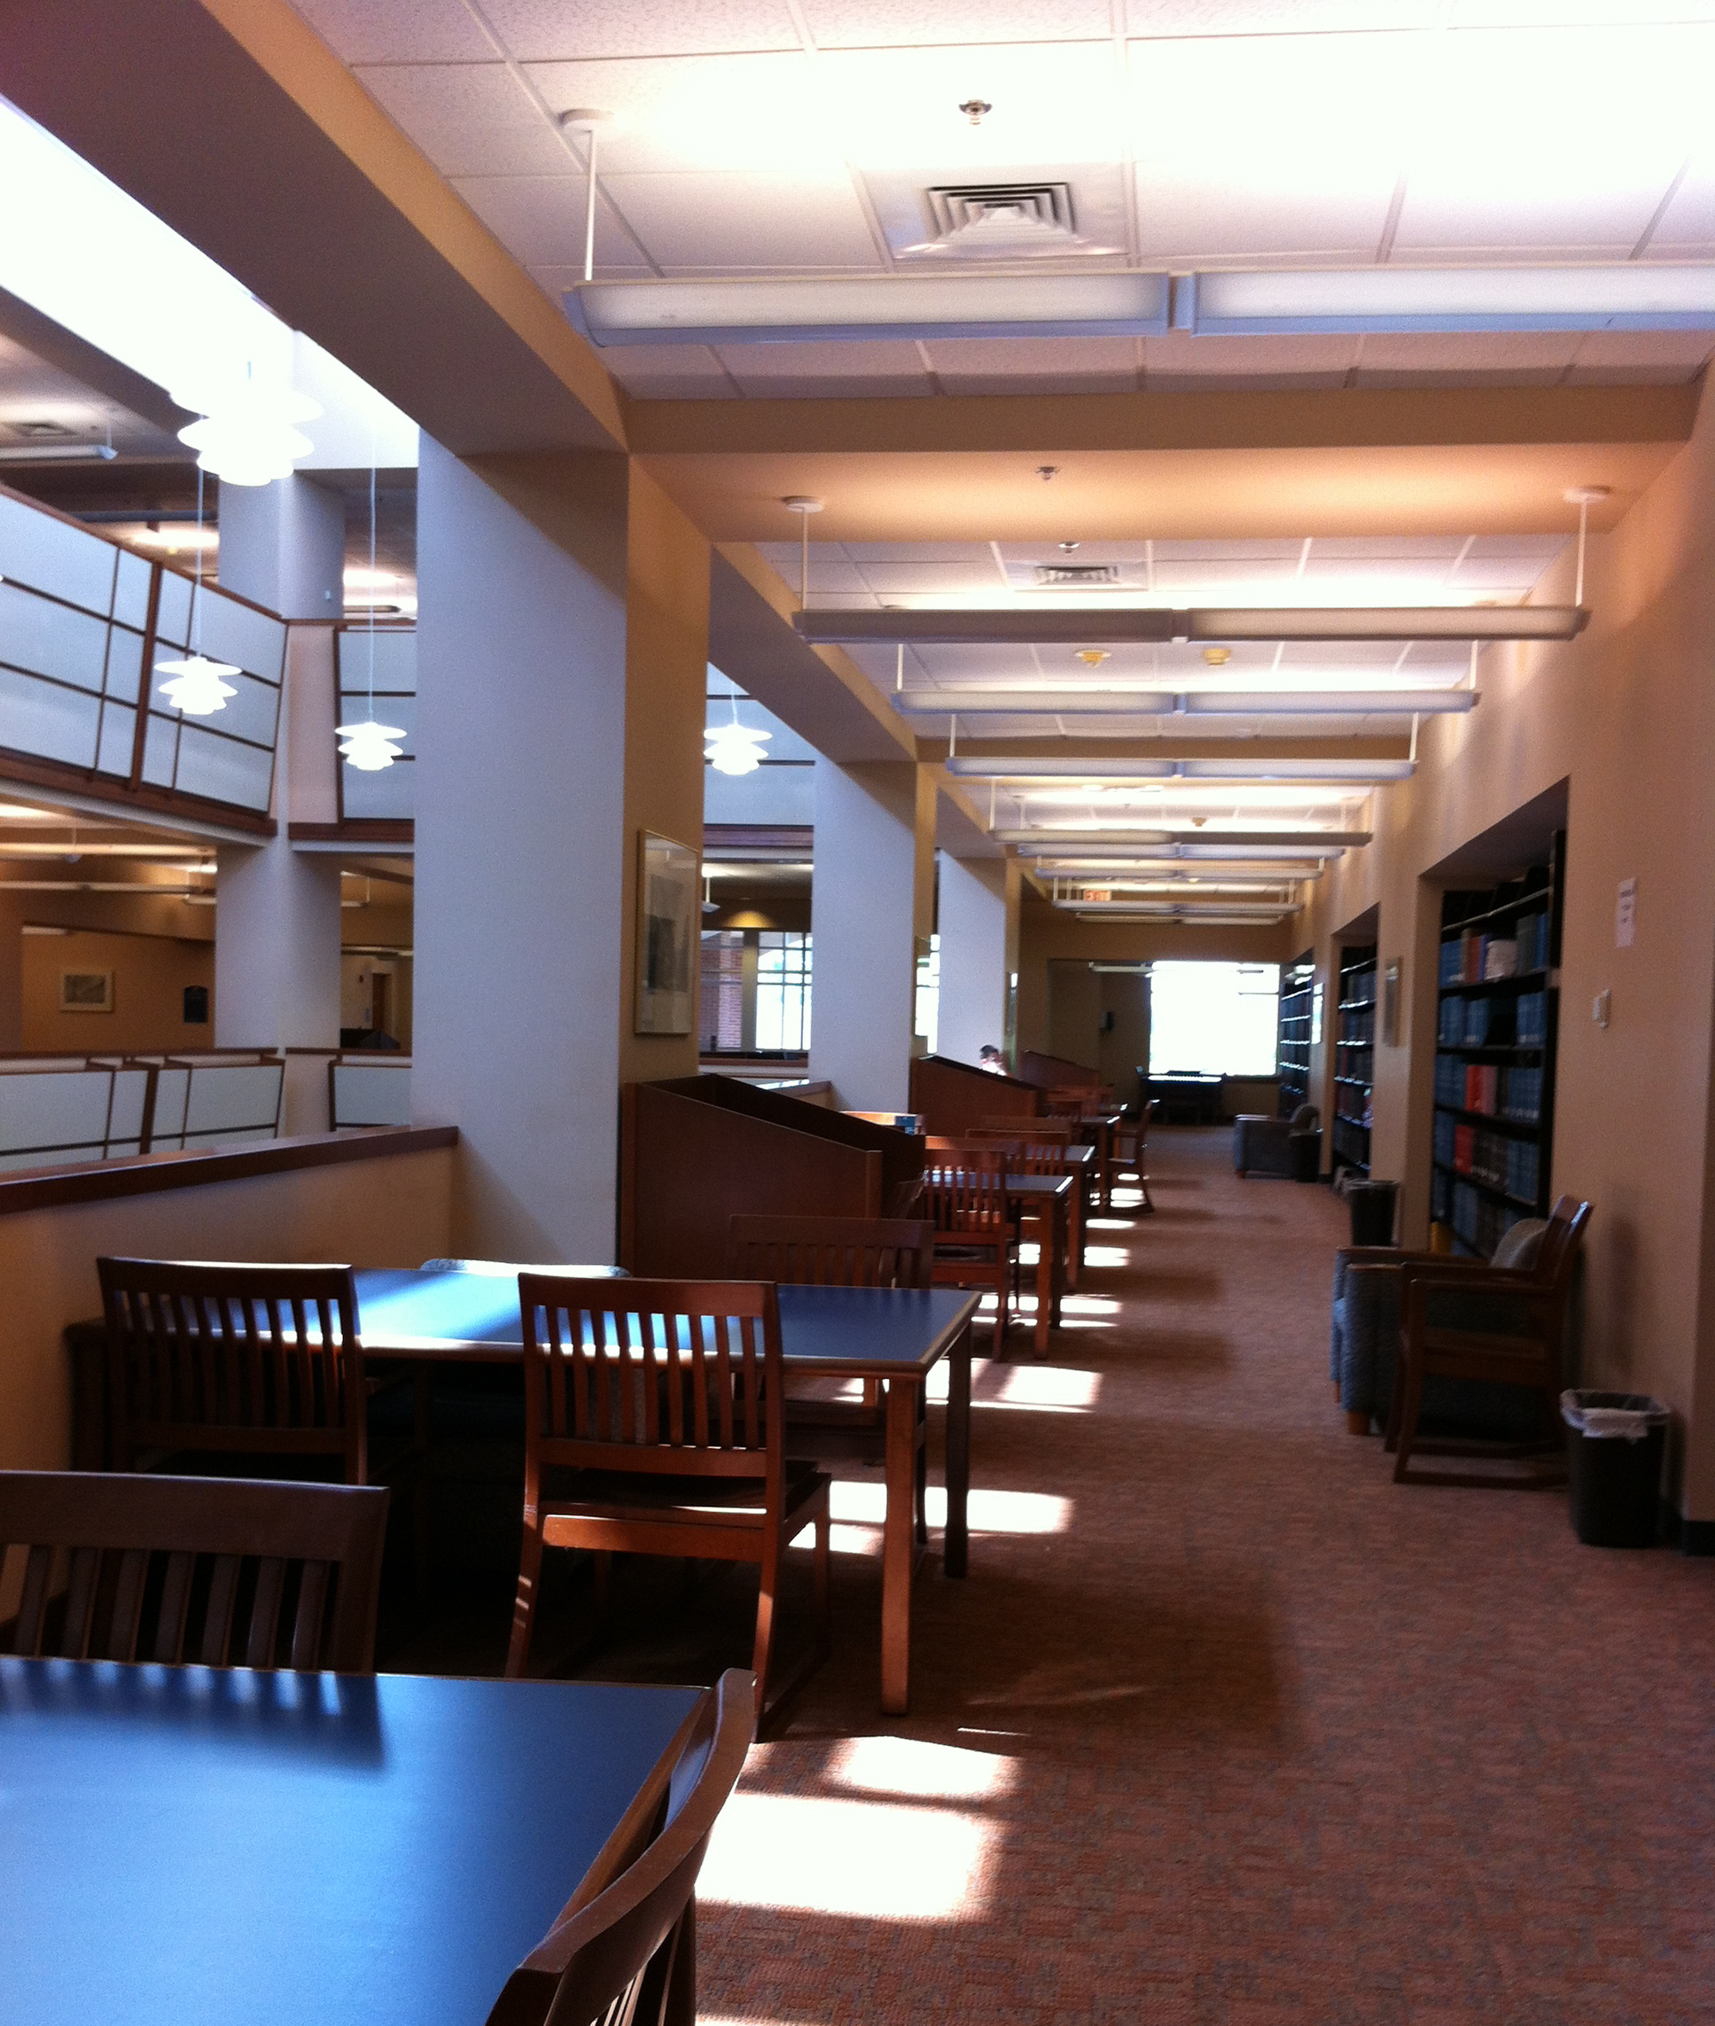
The Tradition
Notes:
Observational studies quickly pointed out that our spaces were not very conducive to collaborative learning. Four years ago the library environment was very traditional as demonstrated by these pictures. Lots of stacks, study carrels and individual spaces.

Slide 8
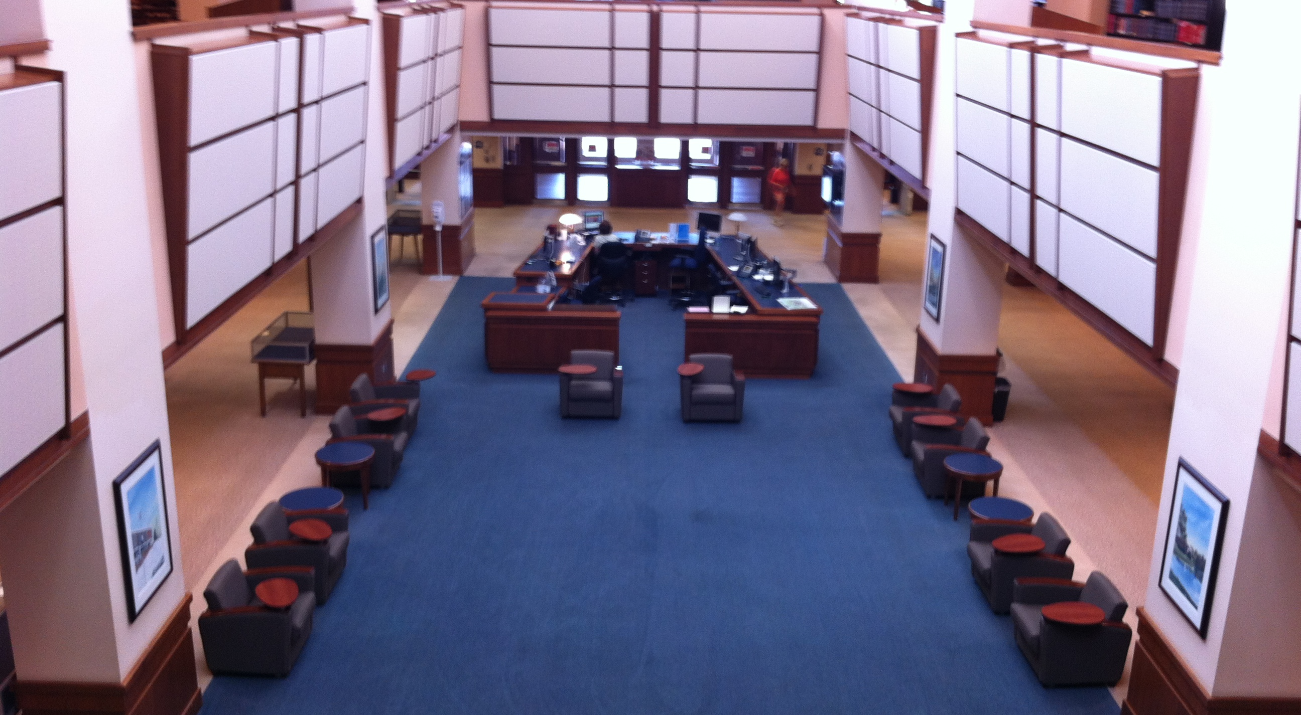
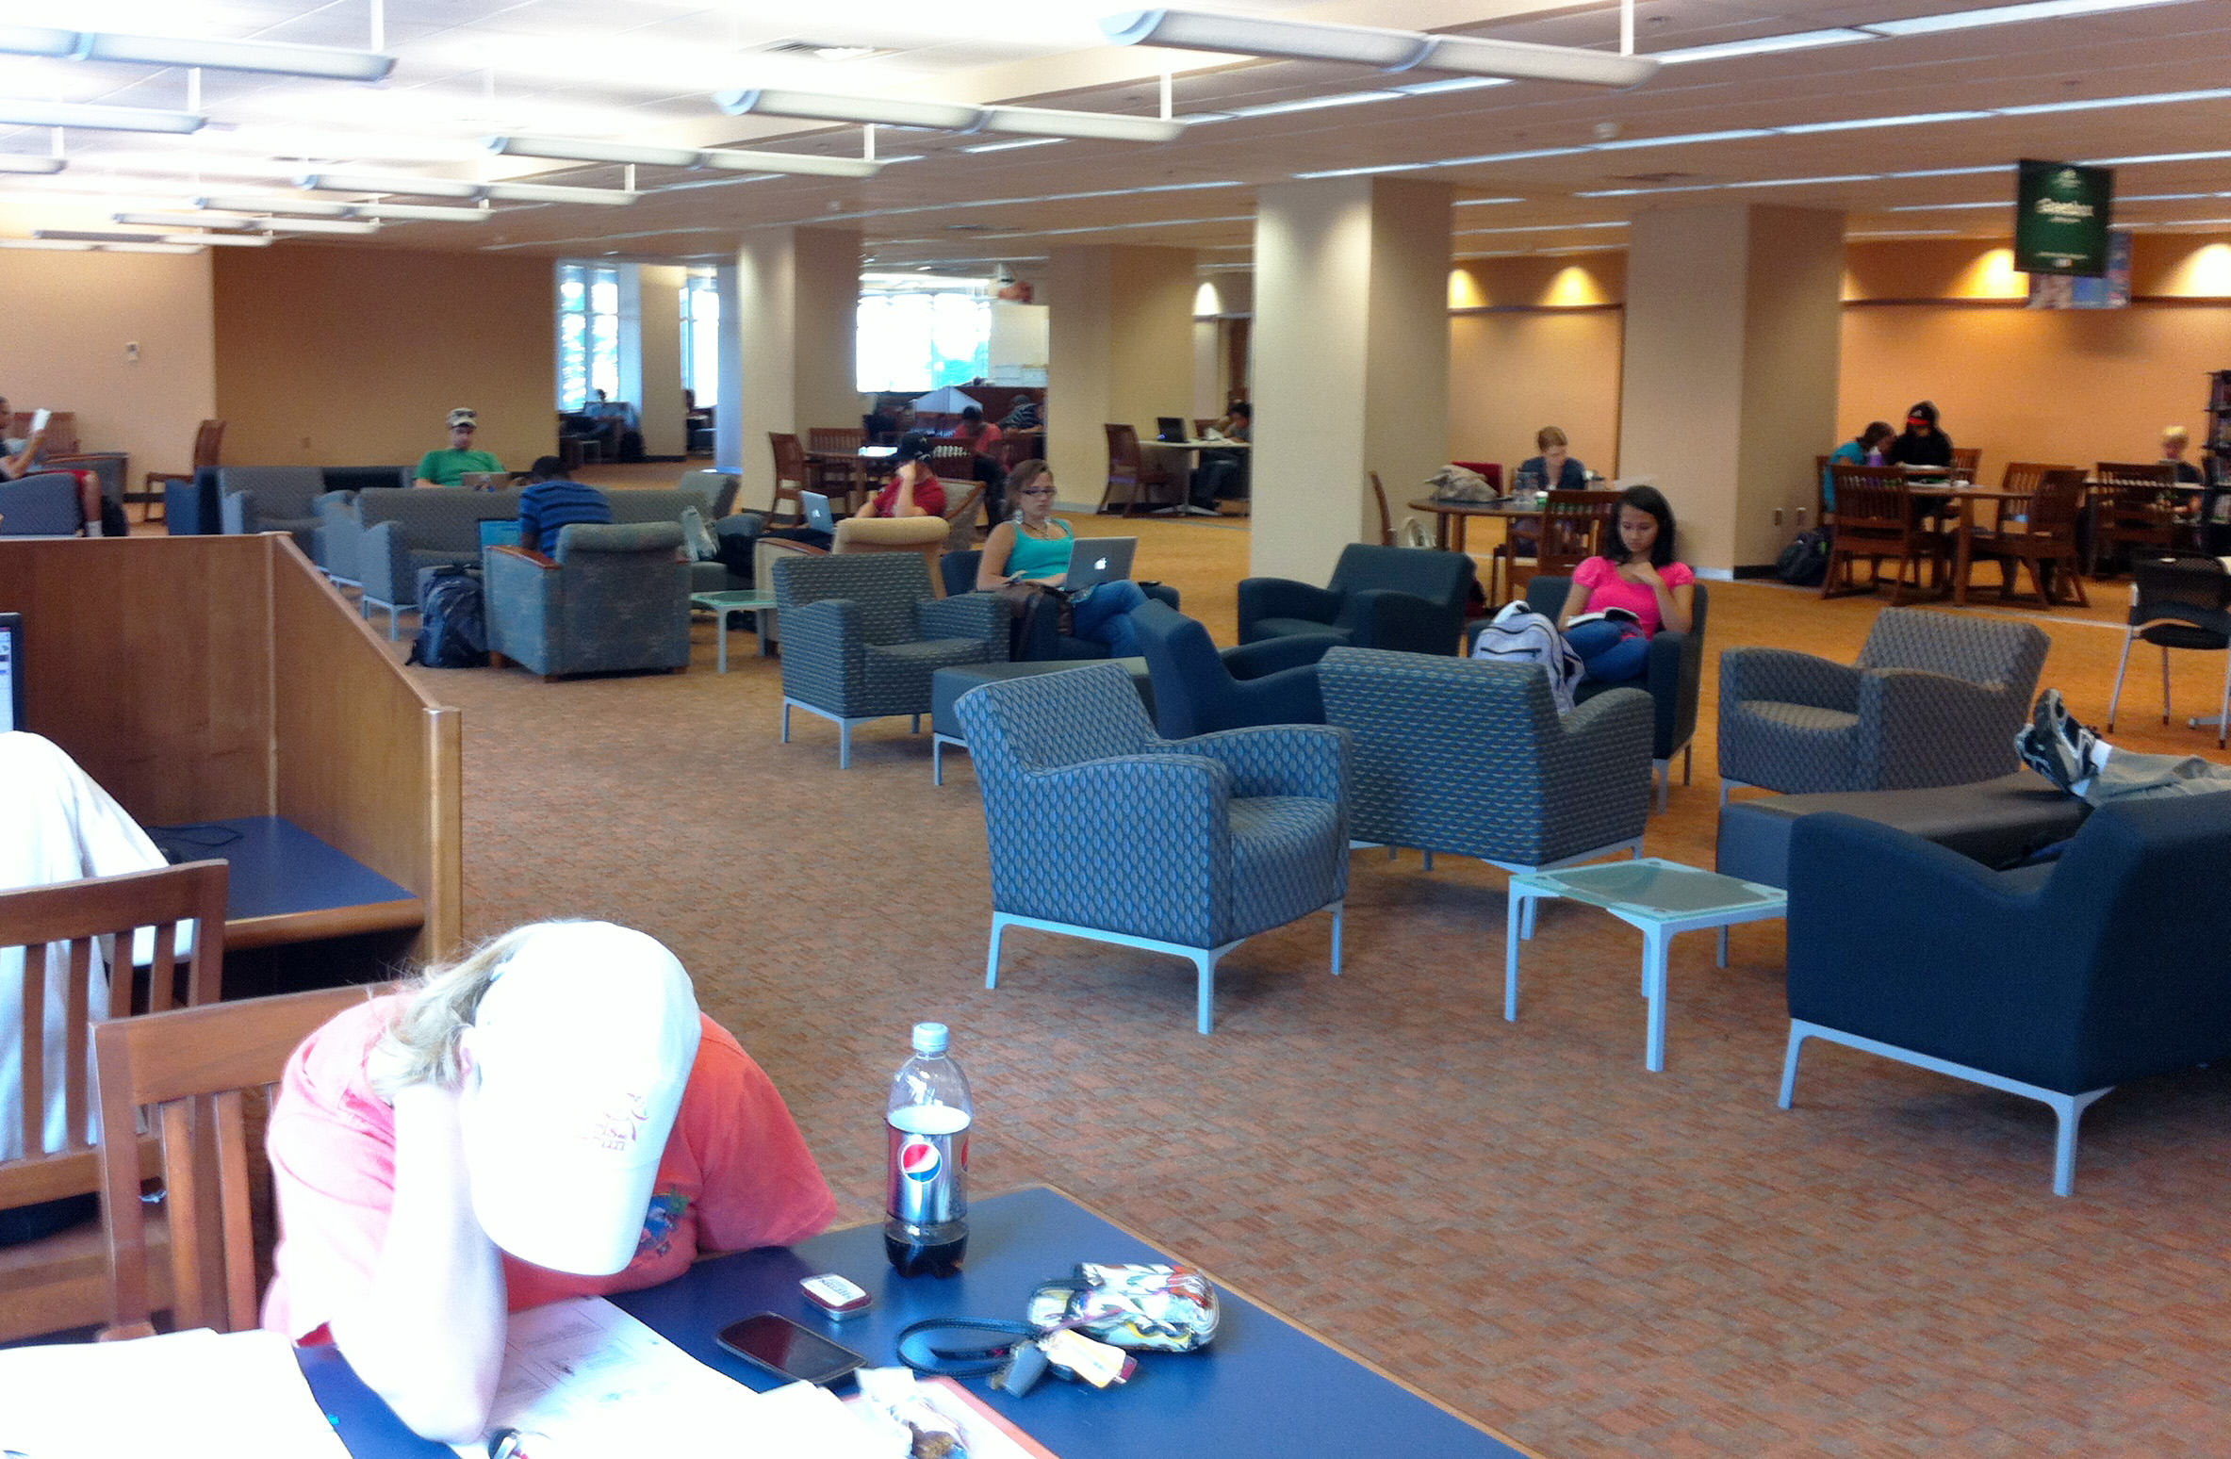
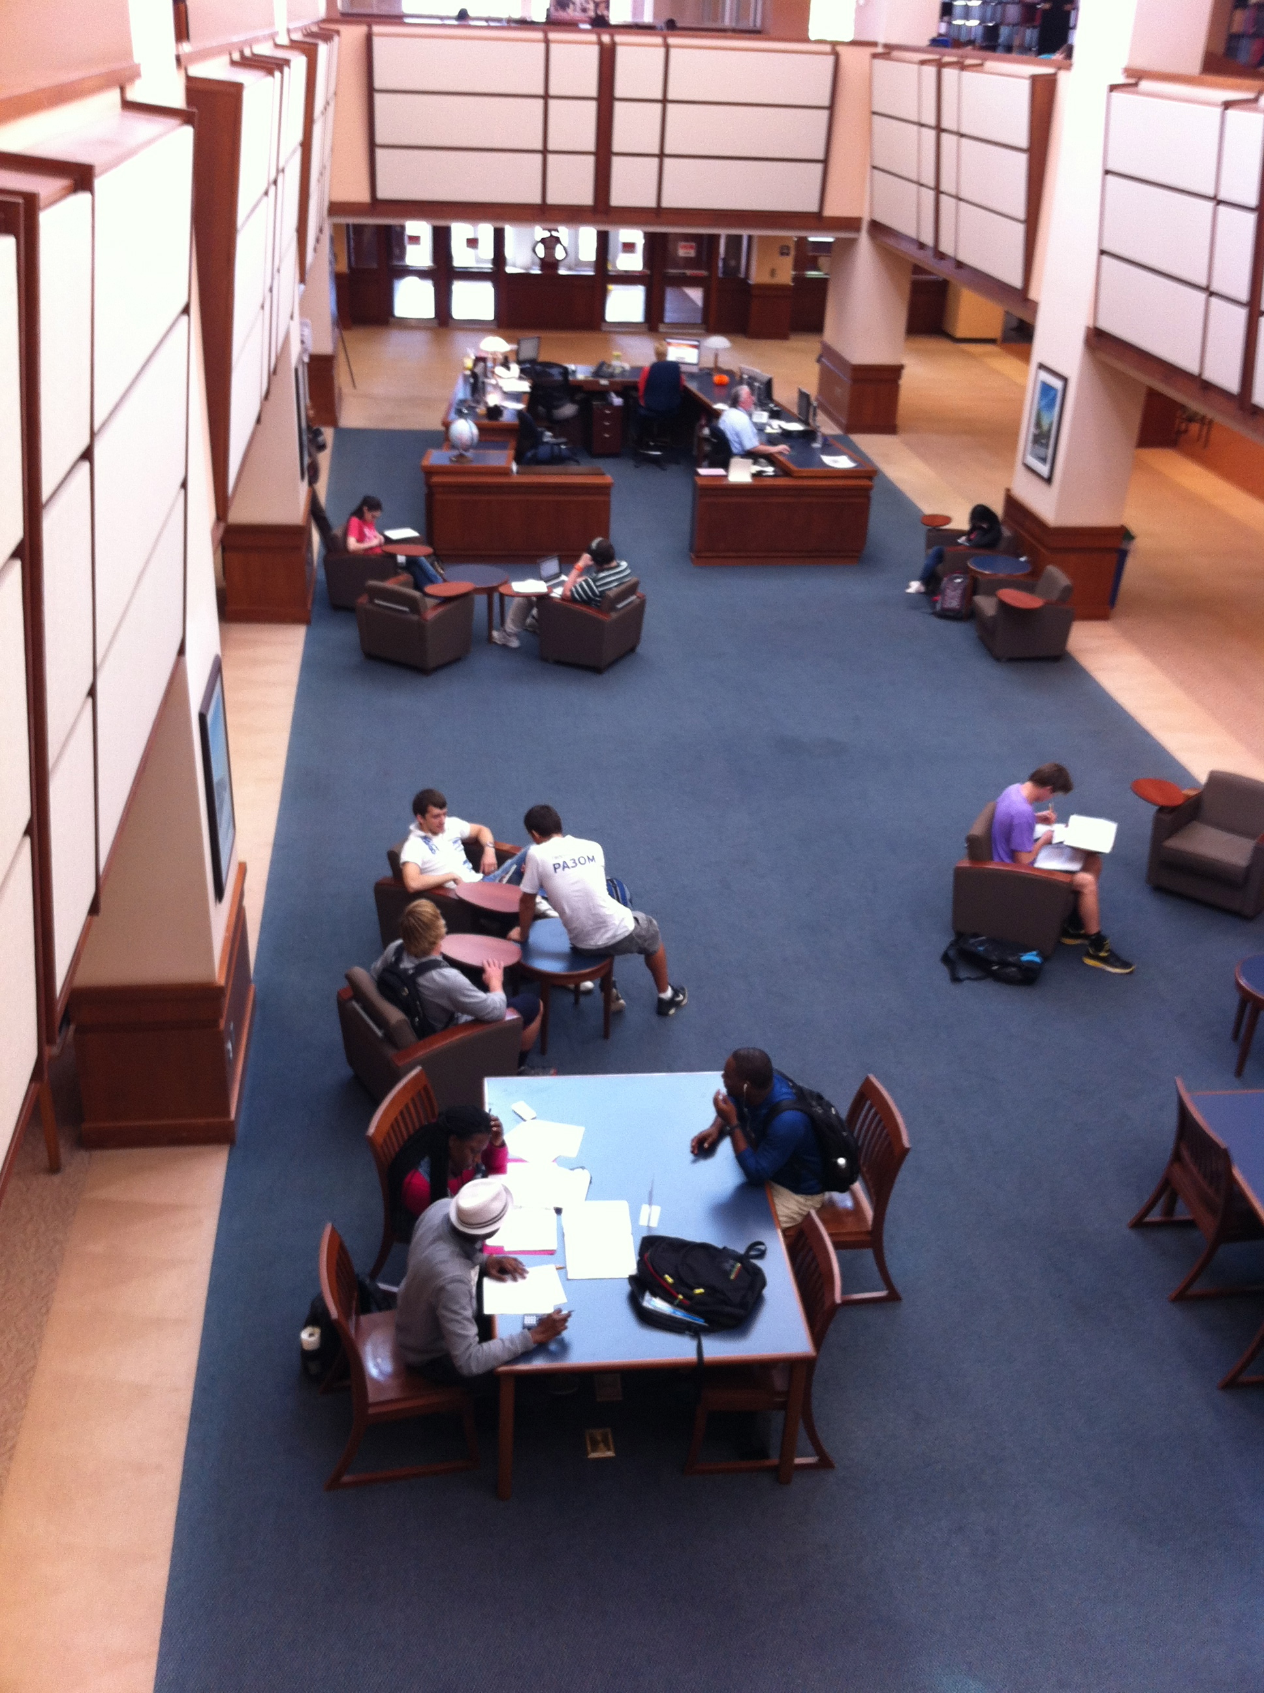
Redoing the Space
Before
Before
After
After
Notes:
It was relatively simple to rearrange some areas of the library to provide a more collaborative environment. Since the majority of the reference resources needed by students and faculty are now available electronically, the print reference collection was dismantled and integrated into the general, circulating collection. Several service desks were combined into one super desk. Comfortable chairs, couches and tables were moved into the newly created spaces and were quickly filled by students.

Slide 9
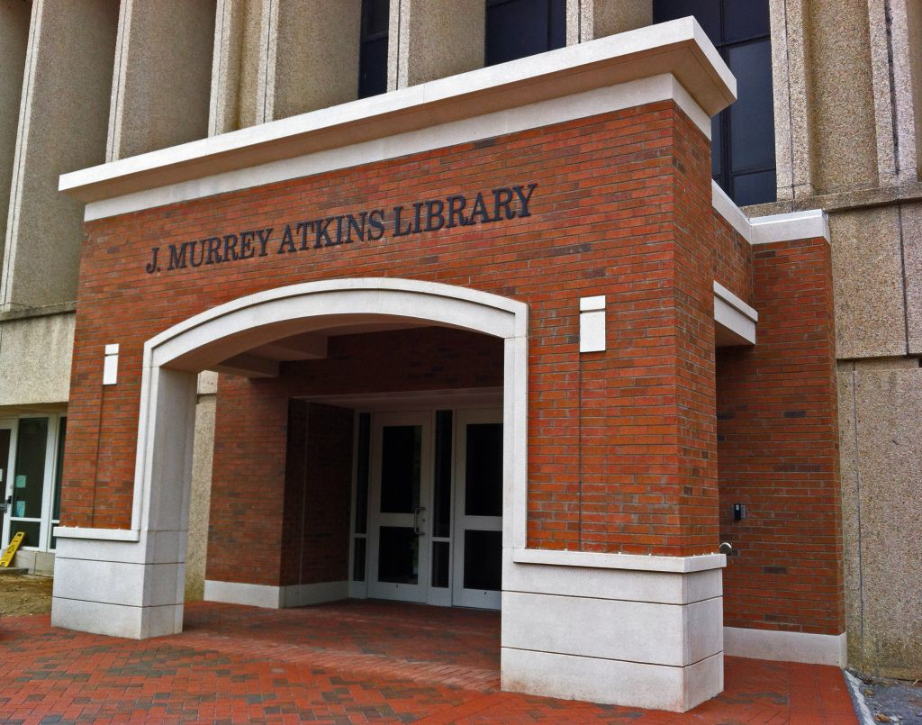
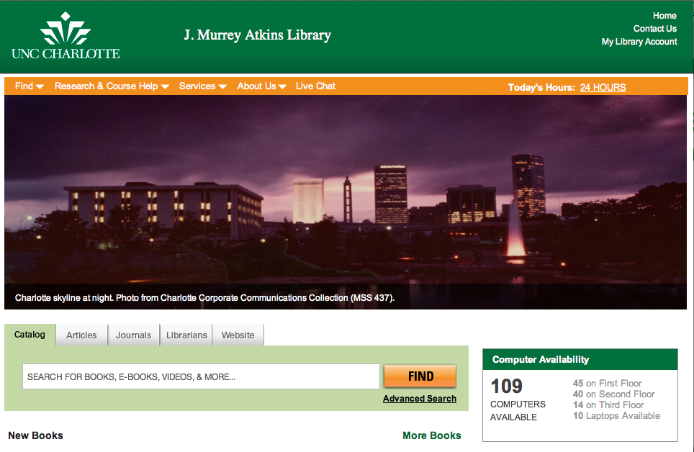
Not so Quick & Easy Responses
Notes:
Both physical and virtual access to the library services and resources were not as user friendly as we had assumed. The University of North Carolina at Charlotte is a rapidly growing urban campus. When the library was built it was in the heart of campus. However, the campus has grown in all directions around the building. The one main entrance was not conveniently located for the majority of students. Students and faculty repeatedly complained about having to go out of their way to get to the library. Our director was able to take the data from the studies and convince the University Administration that we needed to add another entrance to the building.
At the same time we took data from extensive web interface usability studies to upgrade and redesign our web page access.

Slide 10
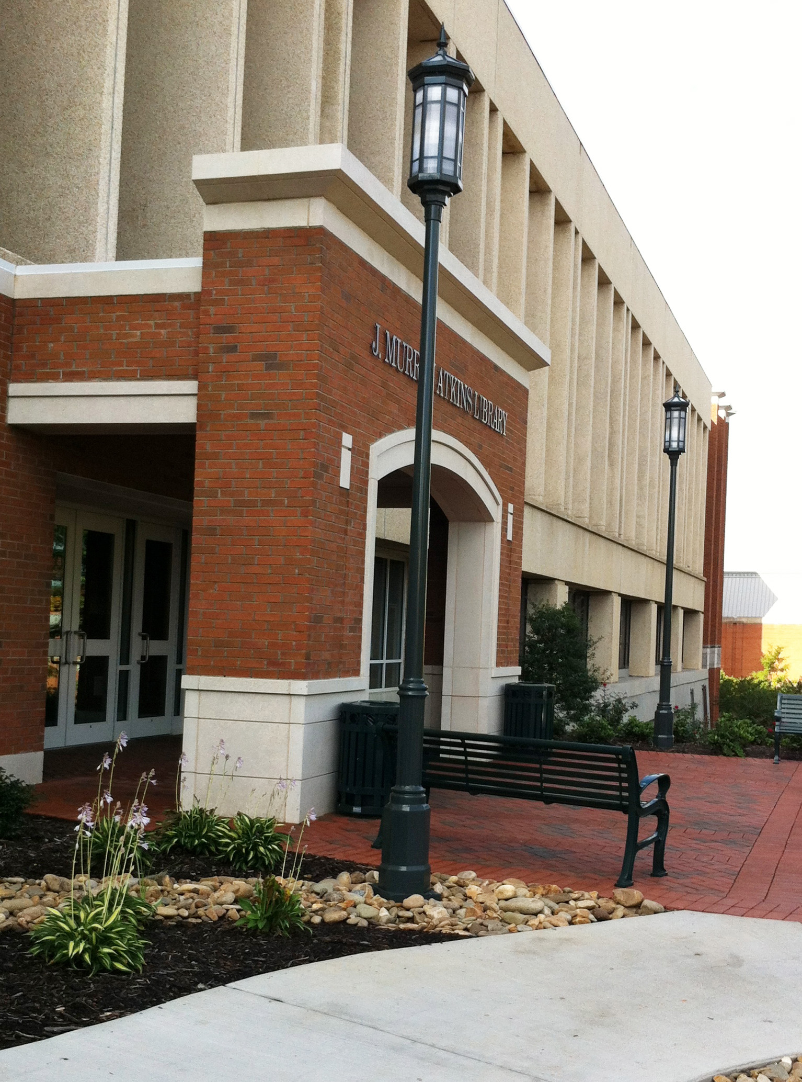
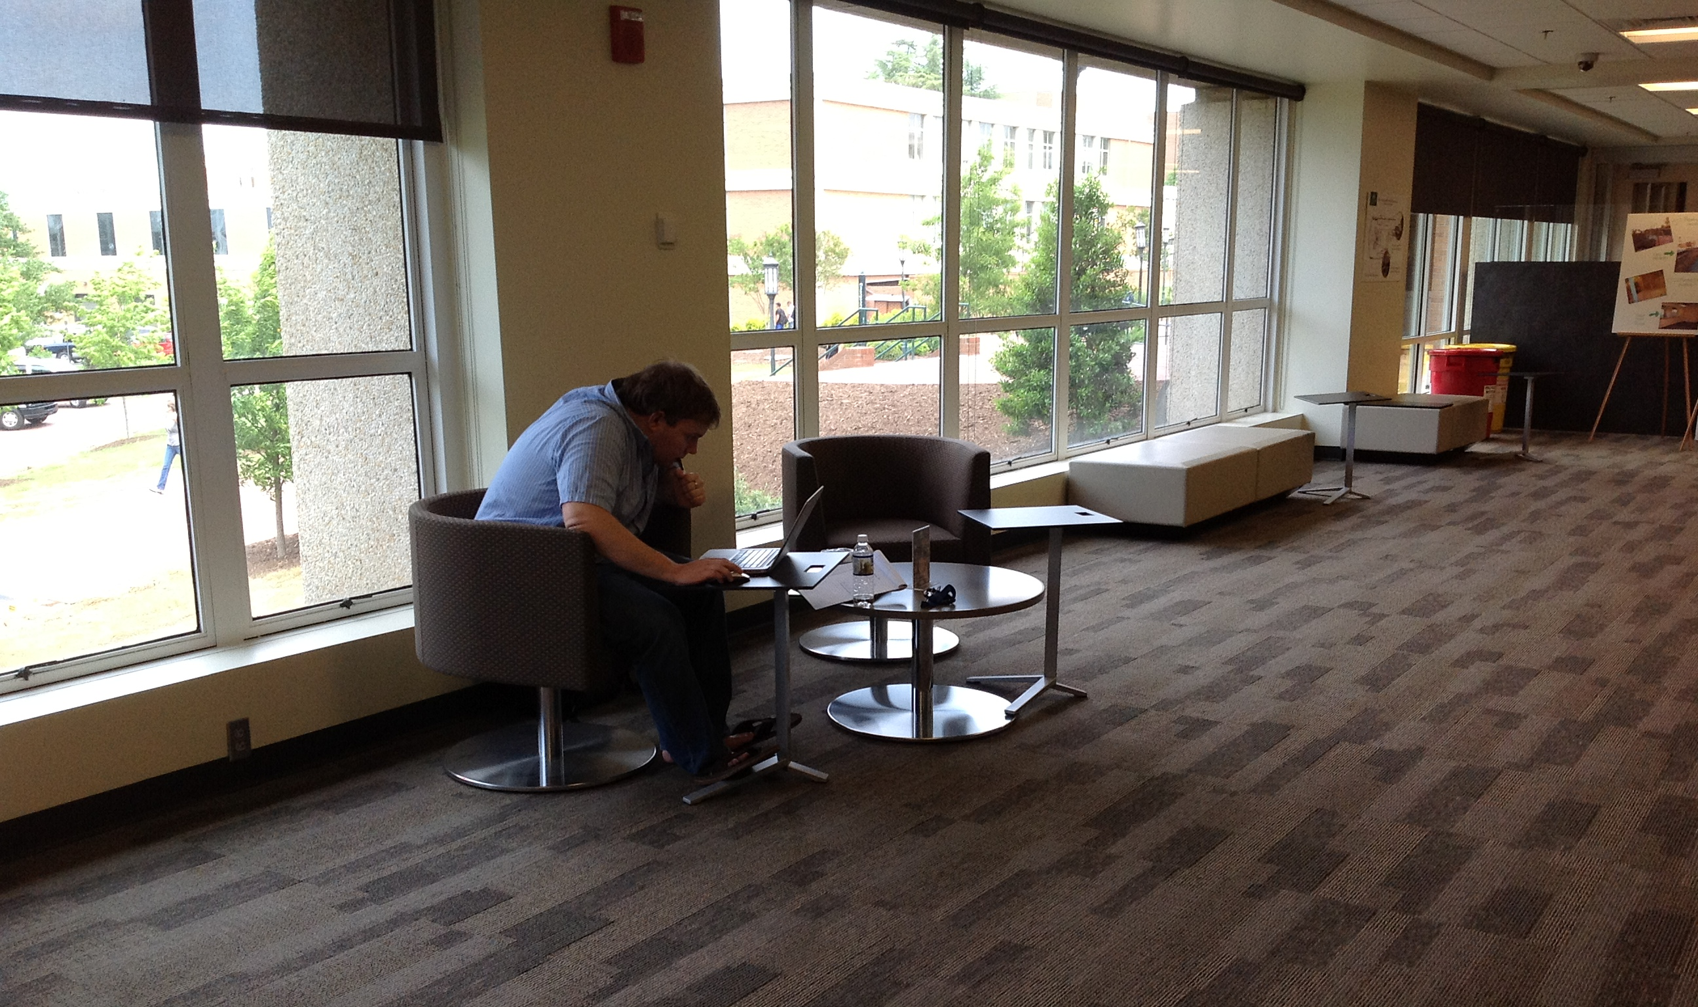
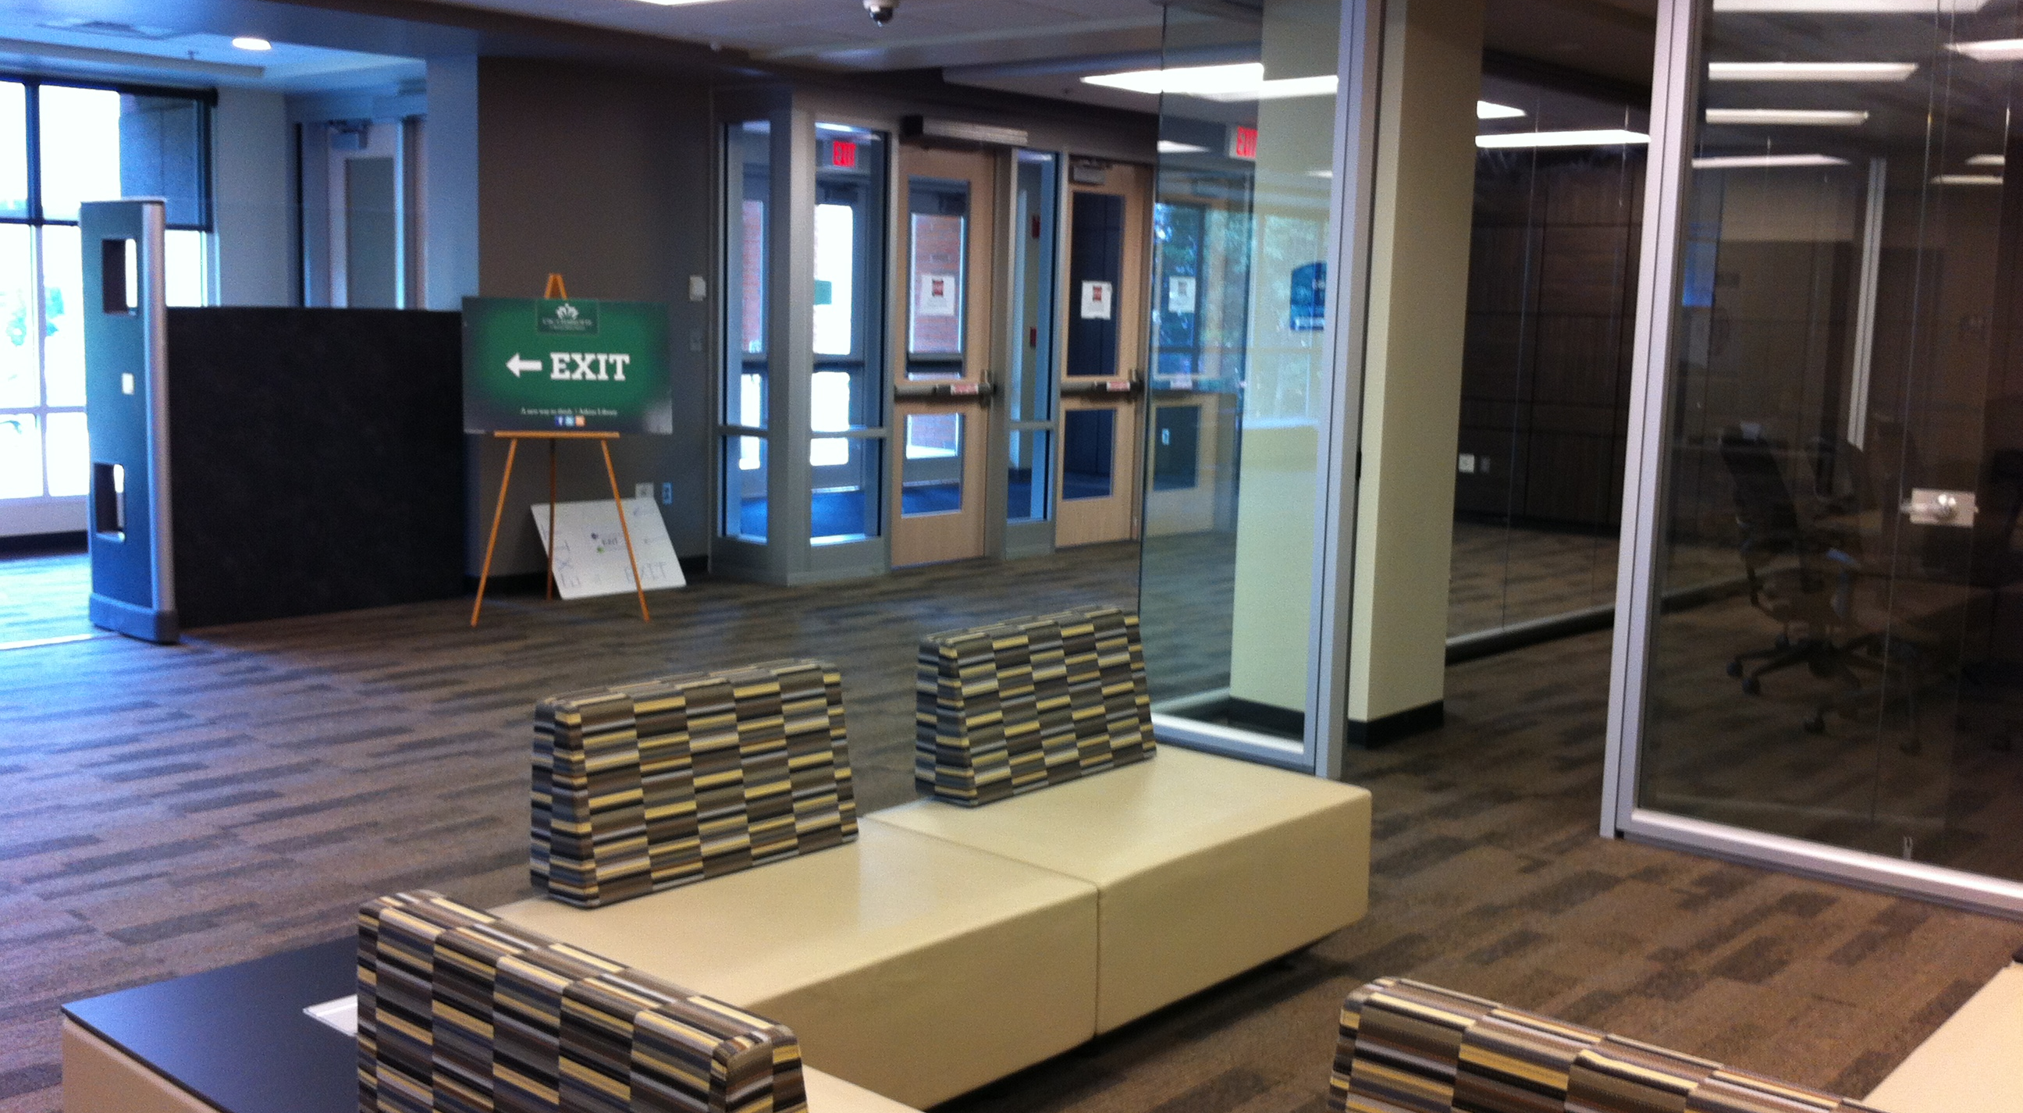
New Access
Notes:
This is what our new, north entrance looks like.

Slide 11
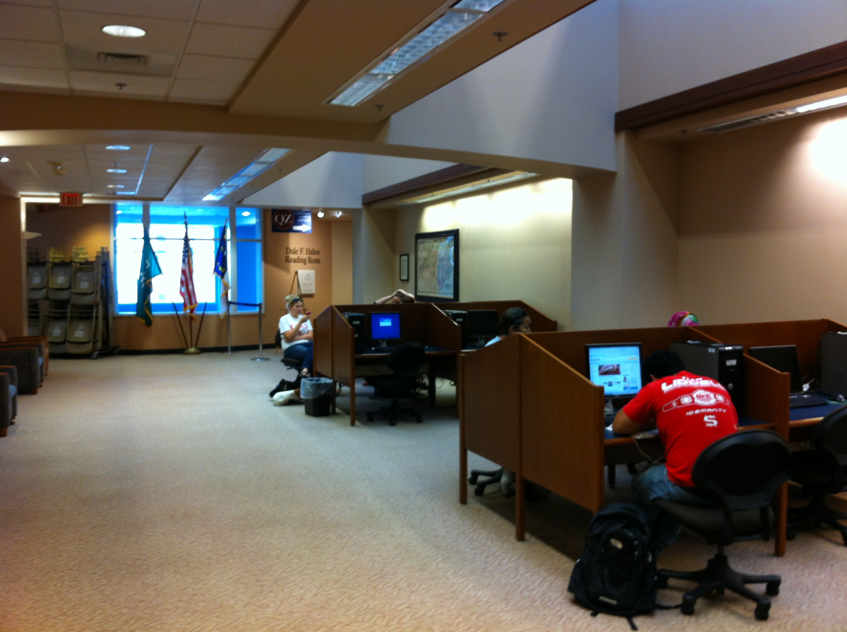
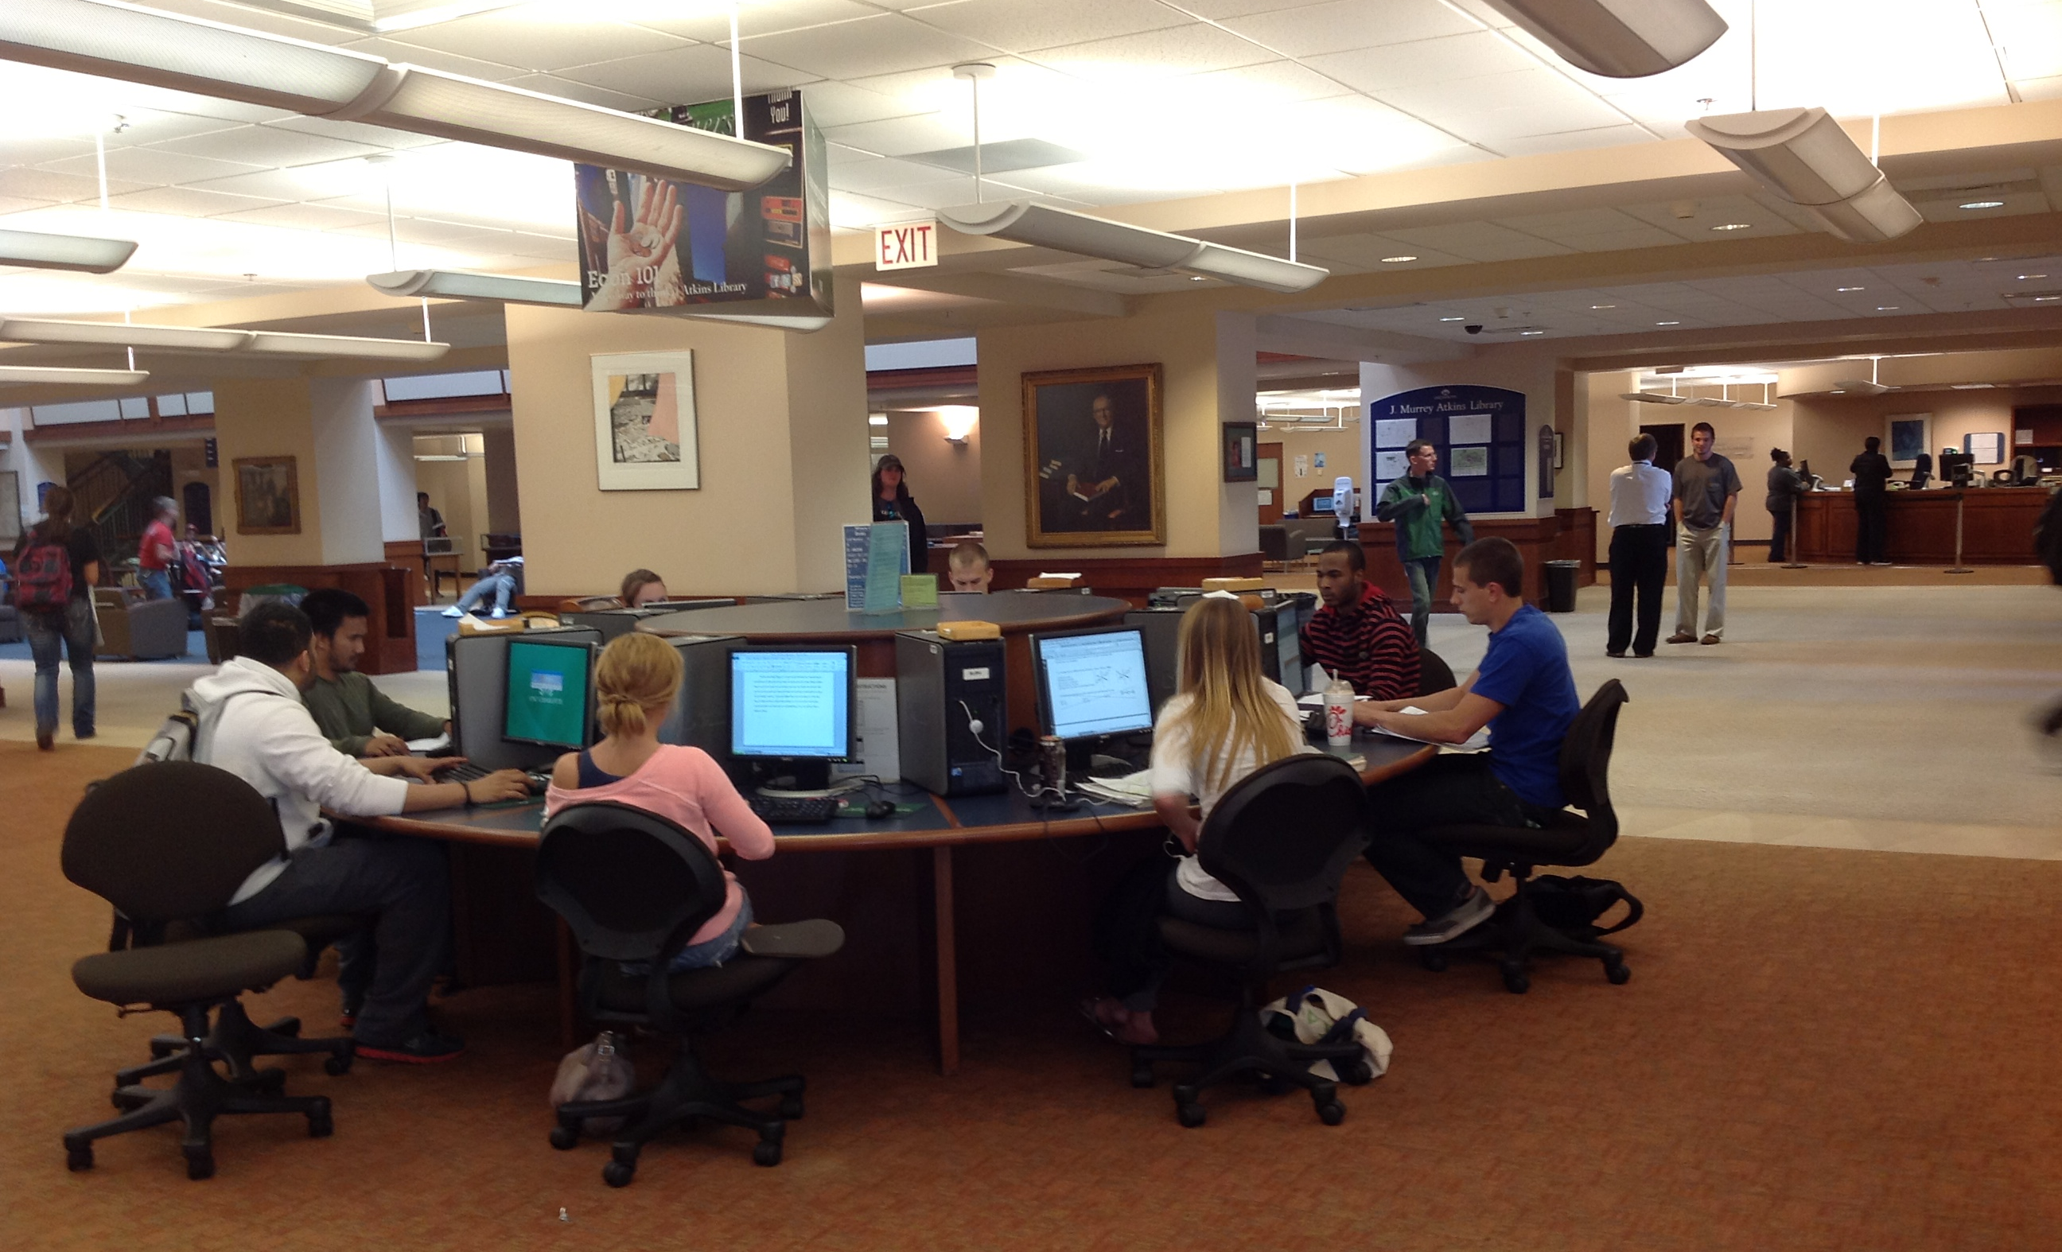
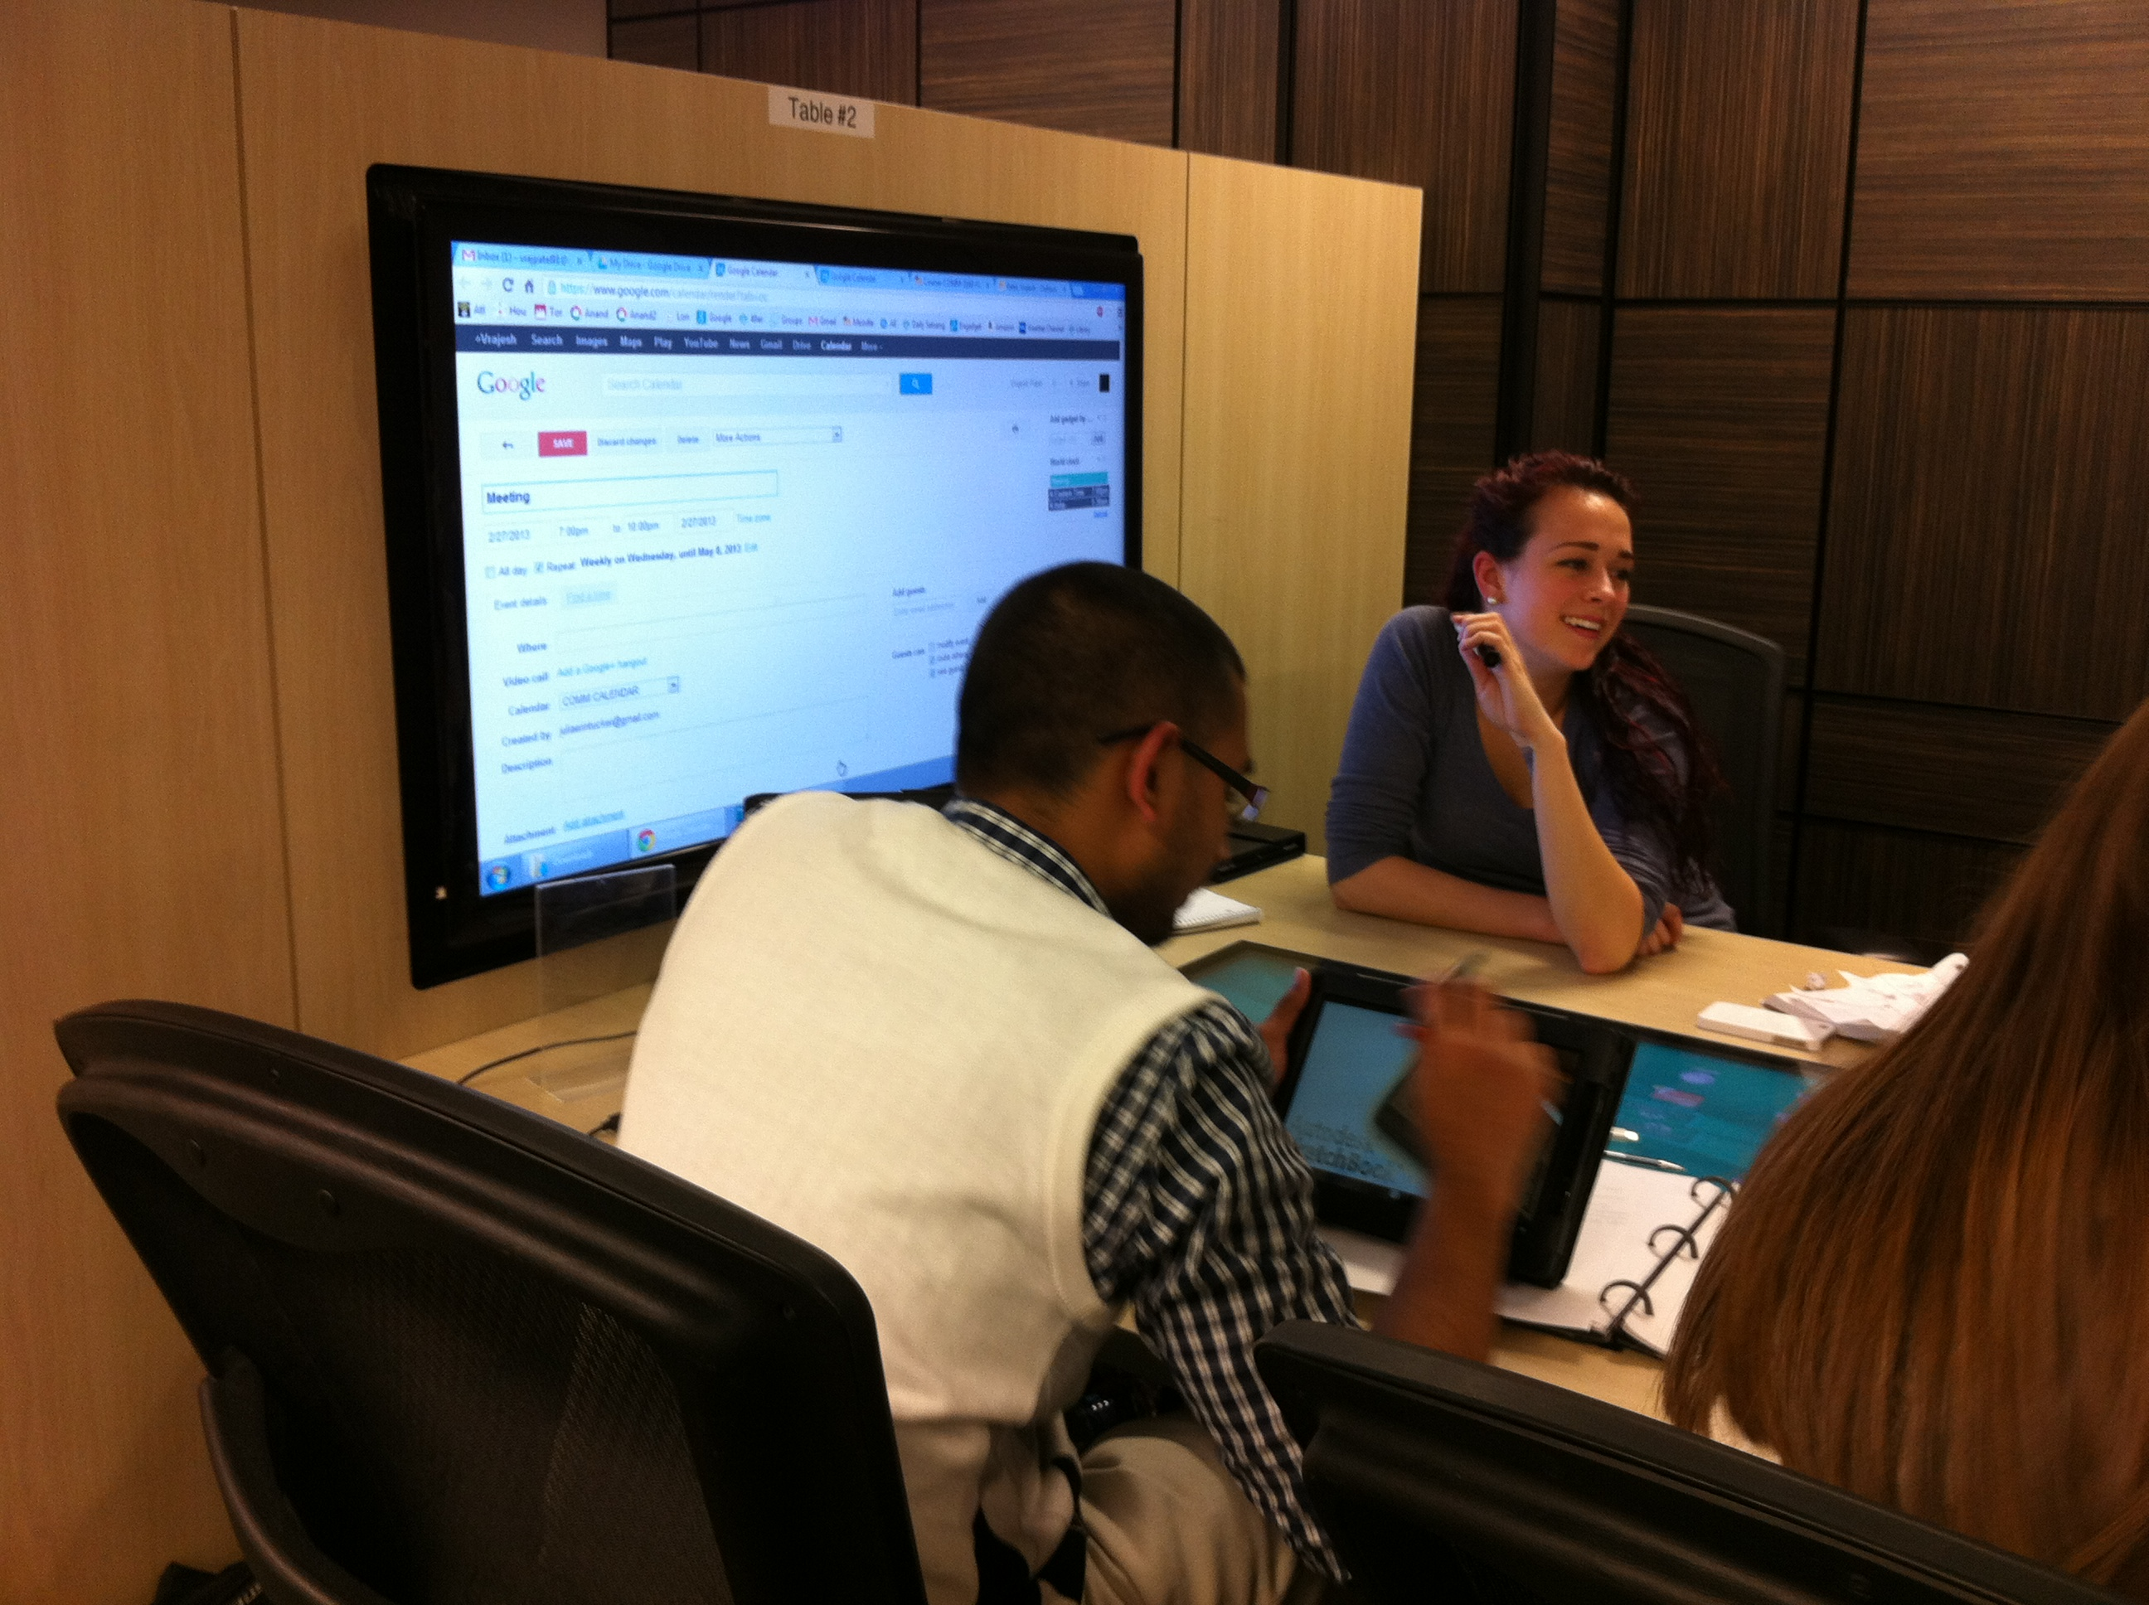
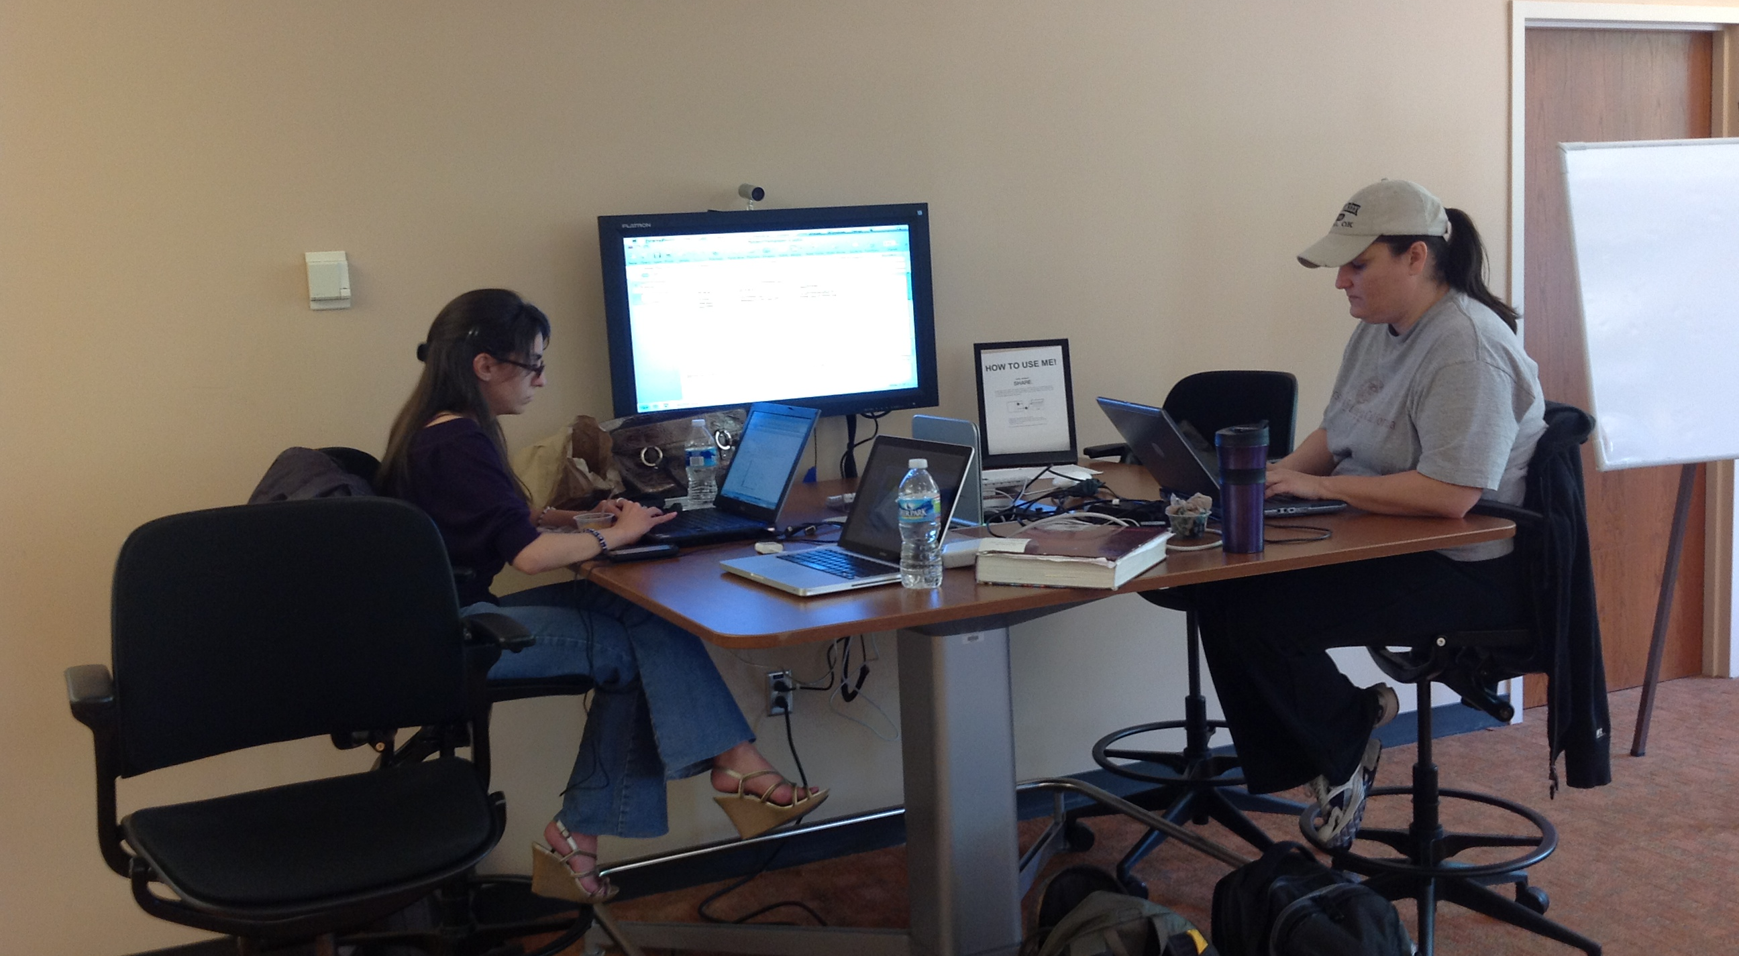
Reconfiguring Computer Space
Better
Bad
Best
Notes:
The feedback from our studies was also used to argue for the renovation of our ground floor. But while we waited for the monies to become available we worked on reconfiguring computer spaces. Originally most of our 300 computers were located in individual study carrels with very little workspace around the computers. The use of circular pods was a little better and provided for some collaborative work area. The best solution though was a combination of flat screens powered by an Apple mini computers which students could plug into and share documents.

Slide 12
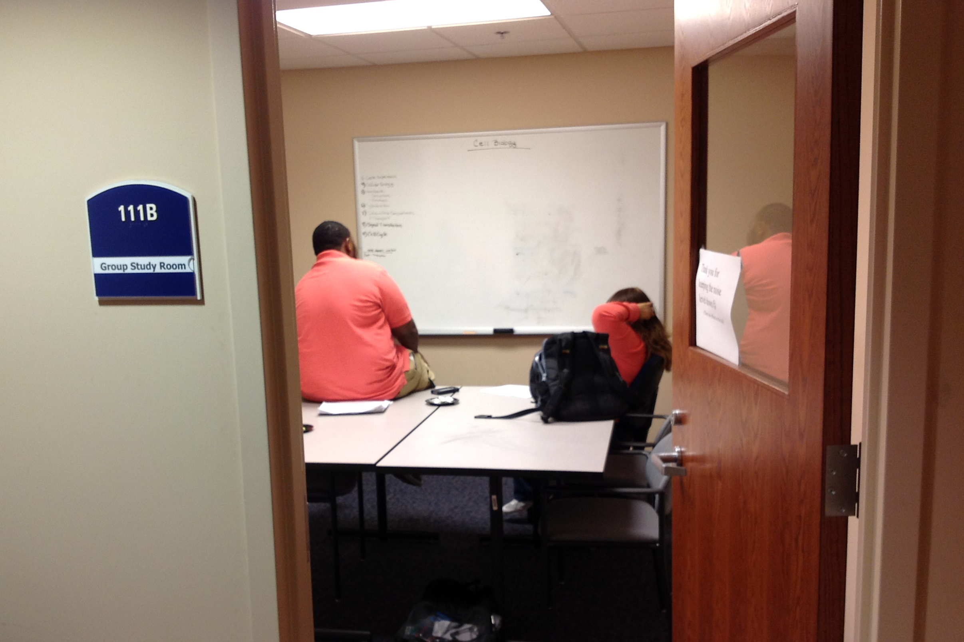
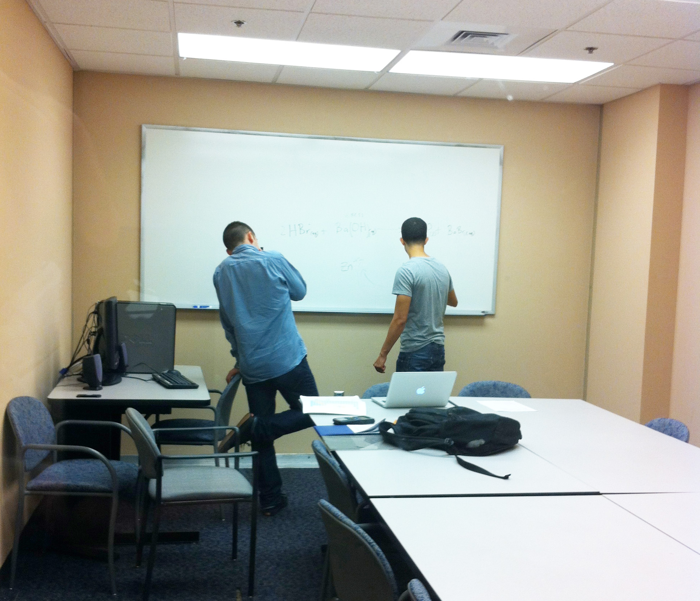
Collaborative Rooms
a.k.a. Study Rooms
Traditional
Notes:
The number of study rooms has steadily increased and now number 30. About half of these would be considered ‘traditional’ or low tech rooms and will seat from 4 to 24 students.

Slide 13
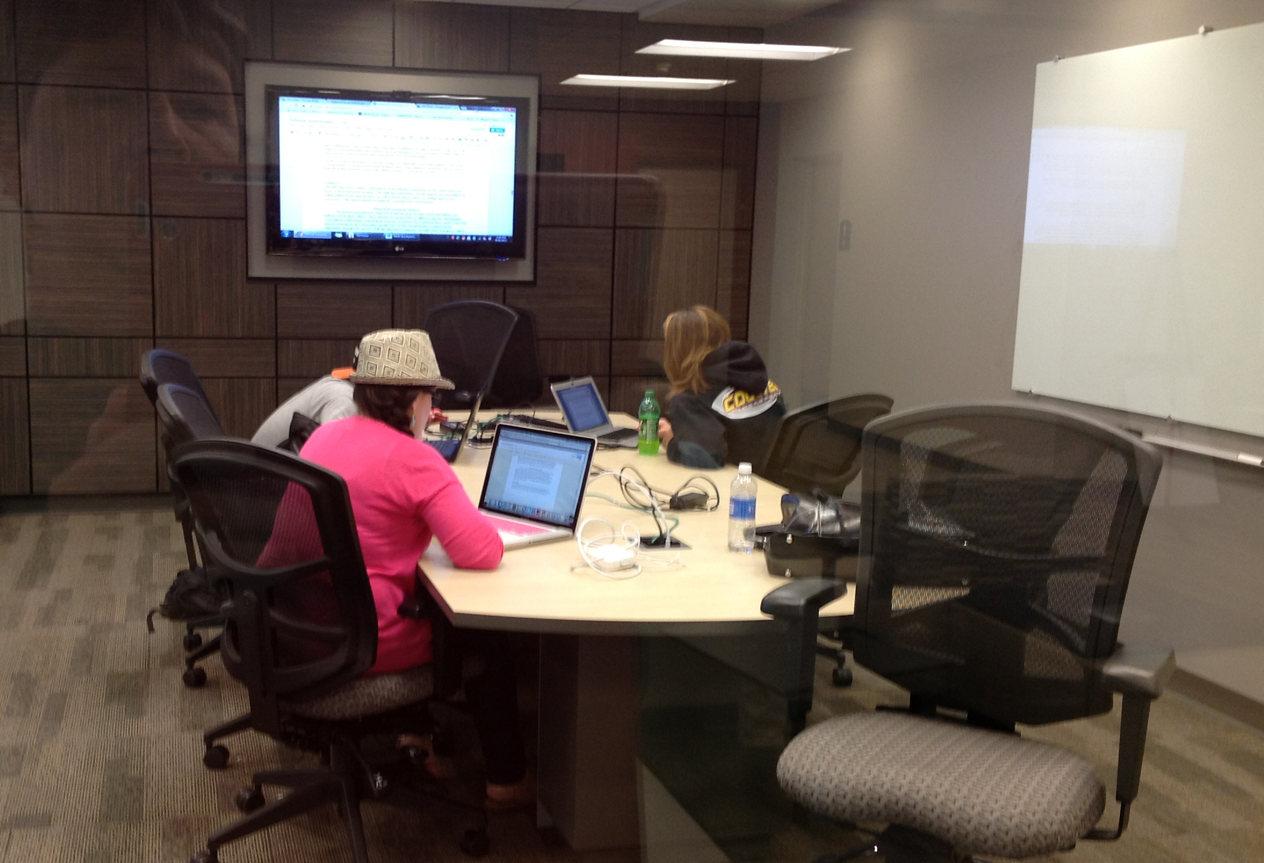
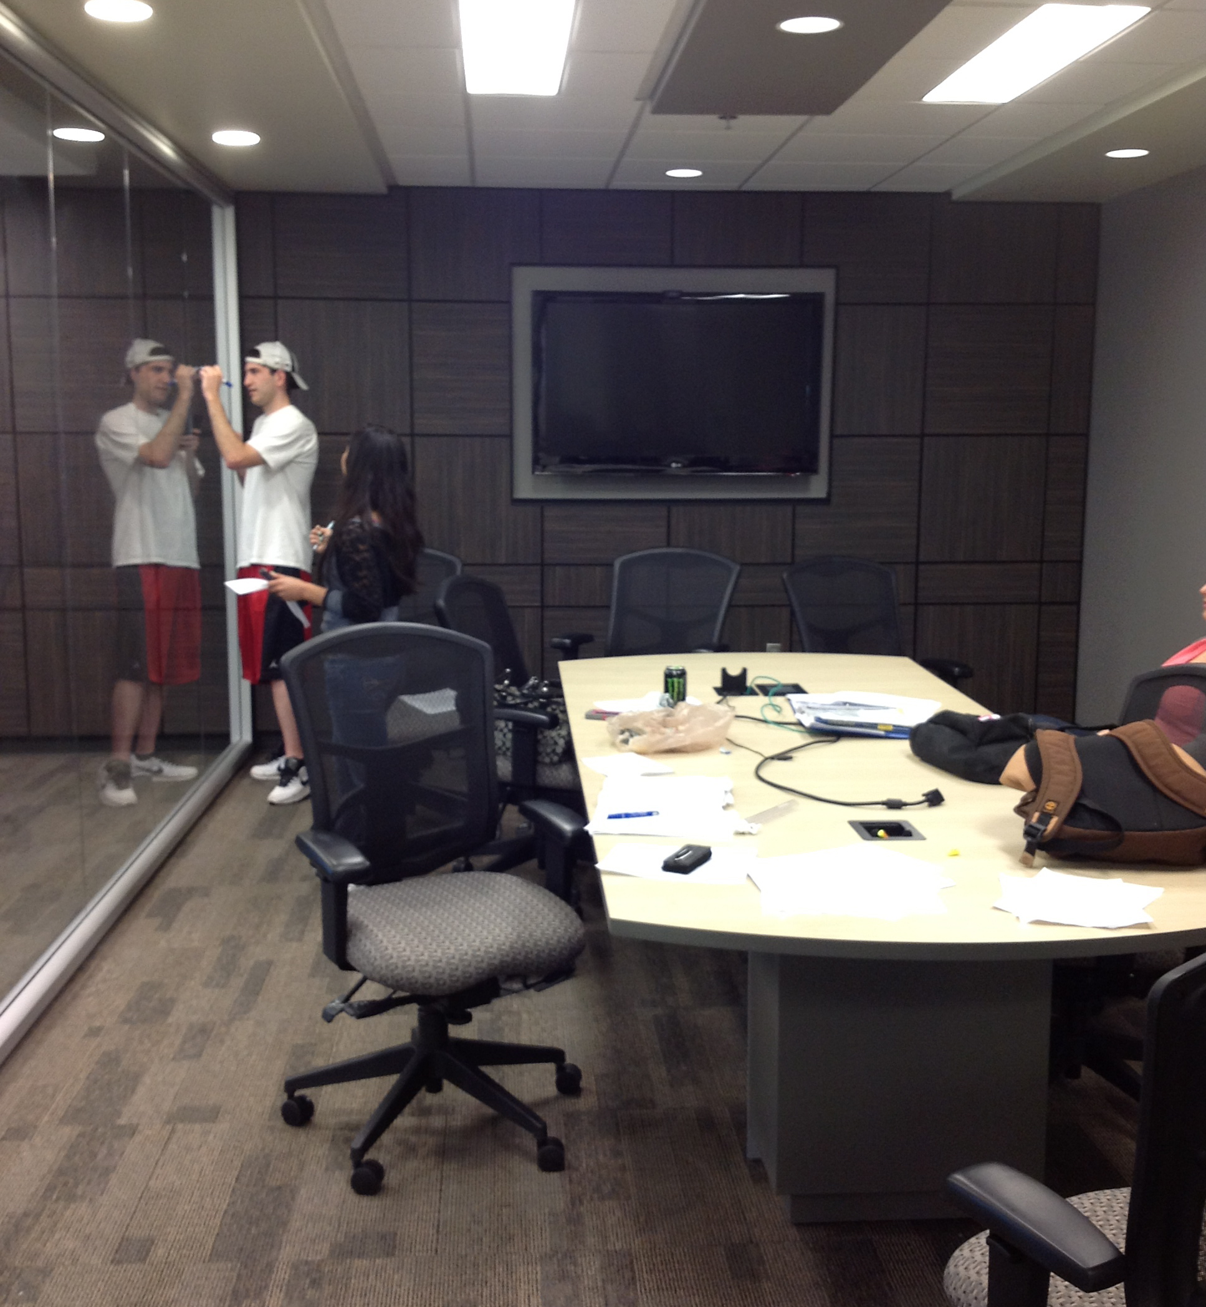
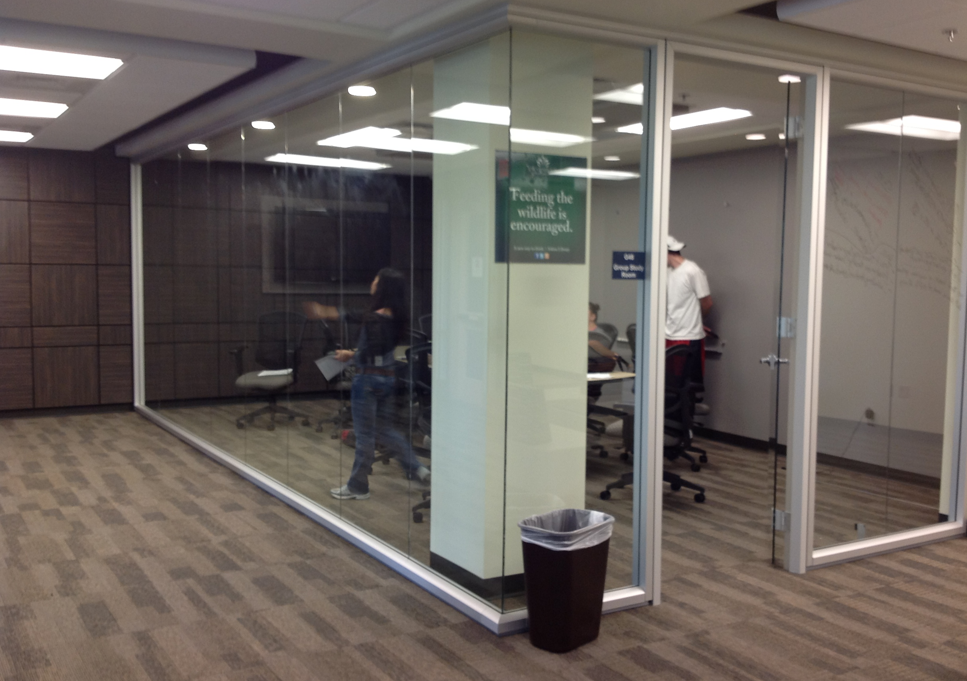
Collaborative Rooms
High Tech
Notes:
The study rooms in the newly renovated areas are very high tech. The flat screens are connected to Apple mini computers and students can plug in their laptops and/or mobile devices. All the new rooms have at least one glass wall, which helps with security issues. Students can write either on the whiteboard or the glass.

Slide 14
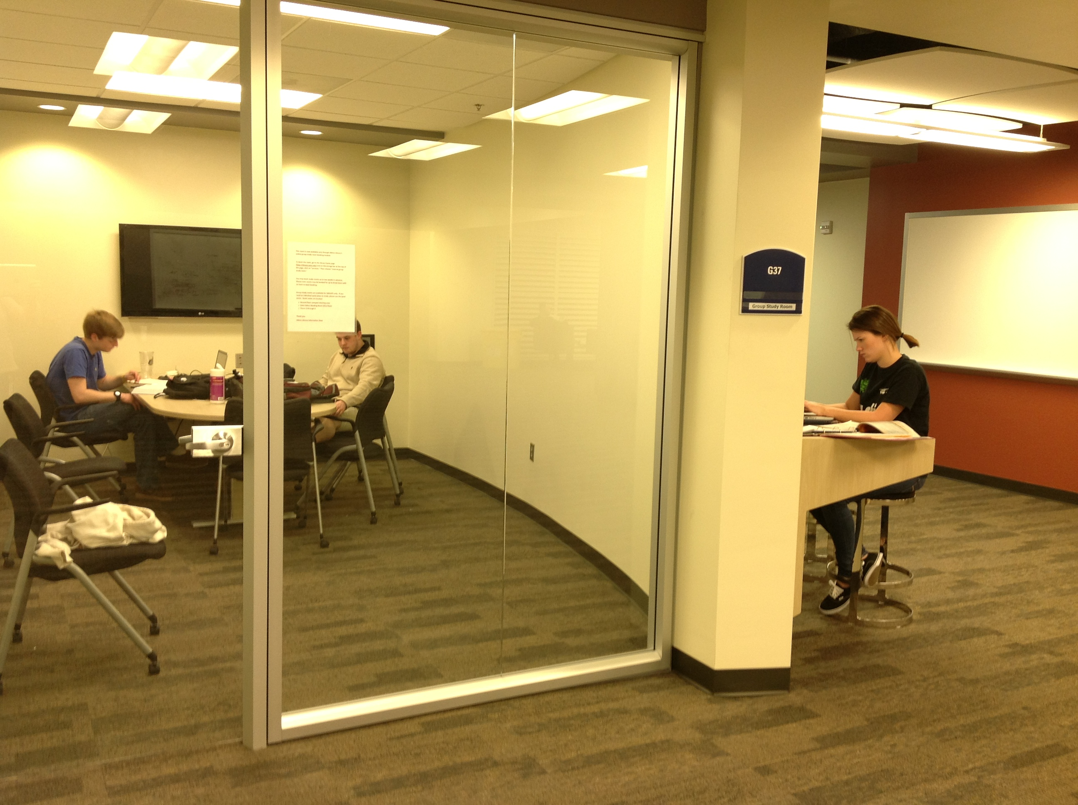
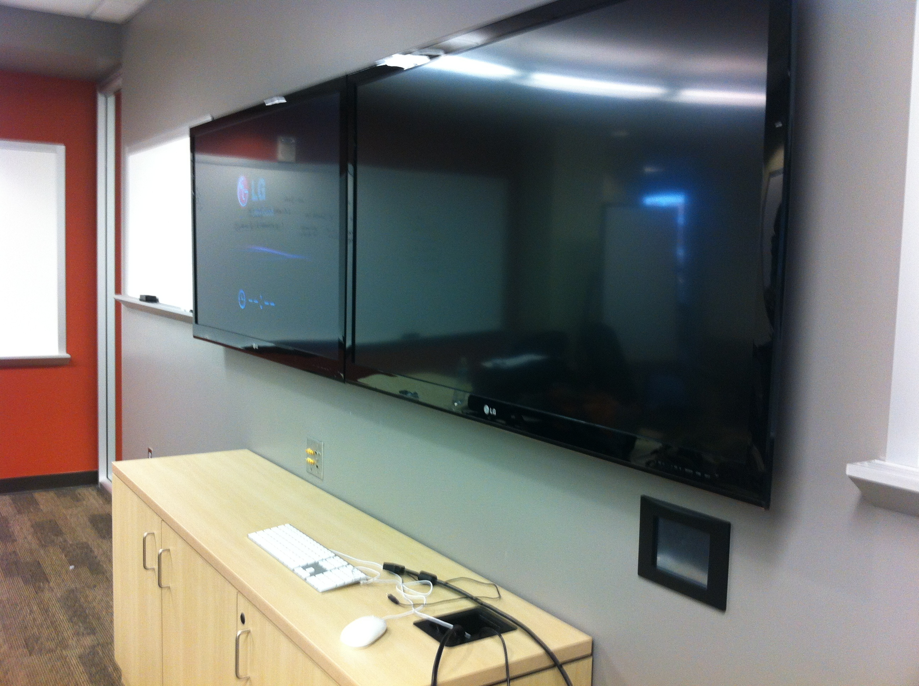
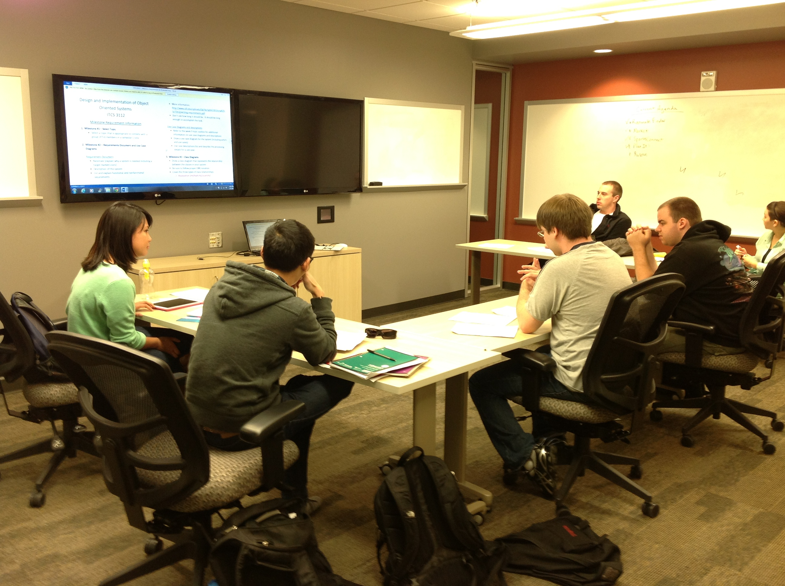
Collaborative Rooms
High Tech
Notes:
Several rooms have the capability of displaying content from a laptop/mobile on one screen and a video or other media from the web on a second screen. These rooms can also act as small seminar rooms. As you can imagine these rooms are in high demand. They must be reserved in advance and students are given priority.

Slide 15
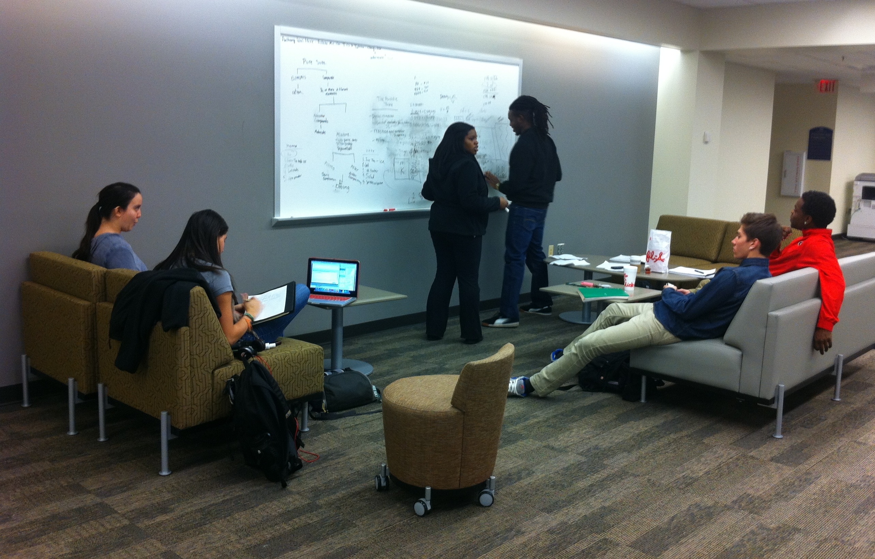
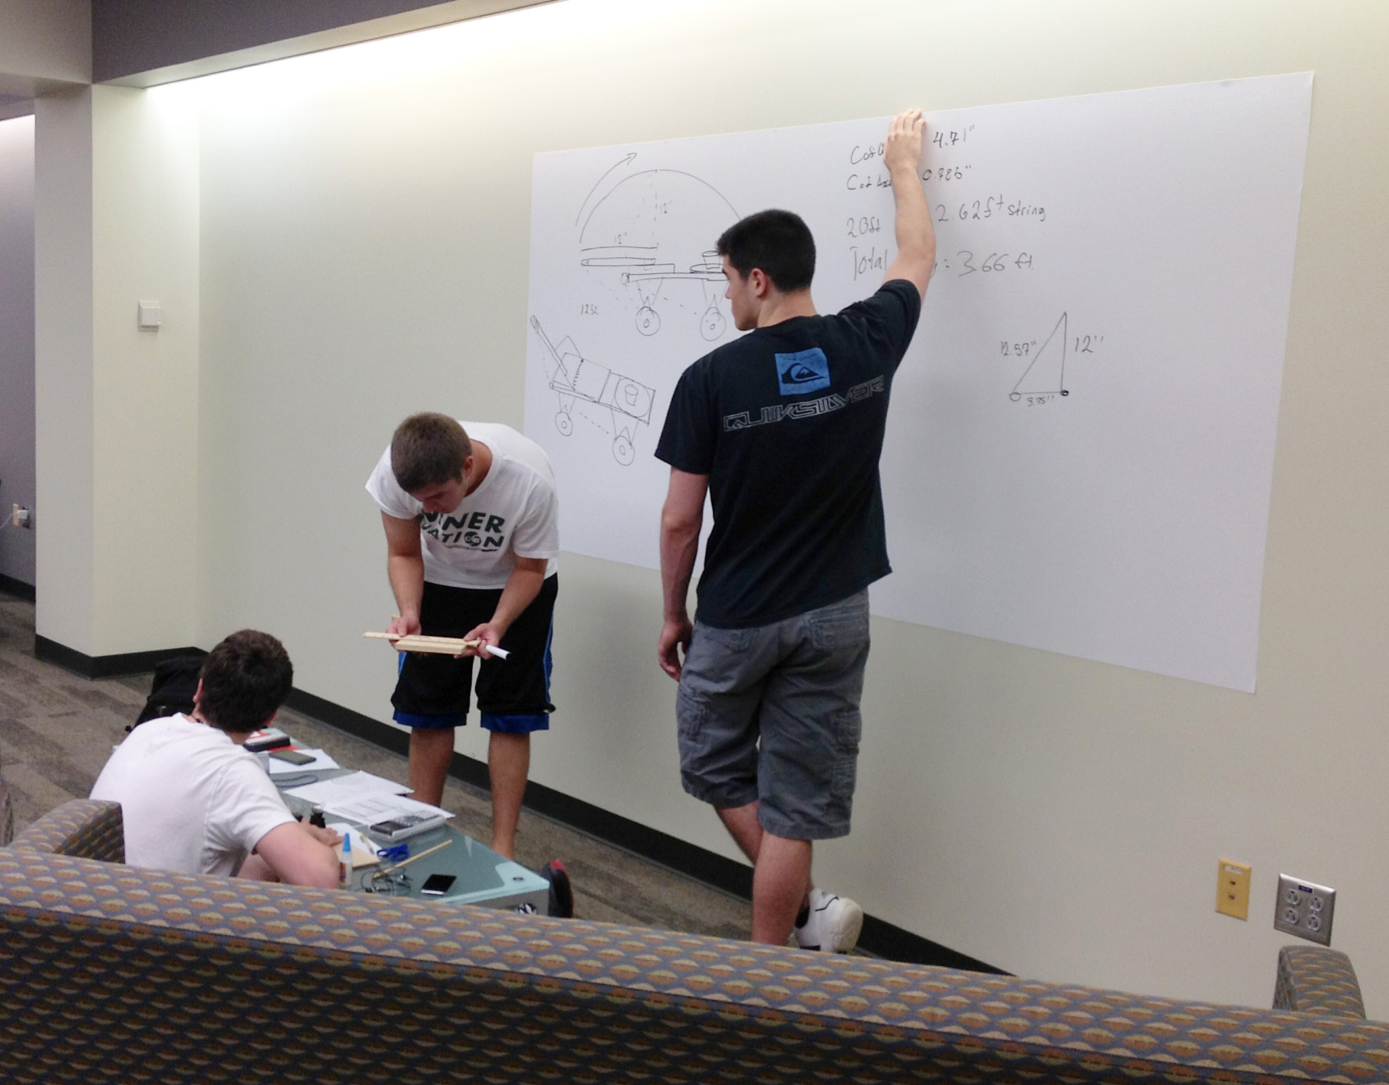
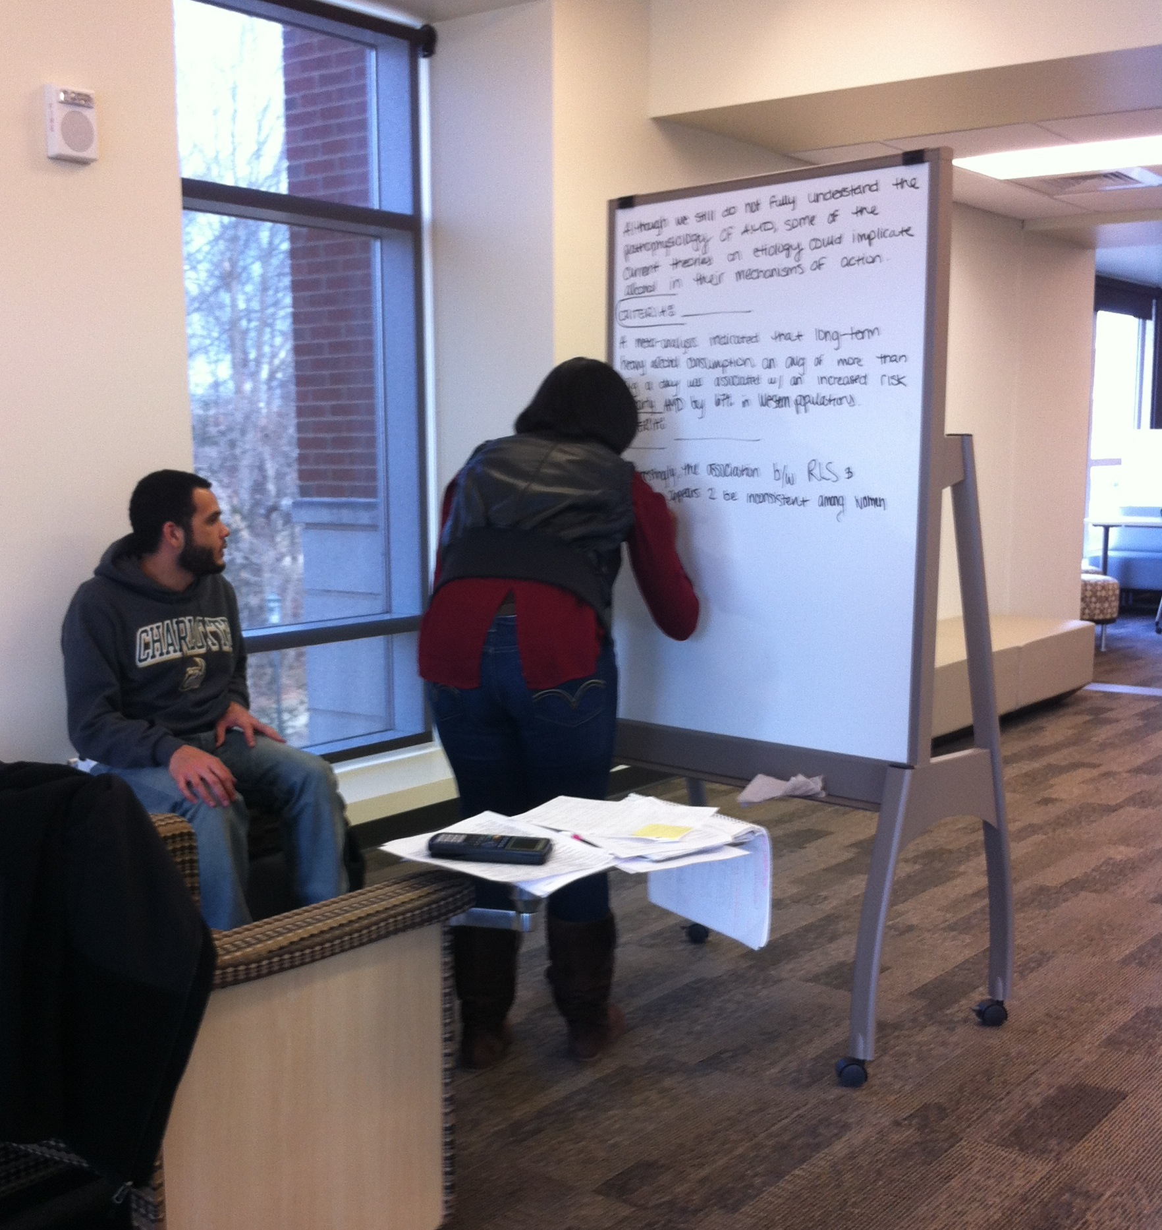
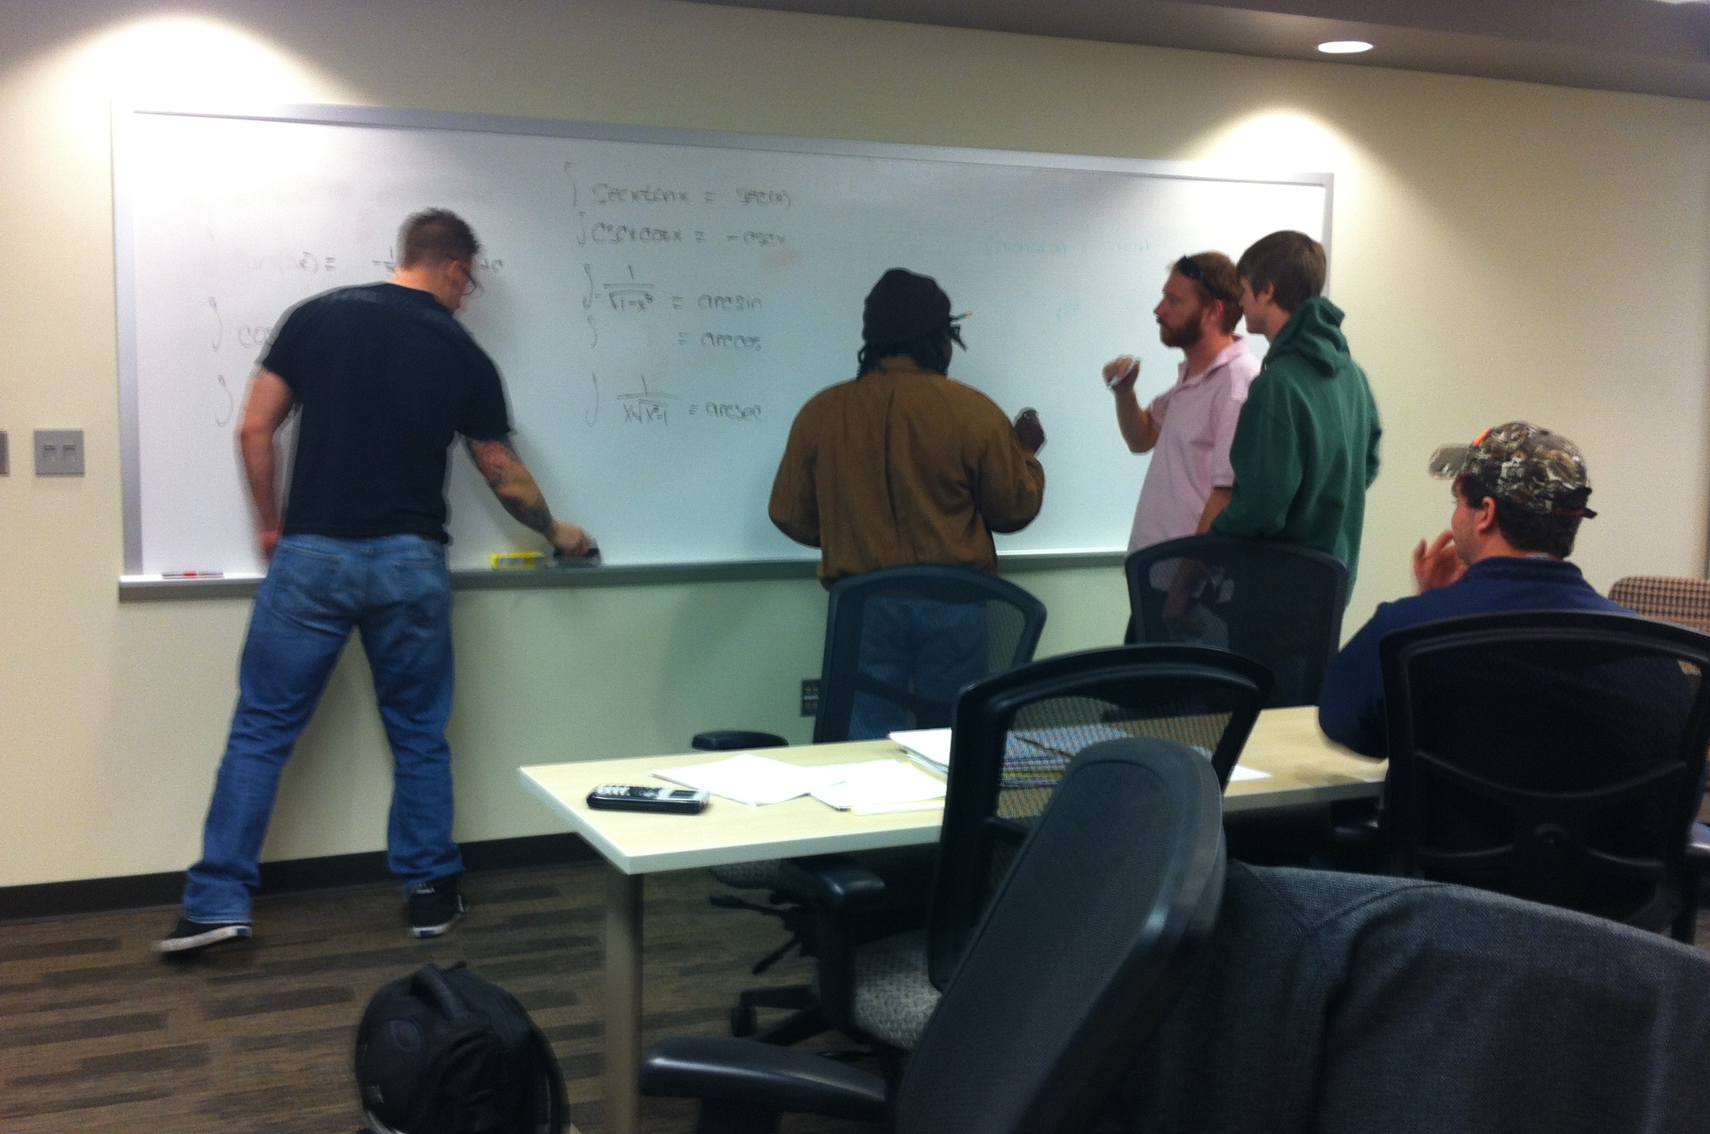
Collaborative
Walls
Notes:
One low tech solution for meeting the need for collaborative workspace has been the inclusion of whiteboards throughout the library. Some are mobile, while most are on walls with comfortable seating and tables adjacent to them. These boards are so popular that students couldn’t wait for the construction workers to put the frame around one. They just whipped out their markers and started writing!

Slide 16
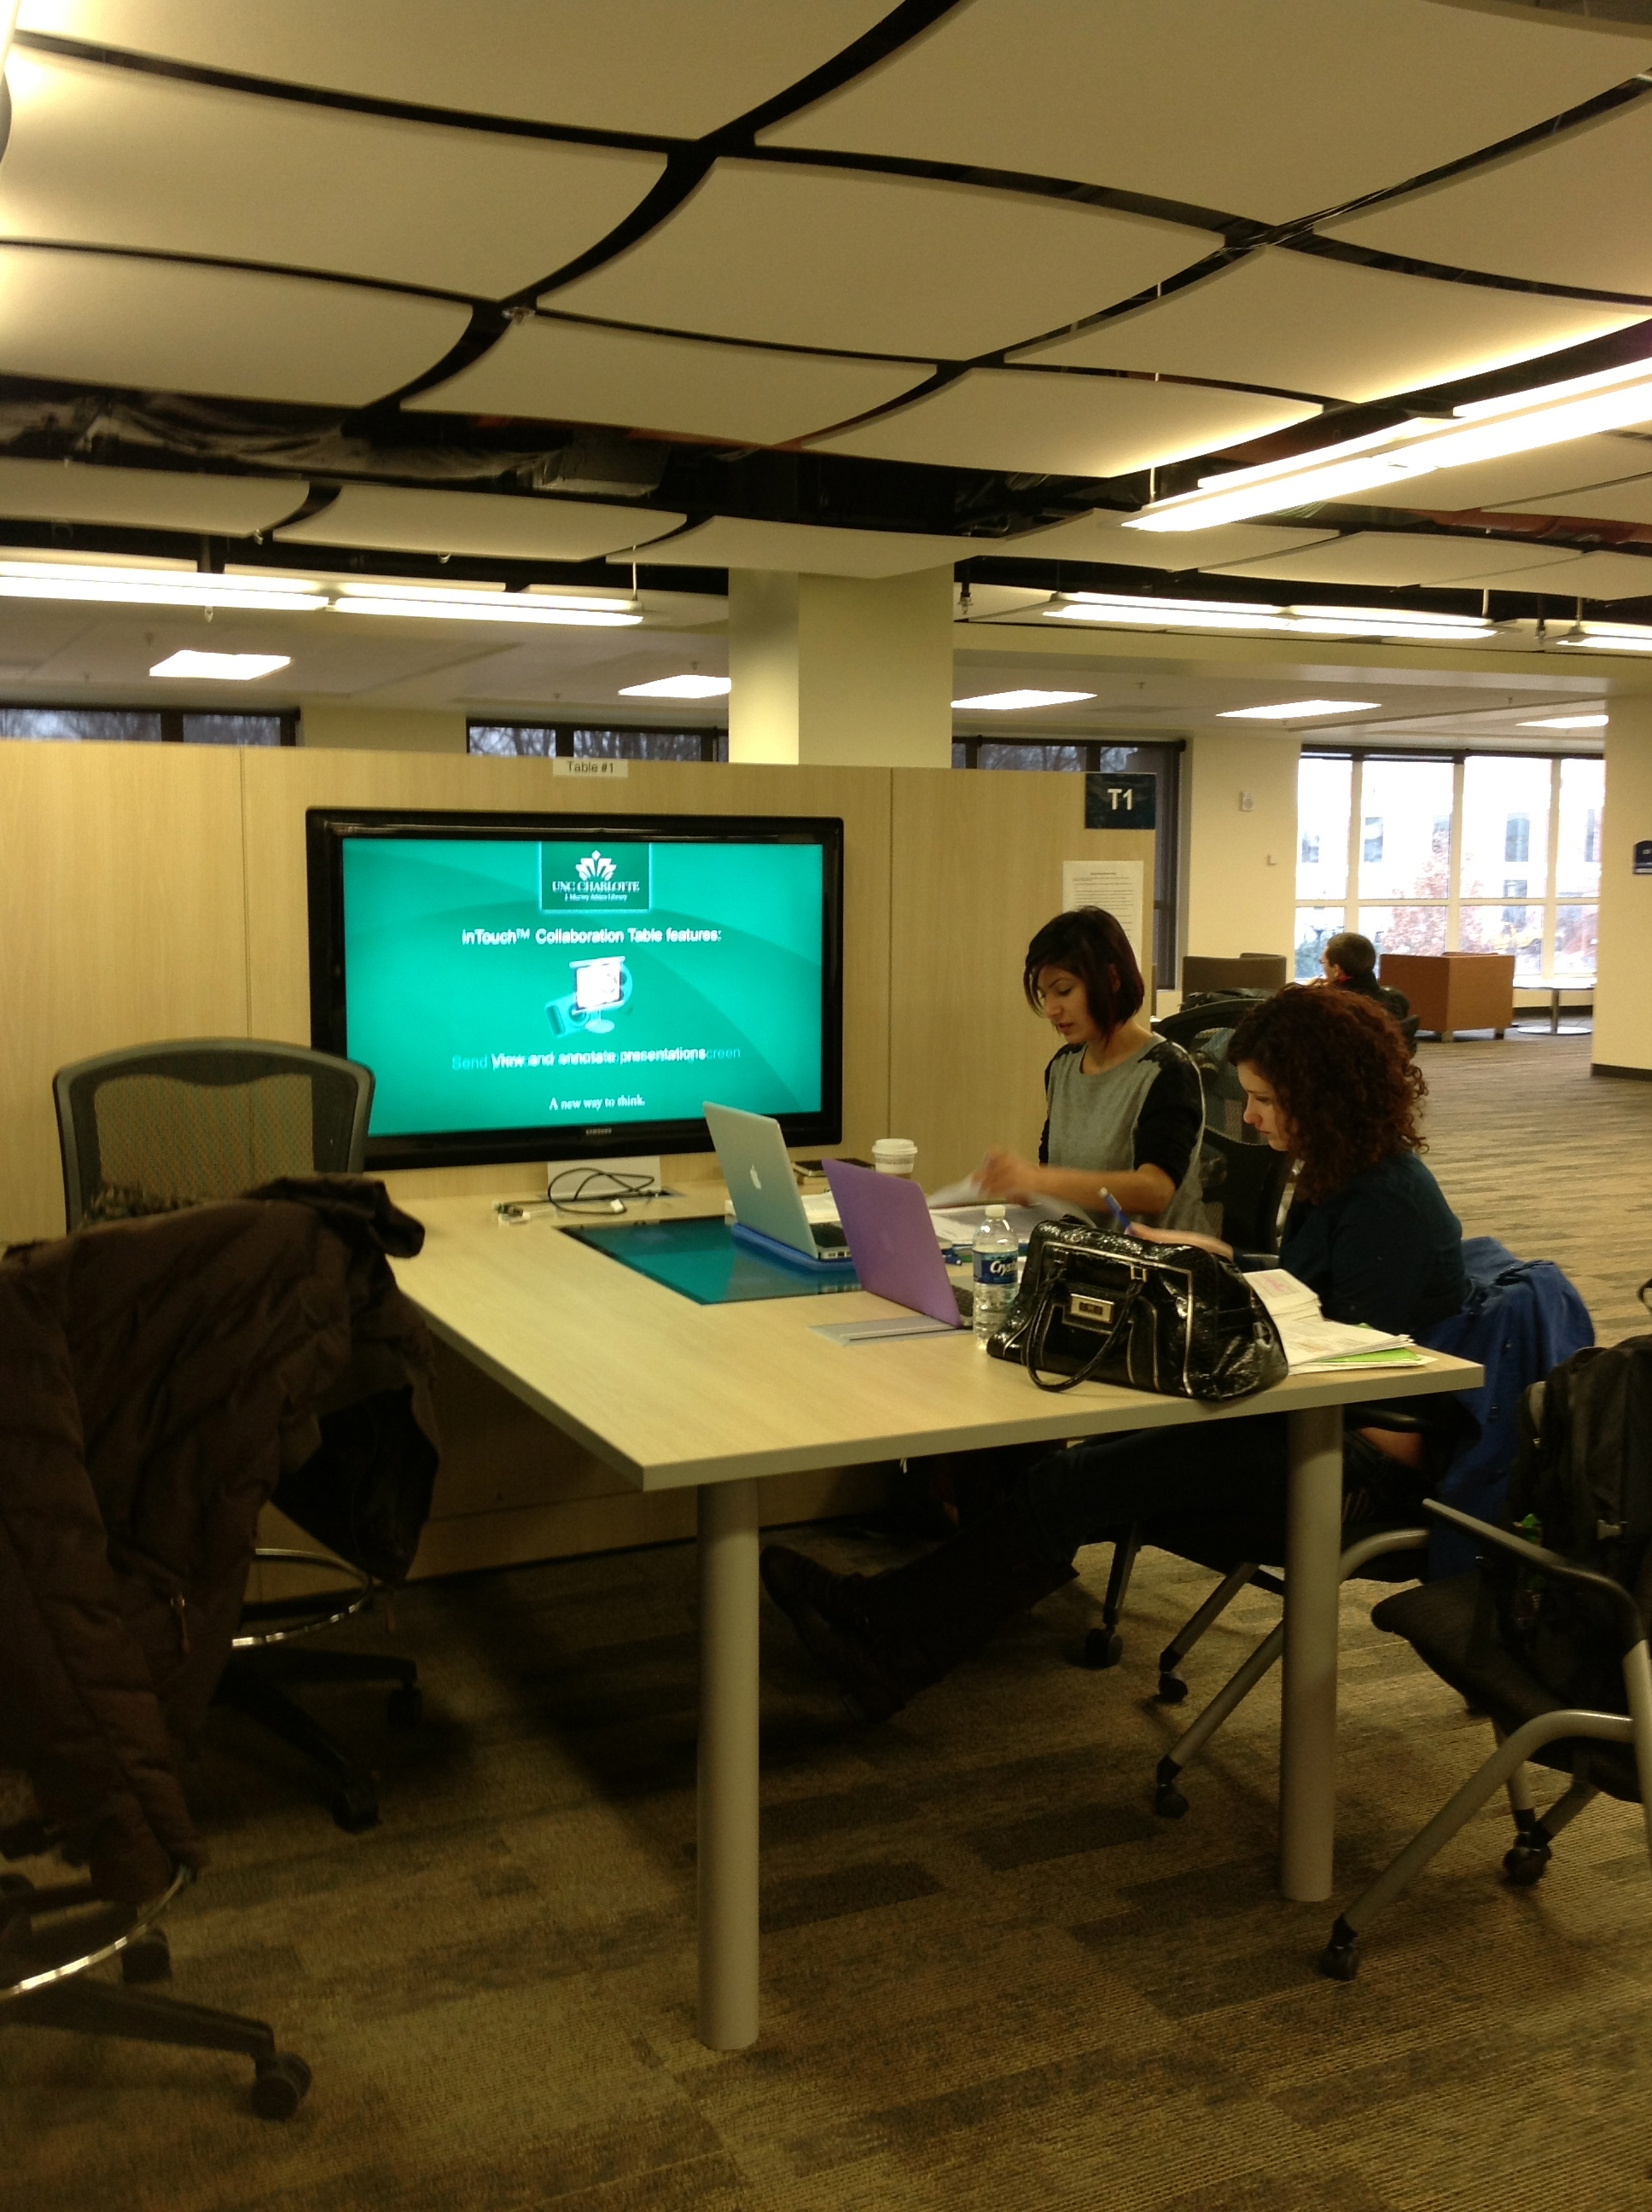
Collaborative Tables
Notes:
As part of the renovation, the library was able to work with a former professor to install several interactive collaborative computer tables.

Slide 17
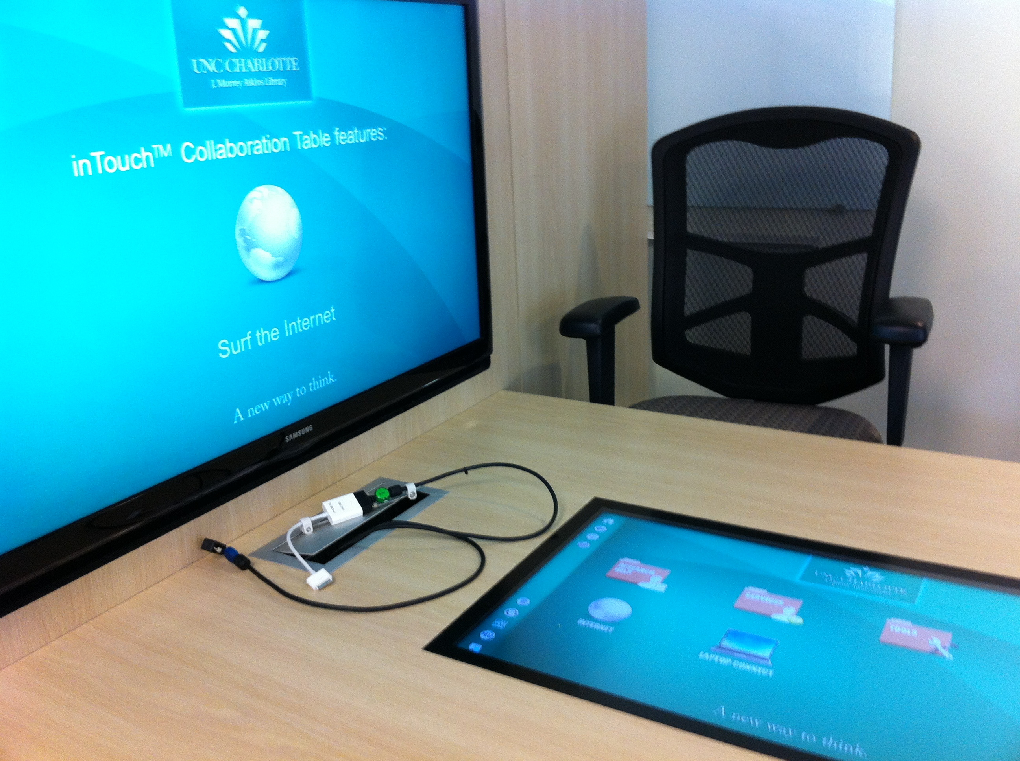
Collaborative Tables
Notes:
Like several other collaborative computer tables in scattered around the library and in the study rooms, students can plug into the computer and display their work on the large flat screen. But these tables also include a touch screen computer build into the table itself. As many as four students can simultaneously surf the web, use it as a white board and even take a break and play a few interactive games.

Slide 18
Student Response
Notes:
To say the least the students have taken to the new spaces and technology like fish to water. The picture on the right is fairly typical during exams. It was also take before the major renovation of the ground floor area, which you will see shortly.

Slide 19
Proof is in the Data
Average Weekly Logins
Notes:
The University’s IT department conducted an audit of computer usage across campus. The library began its research and transformation of space and services in 2009. The data would indicated that library indeed has become an attractive place for students to work. We are currently conducting additional research to determine if this translates to academic success for the students.

Slide 20
Proof is in the
Data
Average Weekly Unique Users

Slide 21
The Future is NOW
Notes:
One of the key components of this ongoing project is the direct involvement of the students in the planning process. When beginning to plan for the renovation of the ground floor we asked students from around campus to submit ideas of how they would design the space. The graphic on the left is an example of one student’s idea. The student was a Kinesiology student not an architecture or engineering student. The graphic on the right is a copy of the architectural plans.

Slide 22
The Future is NOW
Notes:
In the summer of 2012 the major renovation project began to create more collaborative learning space for students. As you can see the students didn’t wait until it was done to move in!

Slide 23
The Transition

Slide 24
Concept to Reality

Slide 25
The New Space
Notes:
The new space can accommodate both group work and individual spaces. The Library Café is adjacent to this new collaborative area.

Slide 26
The Emerging Future
Digital Scholarship Lab
dsl.uncc.edu
Notes:
Feedback from our graduate students and faculty was the impetuous for the formation of our Digital Scholarship Lab which focuses on assisting graduate students and faculty in data research and analysis. Although currently housed in merger facilities, we are currently looking for funding to create a state-of-the-art facility which will include and high-end media lab and a graduate student reading room.

Slide 27
Challenges
Quiet Study
vs
Active
Collaboration
Notes:
When we embarked on this endeavor the literature was thick with discussions about how 21st century students are collaborators and multitaskers. Recent studies and reports have indicated these same students also want quiet spaces for individual studying. It is easy to get caught up in providing new, flashy environments with the latest technology. But this type of environment can be very noisy and even chaotic at times. Feedback indicates that students also want quiet places to study. They want to be able to plug-in but also be quiet. We need to honor those requests as well. As part of the renovation we also added doors to some areas to delineate quiet areas. These spaces also have lots of study carrels for individual spaces. We have also purchased modular individual seating so students can create their own private space even in the midst of all the activity. And yes those are ear plugs. Students can pick them up at the information desk if they want them.
Changing Course: Connecting campus design to a new kind of student. http://www.gensler.com/uploads/documents/Changing_Course_Survey_10_08_2012.pdf

Slide 28
Challenges
Infrastructure
Simultaneous WiFi Connections
Notes:
Portions of our building also posed significant infrastructure issues – not enough outlets or connectivity. Thanks again to the data collected from students, the library was put at the top of the list for wireless upgrade which has been greatly appreciated.
The IT audit of wireless usage, demonstrates the need to concentrate on the wireless infrastructure instead of supplying more computer workstations. Students want to be able to move around with their devices. We have approximately 300 computer workstations not including the computers in the study rooms. We also circulate 80 laptops. The computer availability above was a snapshot taken in the middle of the afternoon. There is now a higher demand for laptops than the workstations.

Slide 29
Challenges
Staffing
Budgets
Notes:
It does take time and energy to conduct this type of research. Plus, the renovations have physically displaced staff, which has caused some consternation on their part. Change management is crucial.
It is amazing that we have been able to do what we have over the past three years considering the state of the economy. But the data/feedback demonstrated the need and the administration responded admirably. Many of the changes like rearranging furniture and adding whiteboards, which were relatively inexpensive, provided a good bang for the buck.

Slide 30
What We Learned
Use local human resources
Student Projects
Notes:
Doing the research can be a daunting task for the library staff on top of already full plates. So what we did was partner with departments (communications studies, anthropology, computer science) around campus to use students in those majors to conduct the research. The projects provided practical experience for the students and saved us time and money. One such exercise was Project C.O.R.E. which looked at participants’ perceptions of space, resources and safety. Library for Smarties was result of that research. Quotes in this presentation are taken from some of these projects.

Slide 31
What We Learned
Include users in the process
Notes:
As mentioned earlier, the key to this project has been the involvement of the users - a.k.a. the students. Instead of distributing surveys, we placed whiteboards and/or paper flip charts with a question throughout the library. Not all questions were directly related to the library as demonstrated by the question ‘Where do you like to read & write?’ We wanted to know how students work more than how they used the library. Students readily respond to such prompts. We also interviewed students inside the library and at other locations across campus.

Slide 32
What We Learned
Mobility is a must
“His group seems to have rearranged the furniture to make their own study space.” (Kaitlin, field notes, p.9-10)
Notes:
We are not talking about mobile devices, although infrastructure to support the ever growing appetite for more bandwidth is extremely important. The mobility referred to here is the mobility of furniture. Students want to reconfigure the space to meet their needs. So providing light but durable furniture is important. It also important to provide furniture for both individual and group work.

Slide 33
What We Learned
Work closely with IT folks
“But I still can’t connect to the Wi-Fi … I still can’t connect to the Wi-Fi … The Wi-Fi is finally connected! That took way too long. If I actually needed it, I probably would have moved locations” (Sayde, field notes, p. 11).
Notes:
As mentioned earlier data gather from students was used when we had to make our case for improving the infrastructure of the library. The Provost and IT folks were better able to understand our needs and could see how they impacted our students. Poor Wi-Fi connections didn’t just reflect badly on the library but on the University as a whole in the eyes of the students.

Slide 34
What We Learned
Interactivity/Digitization
Notes:
Students want to be able to interact with their environment both physically and electronically. Migrating to digital formats such as e-books whenever practical/possible benefits on-site and distance learners.

Slide 35
Bridgette Sanders
btsander@uncc.edu
Judy Walker
jwalker@uncc.edu

