Slide 1
Successful Mentoring Relationships for Career Development
Keith W. McIntosh
Pima County Community College District
Melissa Woo
University of Oregon
Notes:
Session abstract:
Participation in mentoring activities can be a key success factor in your career development. But how do you start? How do you find the right mentor or set of mentors for your situation? What should the focus of your conversations be? This session will help you with these questions and help you understand what to focus on in mentee/mentor conversations. This session will cover important mentoring resources, benefits, styles, and functions and setting expectations. Whether you want to find a mentor or a coach, or to be one, join this lively session—make a difference in your career planning and development.

Slide 2
Agenda
About us
Workshop goals
Career/self assessments
What are you looking to gain from a mentoring relationship?
Next steps?
Notes:
2 mins

Slide 3

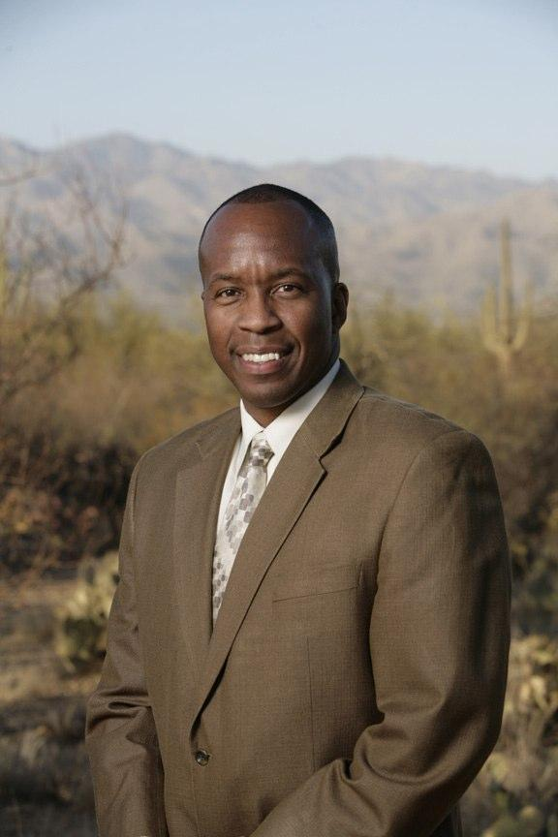
About Us
Melissa Woo
Vice Provost for Information Systems
and Chief Information Officer
University of Oregon
Keith W. McIntosh
Vice Chancellor for Information Technology
and Chief Information Officer
Pima County Community College District

Slide 4
Workshop Goals
Finding the right mentor(s)/mentee(s)
Finding the right focus for your mentoring conversations
Notes:
5 mins

Slide 5
Career/Self Assessment
Of the new and recent developments in my organization/field, what interests me the most?
What do I need to do to reposition my career so that I can get involved in these new areas?
Notes:
Self-assessment worksheet (10 minutes)

Slide 6
Career/Self Assessment
What is most important to me in my work?

Slide 7
Career/Self Assessment
What values guide the kind of work I want to do? What are "must haves" for a job?

Slide 8
Career/Self Assessment
What are my limiting factors?

Slide 9
Career/Self Assessment
What knowledge, skills, abilities, experience and/or assistance would help position my career in the direction of my interests?

Slide 10
What Do You Want to Gain from a
Mentoring Relationship?
Sponsorship
Exposure/
visibility
Coaching
Protection
Challenging assignments
Role modeling
Acceptance/
confirmation
Counseling
Friendship
Notes:
Mentoring functions checklist - 10 mins

Slide 11
What Are the Best Mentoring Styles to Achieve Your Goals?
Traditional
Network
Group
Minute
Circle
Invisible
Reverse
Notes:
Mentoring style checklist - 10 mins

Slide 12
Next Steps?
Finding a mentor/mentee...
Ask yourself...
"Do I associate myself with people who add value to my career"?
"Do I belong to the right networking groups"?
"How did my colleagues find their mentors/mentees"?
Notes:
5 mins

Slide 13
Next Steps?
Finding a mentor/mentee...
Get involved in conferences & meetings
Work your networks - professional, personal & online social
EDUCAUSE member search (potential mentors, please add the "mentoring" affinity tag to your EDUCAUSE profile!)
www.educause.edu/members

Slide 14
Next Steps?
Finding a mentor/mentee...
Look for:
Clear expectations
Mutual respect
Reciprocity
Shared values
Notes:
When seeking a mentor, look for:
1. Clear Expectations. The initial meeting should include a discussion of goals and responsibilities, including things such as time commitments, accountability and intellectual property.
2. Mutual Respect. Mentors and mentees need to respect each other's time, effort and qualifications. If the mentee doesn't respect the mentor's time or advice, the mentor may disengage. Good mentors were said to be honest, trustworthy and active listeners.
3. Reciprocity. Bi-directional and include strategies that make the relationship mutually rewarding.
4. Shared Values. Mentors and mentees should share interests and values, which will establish a common ground.

Slide 15
Mentoring Resources
EDUCAUSE Mentoring site:
www.educause.edu/careers/special-topic-programs/mentoring
Creating a Professional Development Plan:
net.educause.edu/section_params/mentoring/M06_%20PDP.pdf
How IT Mentors Can Help Advance Your Tech Career:
www.cio.com/article/727740/How_IT_Mentors_Can_Help_Advance_Your_Tech_Career

Slide 16
Thank You!
Keith W. McIntosh
Melissa Woo

