Slide 1
Digital Popcorn:
Making Media Better
#digipopcorn
Sean Anderson-Technology Librarian/Library Webmaster
@Seanypat1014
Adam Northam-Digital Collections Librarian
@atomic_red77

Slide 2
In the Beginning
Built first digital collection in late 2006
Video has always been a prominent feature of some collections
Centerpiece of WWII collection
  http://dmc.tamuc.edu/cdm/search/collection/uw/searchterm/Moving%20Image/order/nosort
Notes:
Video was originally what people got most excited about when they saw our early digital collections. Continues to be an important part of many of our collections

Slide 3

Staying Ahead of the Curve
Any technology-dependent environment is very dynamic
Format of content has always been a major consideration
Chose Flash as streaming media format early on, due to it’s wide use on the Interwebz and Innertubes
Notes:
We have always tried to consider compatibility when creating online content. When collections were started Flash was the best fit for our streaming media needs; recently we have started to look toward the next phase, and have been thinking about what we need to do to continue to ensure sustained access

Slide 4

HTML5 on the Radar
Adobe announced end of support for mobile devices
Didn’t directly impact current video content but was a good opportunity to explore new options
HTML5 offered some interesting capabilities that had not previously been available
Notes:
Late 2011 Adobe announced they would stop supporting mobile devices. Did not directly our existing content, but did make us begin considering alternative formats, particularly non proprietary
Took a closer look at HTML5; Liked the fact that it could handle media natively in browsers

Slide 5
Exploring HTML5
Our initial exploration of HTML5 capabilities and formats was promising
Would make content even more widely accessible regardless of platform, including mobile
Began thinking about migrating media to new formats
Notes:
Our content is not optimized for mobile devices, but the .flv format completely excludes Apple devices; HTML5 allows any platform to access the content, provided the correct file format is being served out;

Slide 6
Exploring HTML5
Biggest issue is that we would need to serve out multiple formats of videos to ensure maximum compatibility (file size, stored where)
Different browsers support different formats (http://www.w3schools.com/tags/tag_video.asp, http://www.w3schools.com/tags/tag_audio.asp)
Leads to more processing work, more storage space
The benefits will make the extra work worth it!
Discovered Popcorn.js
Notes:
Server space has been and continues to be an issue for us related to our digital collections; a switch to HTML5 would require us to serve out multiple formats of the same content; working out ways to optimize server space; While working on these issues, we discovered popcorn.js

Slide 7

What is Popcorn.js
“Popcorn.js is an HTML5 media framework written in JavaScript…for anyone who wants to create time-based interactive media on the web. Popcorn.js is part of Mozilla's Popcorn project.” (From popcornjs.org)
Relies on ability of HTML 5 to play media within browsers without 3rd party players
Uses plugins to allow integration of YouTube, Google Maps, Wikipedia, etc.
Notes:
This definition comes from the popcorn project website. It essentially allows different forms of media to be integrated into one viewing experience

Slide 8

Who Wouldn’t Want Popcorn with a Movie?
Immediately saw potential to enhance our existing online media
Pull in other materials to supplement the video on-screen
Appeals to many users’ ability to multitask
Notes:
Video in itself is often though of as more engaging than some other forms of media, but still we were very interested in making our existing video content even more interesting to our potential end users

Slide 9

Creating the Popcorn Enhanced Webpage
Looked for examples online for ideas
  Found examples of what NOT to do (information overload!)
  Found example of what we liked
  Confirmed our concept – on-screen video augmented with content nearby – was valid

Slide 10
Creating our Webpage Template
Focus on subject material
Display meaningful content
Stationary content
Simple, informative layout
CSS styling

Slide 11
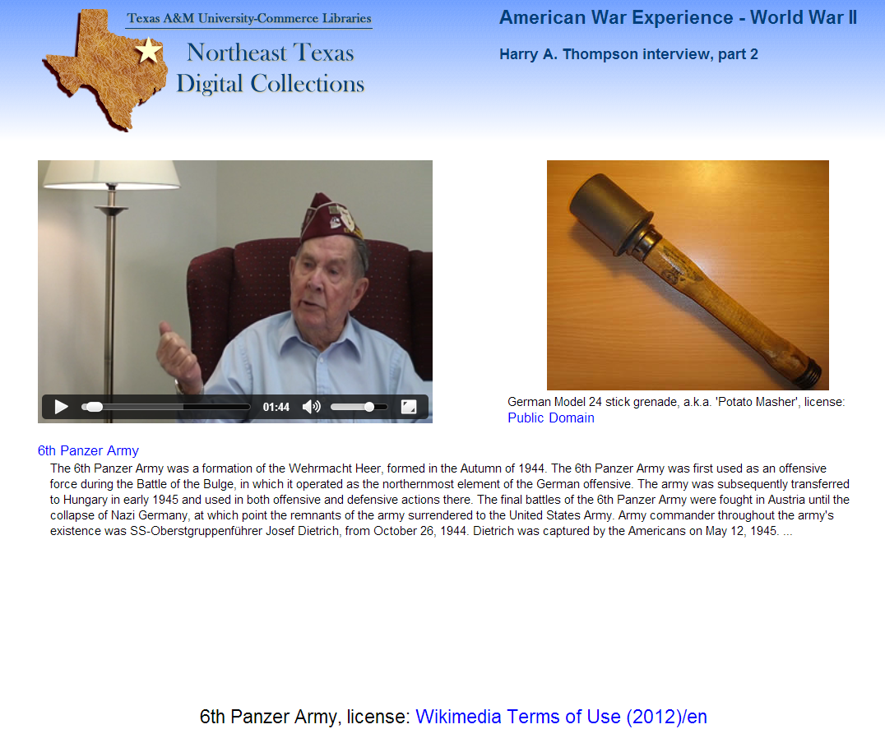
Notes:
Move to position 11

Slide 12
Assembling the Popcorn Machine
The basic popcorn machine
  popcorn.js – basic component required for any popcorn project
Webpage template
  Color scheme and style based on home site
  Digital Collections logo displayed prominently
    Specific collection name on-screen too

Slide 13
Popping Corntent
Where’s the video?
  Different browsers gave different errors when video did not display!
  <video> and <audio> need unique ID for script to identify it
Why isn’t Google Maps working?!
  Plugins given away separately. Some assembly required. No instructions about this!
Why is nothing happening at the right time?
  Time in the popcorn.js framework is in seconds (http://www.csgnetwork.com/directcvthrminsec2sec.html)
Where does “this” go?
  Customizing plugins
  Adapting plugins to meet our needs

Slide 14
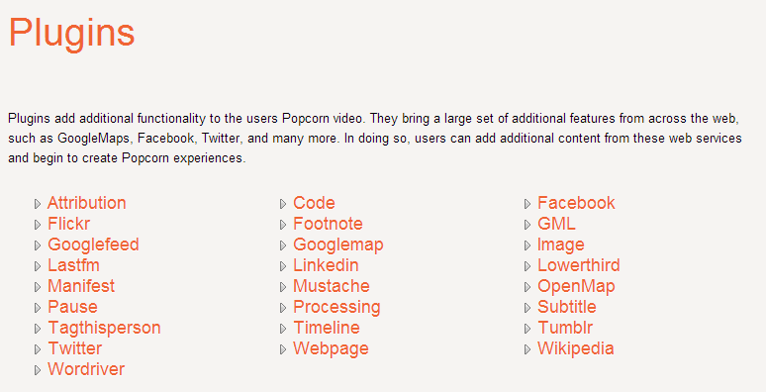
Popcorn Plugins
http://popcornjs.org/popcorn-docs/plugins/
6 February 2013

Slide 15
Popcorn.js At Work
Once we figured out how it worked, we needed to integrate it into our Digital Collections workflow
Only 2 people currently working on the project
Detailed log of video with time marks to make programing easier
Search Internet to find appropriate supplemental content that can be properly attributed
First video took about 40 man-hours to complete

Slide 16
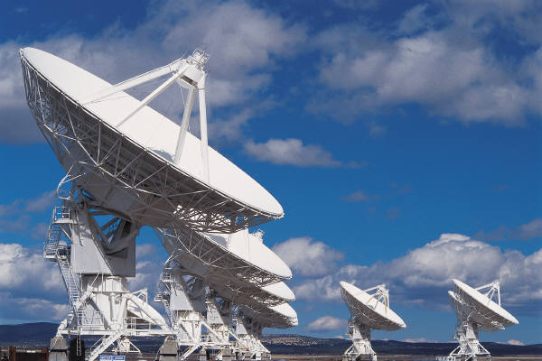
Future Plans
Augment more existing videos from our Digital Collections
Expand to include audio-only oral history recordings from Special Collections
Investigate grants to facilitate faster processing of content
Due to media file sizes, investigate long-term storage options

Slide 17
Recommendations
Just because you can doesn’t mean you should
Decide what elements you want and their presentation on-screen
Download and use local copies of script files
Take your time

Slide 18

Demo Time!
Chief Warrant Officer Harry A. Thompson Interview, part I
Chief Warrant Officer Harry A. Thompson Interview, part II

Slide 19
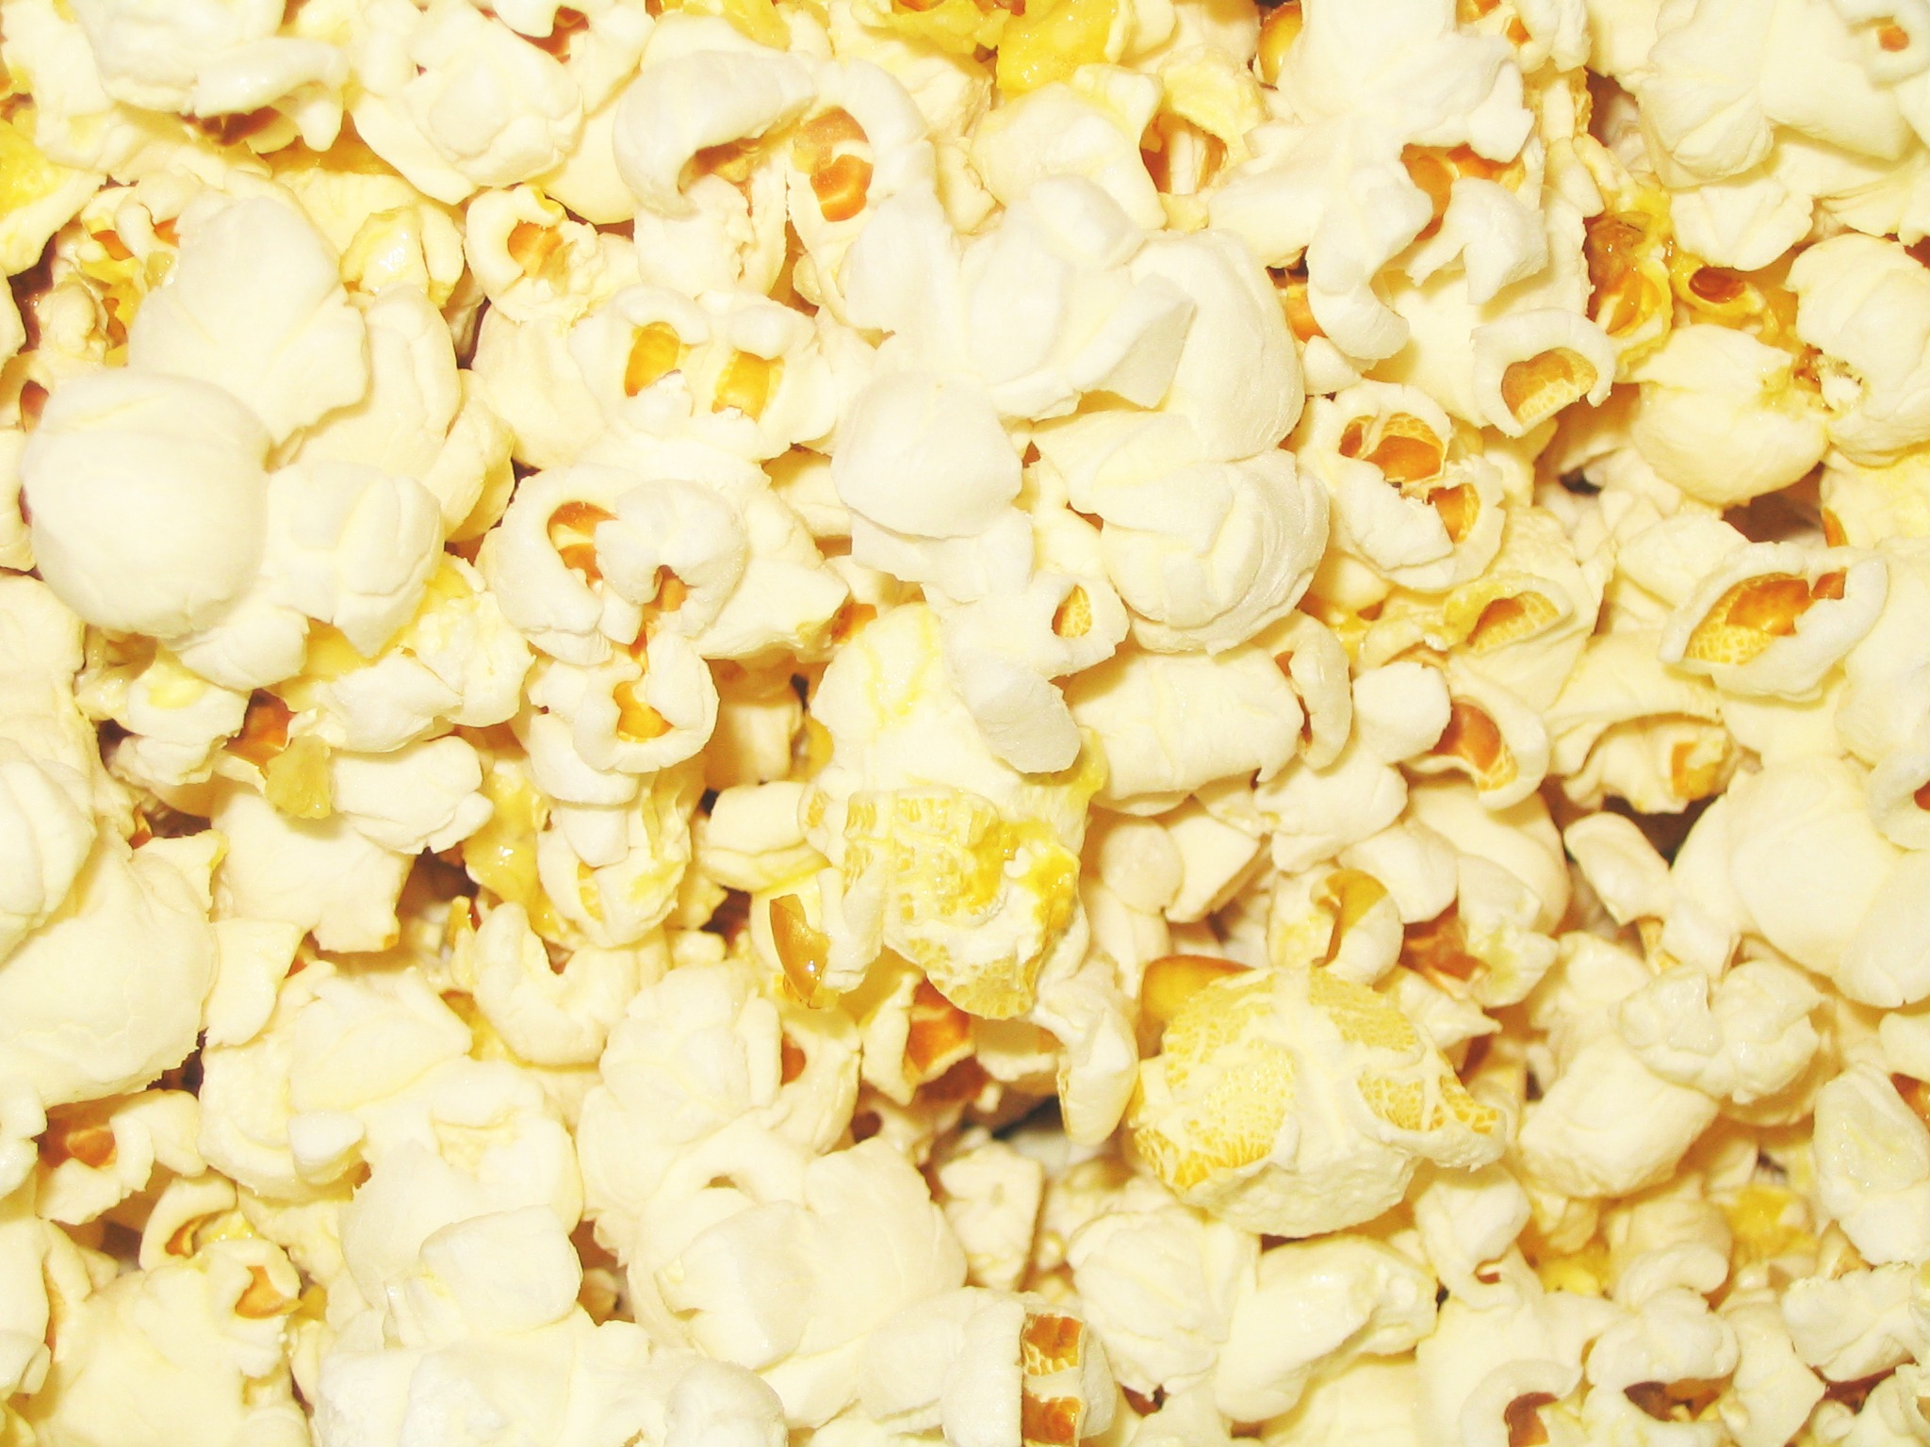
What’s the best thing about
watching a movie online?
POPCORN.js!
KCCO

