Slide 1
Implementing a “Cloud First” Strategy for Infrastructure
A. Michael Berman VP for Technology & Comm.
Herb Aquino
Infrastructure Manager

Slide 2
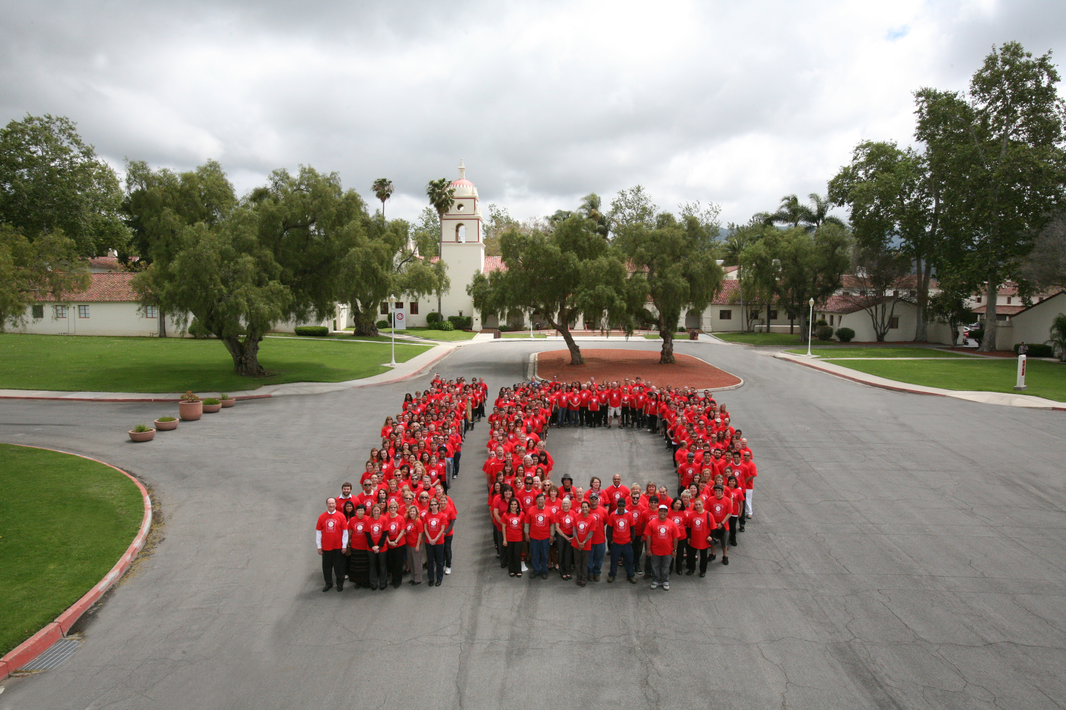

Slide 3
2. The NIST Definition of Cloud Computing
Cloud computing is a model for enabling ubiquitous, convenient, on-demand network access to a shared pool of configurable computing resources (e.g., networks, servers, storage, applications, and services) that can be rapidly provisioned and released with minimal management effort or service provider interaction. This cloud model is composed of five essential characteristics, three service models, and four deployment models.
Essential Characteristics:
On-demand self-service. A consumer can unilaterally provision computing capabilities, such as server time and network storage, as needed automatically without requiring human interaction with each service provider.
Broad network access. Capabilities are available over the network and accessed through standard mechanisms that promote use by heterogeneous thin or thick client platforms (e.g., mobile phones, tablets, laptops, and workstations).
Resource pooling. The provider’s computing resources are pooled to serve multiple consumers using a multi-tenant model, with different physical and virtual resources dynamically assigned and reassigned according to consumer demand. There is a sense of location independence in that the customer generally has no control or knowledge over the exact location of the provided resources but may be able to specify location at a higher level of abstraction (e.g., country, state, or datacenter). Examples of resources include storage, processing, memory, and network bandwidth.
Rapid elasticity. Capabilities can be elastically provisioned and released, in some cases automatically, to scale rapidly outward and inward commensurate with demand. To the consumer, the capabilities available for provisioning often appear to be unlimited and can be appropriated in any quantity at any time.
Measured service. Cloud systems automatically control and optimize resource use by leveraging a metering capability at some level of abstraction appropriate to the type of service (e.g., storage, processing, bandwidth, and active user accounts). Resource usage can be monitored, controlled, and reported, providing transparency for both the provider and consumer of the utilized service

Slide 4
2. The NIST Definition of Cloud Computing
Cloud computing is a model for enabling ubiquitous, convenient, on-demand network access to a shared pool of configurable computing resources (e.g., networks, servers, storage, applications, and services) that can be rapidly provisioned and released with minimal management effort or service provider interaction. This cloud model is composed of five essential characteristics, three service models, and four deployment models.
Essential Characteristics:
On-demand self-service. A consumer can unilaterally provision computing capabilities, such as server time and network storage, as needed automatically without requiring human interaction with each service provider.
Broad network access. Capabilities are available over the network and accessed through standard mechanisms that promote use by heterogeneous thin or thick client platforms (e.g., mobile phones, tablets, laptops, and workstations).
Resource pooling. The provider’s computing resources are pooled to serve multiple consumers using a multi-tenant model, with different physical and virtual resources dynamically assigned and reassigned according to consumer demand. There is a sense of location independence in that the customer generally has no control or knowledge over the exact location of the provided resources but may be able to specify location at a higher level of abstraction (e.g., country, state, or datacenter). Examples of resources include storage, processing, memory, and network bandwidth.
Rapid elasticity. Capabilities can be elastically provisioned and released, in some cases automatically, to scale rapidly outward and inward commensurate with demand. To the consumer, the capabilities available for provisioning often appear to be unlimited and can be appropriated in any quantity at any time.
Measured service. Cloud systems automatically control and optimize resource use by leveraging a metering capability at some level of abstraction appropriate to the type of service (e.g., storage, processing, bandwidth, and active user accounts). Resource usage can be monitored, controlled, and reported, providing transparency for both the provider and consumer of the utilized service

Slide 5
Strategic Issue:
What stays on-premises (i.e., in your data center) and what goes somewhere else?

Slide 6
Poll
How long do you think your institution will maintain an on-premises, full-service data center like you (probably) have now?

Slide 7
How Long Will You Keep Traditional Data Center?
0 years (we already have moved most of our services to the cloud)
2 years
4 years
Forever, or at least as long as I’m working there…

Slide 8
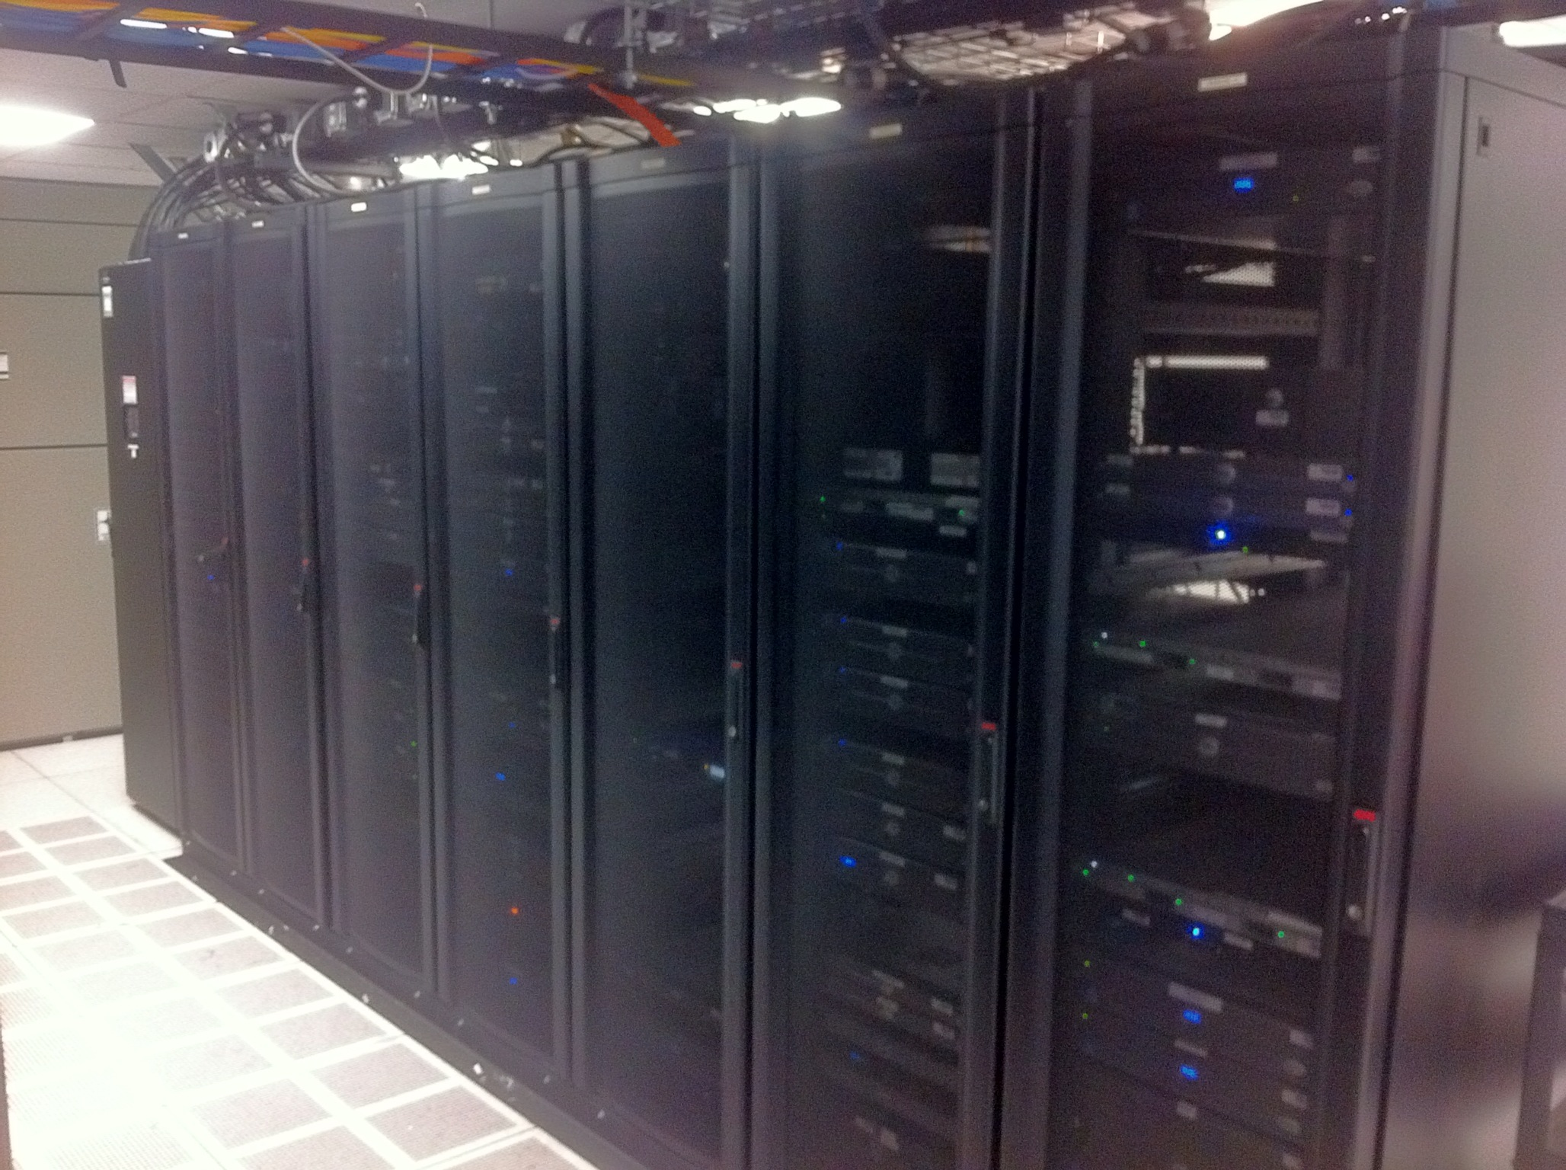

Slide 9
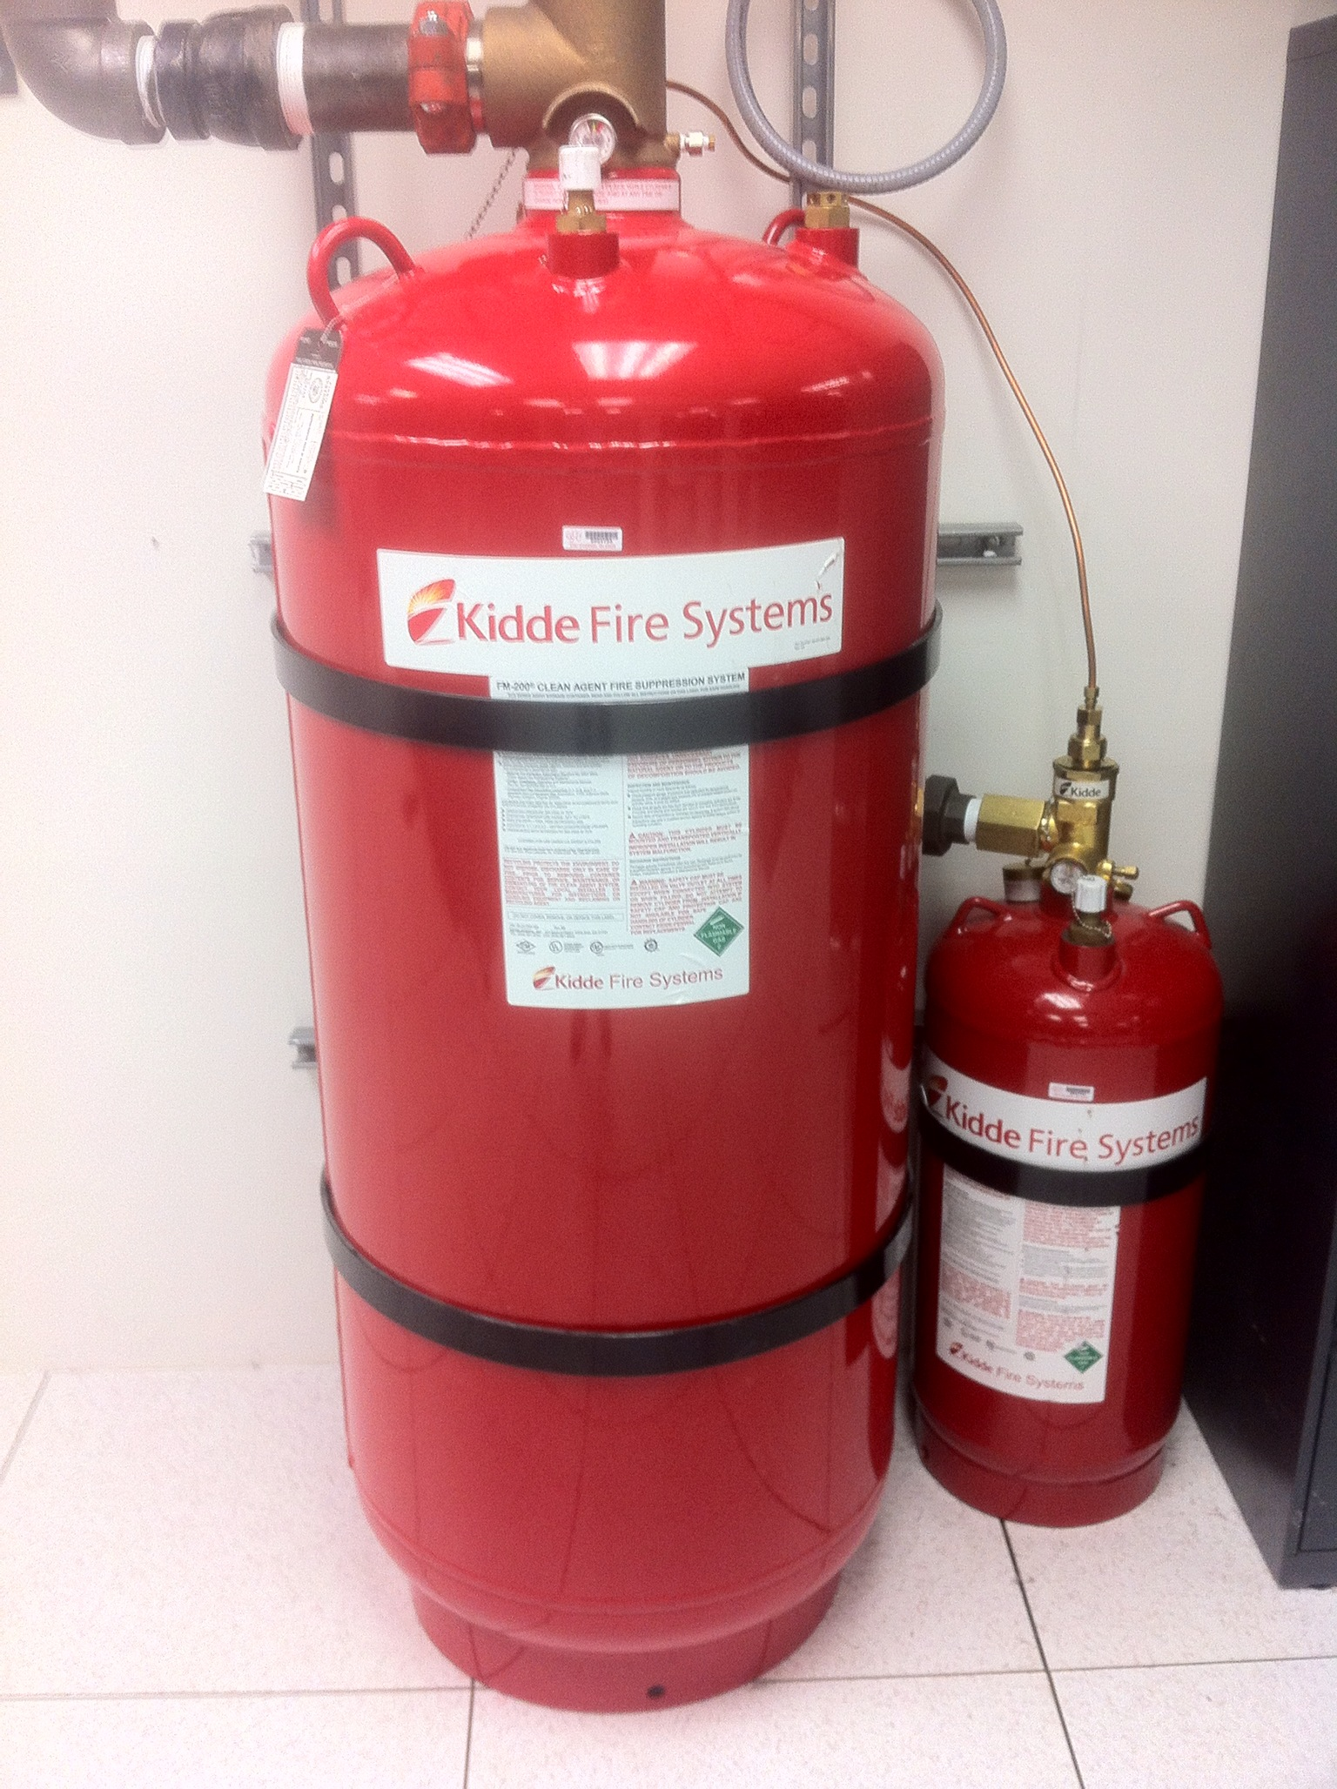

Slide 10
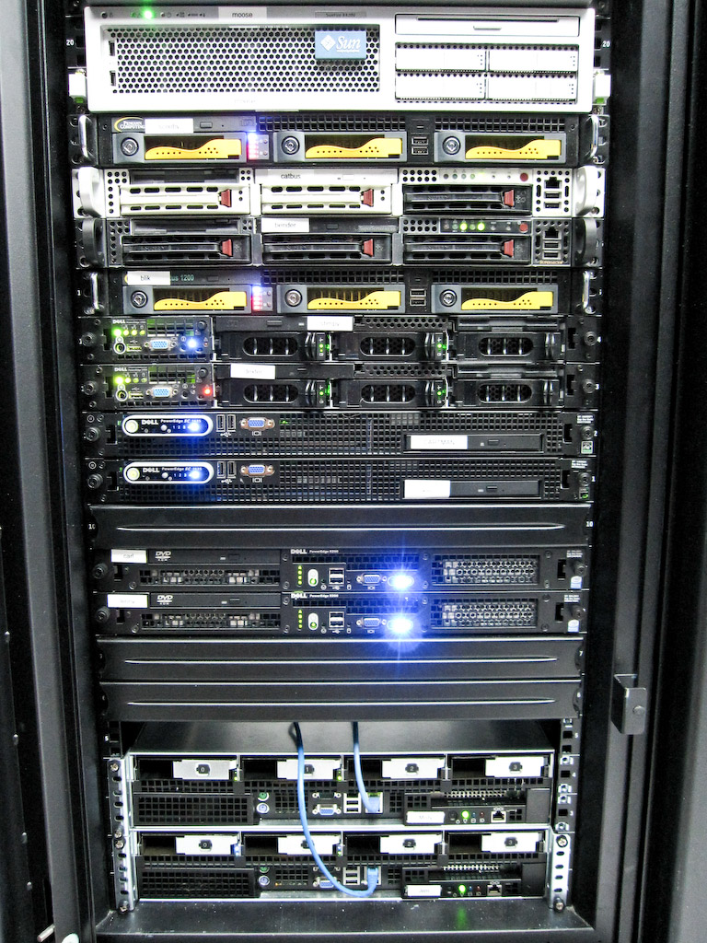
versus
CC Flickr by dotcompals
CC Flickr by mayhem

Slide 11
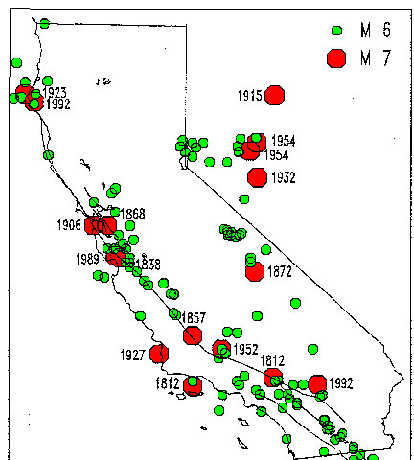
Source: Calif. Dept. of Conservation
http://www.consrv.ca.gov/cgs/rghm/psha/ofr9608/Pages/index.aspx

Slide 12
You are here…

Slide 13
Source: Flickr – CC by Zarzoso

Slide 14
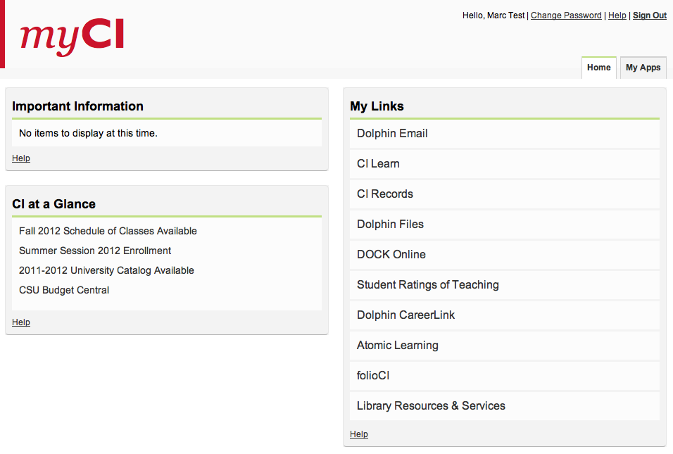

Slide 15
Google
Hosted in VA
Hosted in UT

Slide 16
SCENARIO
Regional fire damages campus data center,
rendering it unusable.
QUESTION
How are online student services impacted?

Slide 17
Email
Learning Management System
Student Information System
Single-Sign On Portal

Slide 18
Email
Learning Management System
Student Information System
Single-Sign On Portal

Slide 19
Email
Learning Management System
Student Information System
Single-Sign On Portal

Slide 20
Email
Learning Management System
Student Information System
Single-Sign On Portal

Slide 21
Email
Learning Management System
Student Information System
Single-Sign On Portal
FAIL!

Slide 22
Options Evaluated
Remote campus co-location
Mirror service on campus
Public Cloud
Hosted Private Cloud

Slide 23
Options Evaluated
Remote campus co-location
Mirror service on campus
Public Cloud
Hosted Private Cloud

Slide 24
Why did we choose hosted private cloud?
Scalable
Instantaneous Satisfaction (spin up VMs on demand)
Reduce capacity as necessary
Rapid deployment and development
Data Security constraints (Level 1 and Level 2)
High Availability Meet Customer Needs
24/7 Support
Robust Infrastructure
Excellent Customer Satisfaction (Fanatical Support)
Notes:
Our Strategy
Our current requirements was to develop a Disaster Recovery Site
Testing results of the hot back sites were excellent
We chose Rackspace as our vendor of choice and decided to use their infrastructure to protect sensitive data (Level 1 and Level 2)

Slide 25
Architecture (Current)
Notes:
omit

Slide 26
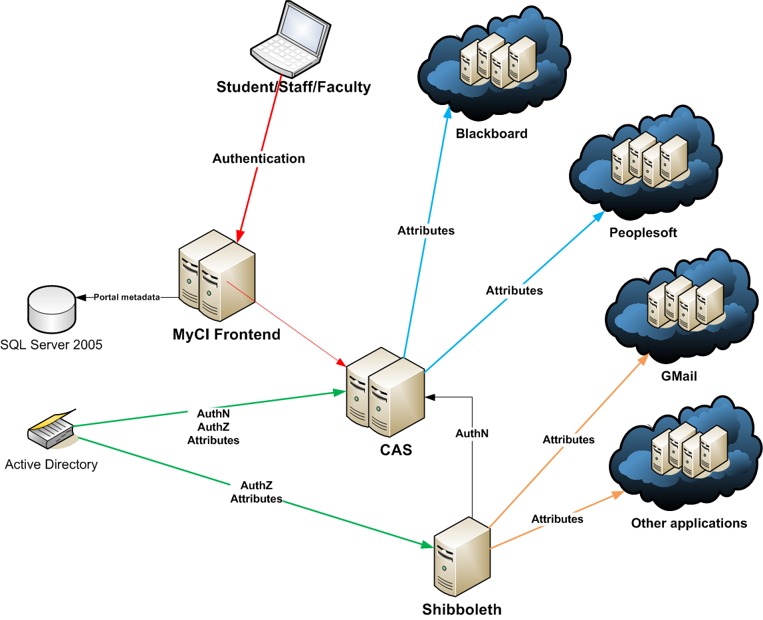
Architecture (Single Sign On)

Slide 27
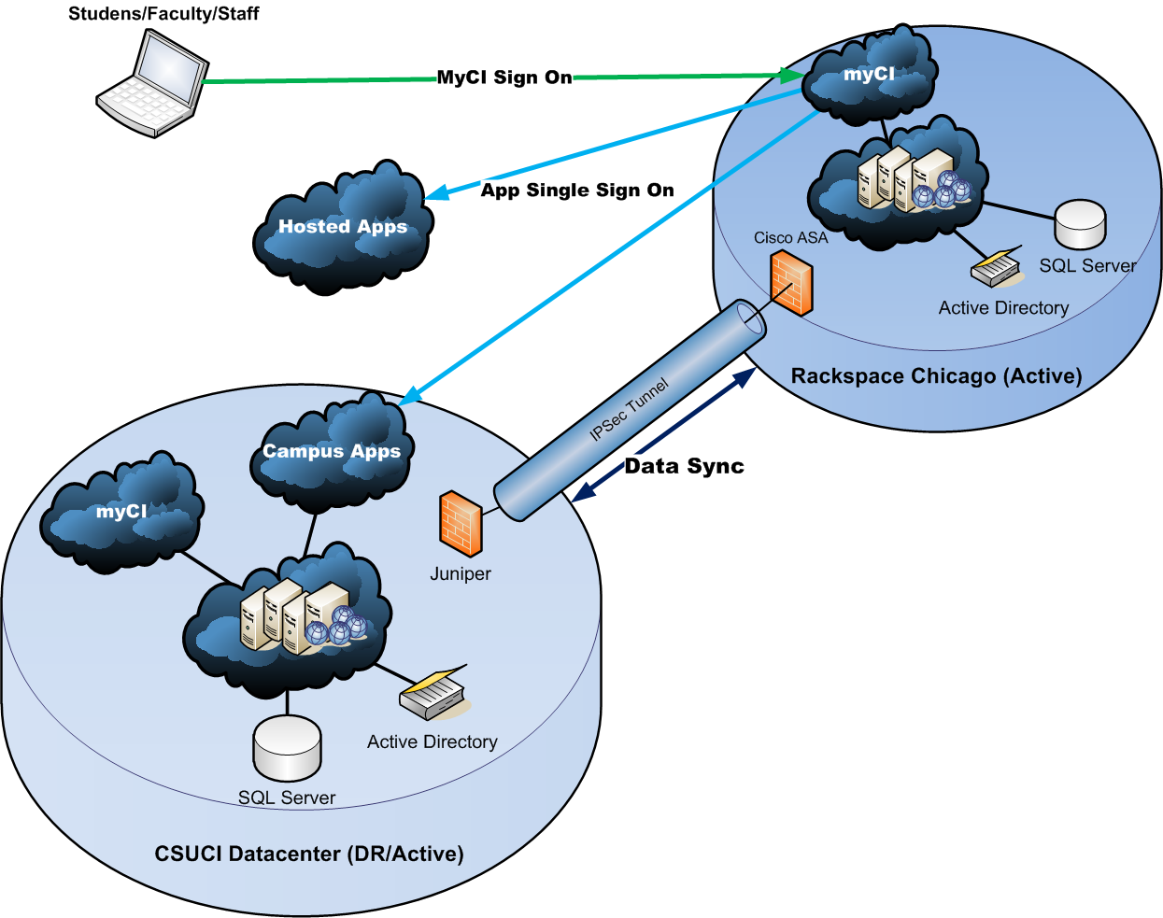
Architecture (Future)

Slide 28
Cost of the Current DR Architecture
Two physical servers
Cisco ASA firewall
5 VMs
Cost DR site one-time setup cost: $1,250 (servers/vmware/firewall/VMs)
Current DR site monthly costs: $4,100
Notes:
Add after slide 33

Slide 29
Cost of using Rackspace as Primary
Two Physical Servers
Cisco ASA firewall
9 VMs
Brocade load balancer
Future live site setup costs: $550 (setup costs related to going from 5 to 9 Vms and brocade load balancer)
Future monthly cost: estimated to $5,800

Slide 30
Which is more reliable?
On-premise
Remote Hosted
Very good data center facilities
World-class data center facilities

Slide 31
Which is more reliable?
On-premise
Remote Hosted
Very good data center facilities
Network with modest amount of redundancy
World-class data center facilities
Network with massive redundancy

Slide 32
Which is more reliable?
On-premise
Remote Hosted
Very good data center facilities
Network with modest amount of redundancy
Well-qualified staff
World-class data center facilities
Network with massive redundancy
Well-qualified staff

Slide 33
Which is more reliable?
On-premise
Remote Hosted
Very good data center facilities
Network with modest amount of redundancy
Well-qualified staff
Staffed 8-5, Monday-Friday
World-class data center facilities
Network with massive redundancy
Well-qualified staff
Staffed 24/7

Slide 34
A Mental Evolution…
Use remote site as a hot backup, disaster recovery location
Use remote site as a live, load-balanced mirror of campus site
Use campus site as a live, load balanced mirror of remote site
(Eventually) – use public cloud as a live, load balanced mirror for primary hosted site

Slide 35
Other “cloud” initiatives
Academic servers via Amazon AWS
Cloud appliance file share (best for large, infrequently-used files, e.g. photo/video archives)
Cloud-based backups
Move primary campus website hosting to public cloud
Migrate from mixed SaaS/locally hosted email to full SaaS-based email

Slide 36
Considerations
Security and auditing – Personally-Identifiable Information
Changing role of IT staff
Network connectivity
Residents vs. Commuters
Cost
CSU Collaboration, and CENIC initiatives

Slide 37
Questions?
CONTACT INFORMATION
michael.berman@csuci.edu
herb.aquino@csuci.edu

Slide 38
References
www.rackspace.com
aws.amazon.com
www.nasuni.com
www.zetta.net
www.cenic.org
www.csuci.edu/tc

