Slide 1
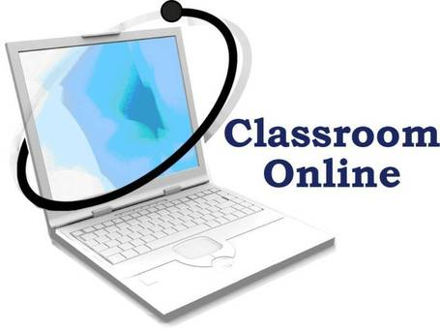

Creating a Virtual Classroom at SMU
Blair Simmons MS
Patricia Brennan PhD, RN, MS
Marcus Walton BS, CCNA
Ellie Hoffman MA

Slide 2
Takeaways from this session
1) The importance of providing a social presence and collaborative approach to online learning in by supplementing asynchronous learning with online synchronous sessions to deliver dynamic content through real-time interactions in a virtual classroom.
2) How institutions must embrace a culture of collaboration, in which academic program leadership, faculty, information technology, and students work together to effectively adopt new models for academic pedagogy and content delivery.
3) Approaches to evaluating, analyzing, and mastering synchronous communication technologies for the purpose of incorporating synchronous learning into doctoral-level courses.

Slide 3
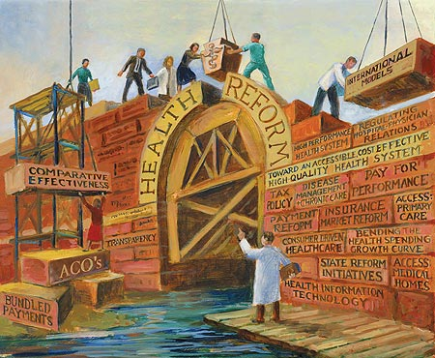

N702 Health Policy
The Opportunity and the Challenge
Challenge
N702 Health Policy and Advocacy
Create an atmosphere encouraging dialogue and discourse
Provide for engaged student learning during a particularly dynamic time in health policy development

Slide 4
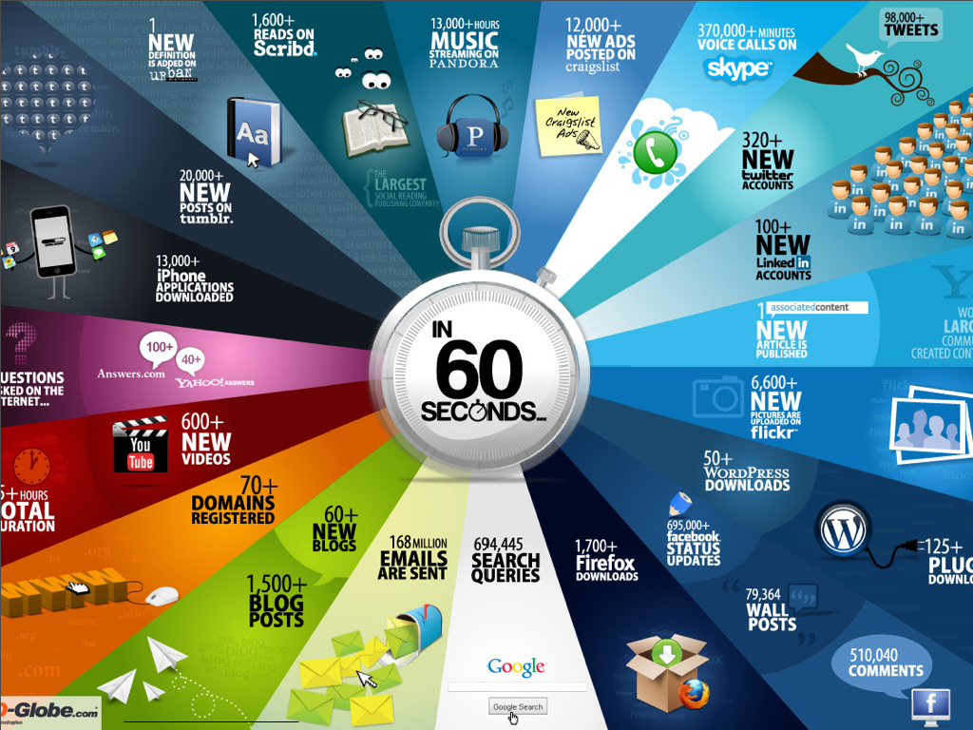

Slide 5
Purpose
The purpose of this project was to provide a social presence* and collaborative approach to on-line learning in the DNP Program at Samuel Merritt University by supplementing asynchronous learning with 4 on-line synchronous sessions to deliver dynamic content (Health Policy) through real-time interactions in a virtual classroom.
*Social Presence
“The ability of participants to identify with the community (e.g., course of study), communicate purposefully in a trusting environment, and develop inter-personal relationships by way of projecting their individual personalities.” (Garrison, 2009)

Slide 6



What is asynchronous learning?
“Literally, not at the same time, asynchronous describes the affordance of online learning and teaching that allows people to work at times that fit their own priorities. Asynchronous learning affords more reflective thinking.”
The Sloan Consortium Commons
Currently, most online classes are conducted asynchronously

Slide 7
What is synchronous learning?
Synchronous computer-mediated communication (SCMC) takes place with learners and teachers online at the same time. “Interlocutors perceive each others’ presence in real-time” (Yamada & Akahori 2007). This may lead to increased social presence (Short, Williams & Christie 1976).

Slide 8


Asynchronous Synchronous
Cognition Motivation
2008 Stefan Hrastinski

Slide 9
Question:
Could we add synchronous sessions to this course (N702) when all previous on-line courses in the program had been delivered asynchronously?
And, if so, how could this be done?

Slide 10
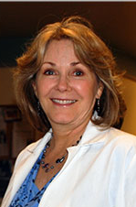


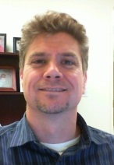


SUPPORT
Administrative approval
Student support
New Pedagogy
Technical Expertise
Training
Time Commitment
More Training
Flexibility

Slide 11

Faculty Challenges
  Limited experience in
  synchronous online teaching
  Logistically naïve
  Training needs
  Time Constraints

Slide 12

Student Challenges
  Limited experiences in
  synchronous online learning
  Technically naïve
  Training needs
  Time Constraints

Slide 13
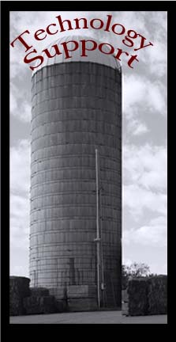
Technology Support Challenges
  Learning curve for managing synchronous communication solution
  Complexity of supporting a wide array of end user technologies
  Distance separation impedes capacity for technical assistance
  Instant results a must for real-time communication support

Slide 14
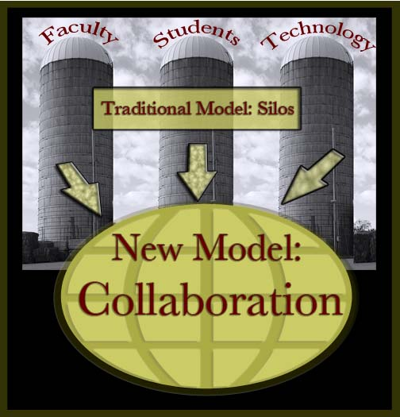
Silos!
Success required
moving outside
of our silos

Slide 15
Ramping up the Network

Slide 16
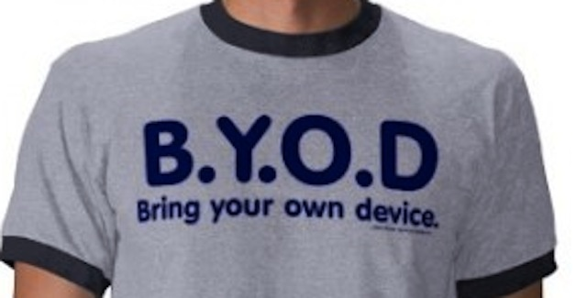
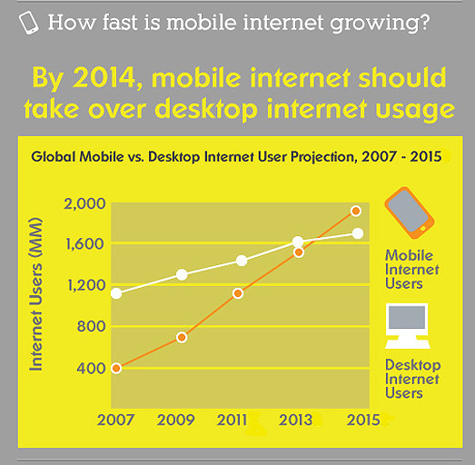
Supporting BYOD
Source: smartinsights.com

Slide 17
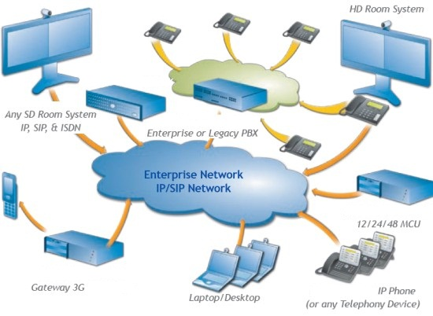
Future: Convergence
Source: VideoCentric Ltd. (2009)

Slide 18



Early Growing Pains
IT Proposes
Microsoft Lync
N702 Conduct Two Sessions on Microsoft Lync Platform
IT evaluates Adobe Connect and Cisco Webex
N702 Conducts Final Two Session on Cisco Webex Platform
IT Reviews the request and analyzes viable solutions
IT Engages N702 Faculty on concerns that Lync does not meet all requirements
Request for Synchronous Learning Platform
Cisco WebEx meets needs for the course’s synchronous learning component

Slide 19
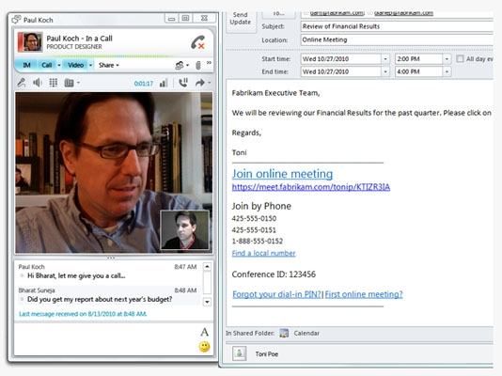
Platform 1: Lync
Session 1 (Jan, 2012)
Session 2 (Feb, 2012)
Requires installed software
Fully integrated audio and video
No per-session cost
Sessions can be initiated by any faculty or staff member
Limited feature support for Mac and mobile
Displays only one attendee video at a time (social presence)
Very limited access for non-SMU community members

Slide 20
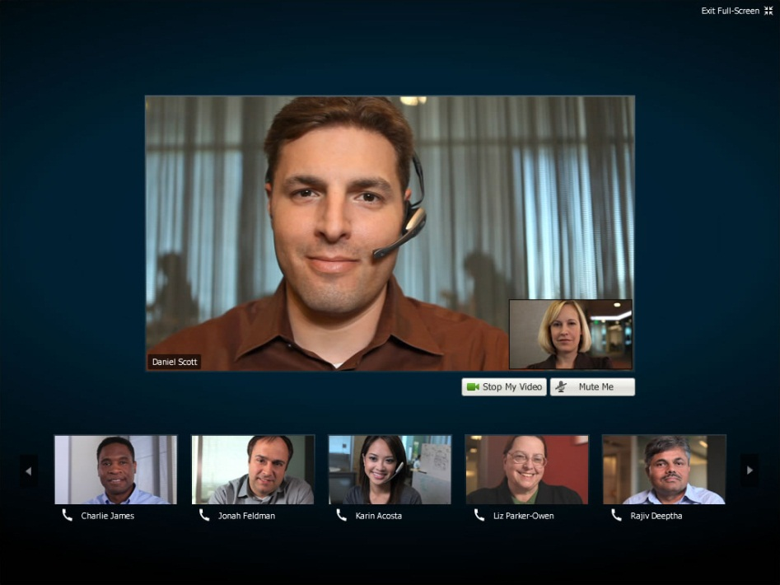
Platform 2: WebEx
Session 3 (NIH Speaker: March 2012)
Session 4 (Students: April 2012)
Web-based
Requires direct-dial phone accessibility
Significant per-session cost
Sessions must be initiated by an administrator
Excellent support for Mac and mobile
Displays multiple attendee video at a time (social presence)
Accessible by any invitee

Slide 21
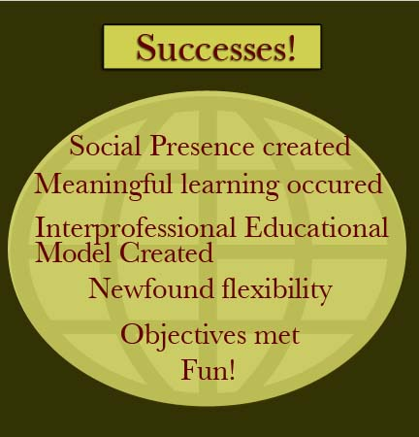

Slide 22
Student comments
It was nice to be face-
to-face
I enjoyed it a lot
I think even with the problems (technical) it helped to feel like a group
I think they (the synchronous sessions) are a helpful addition
I liked it because it gave us a chance to discuss
Thank you for the effort involved in making this synchronous session happen. It was a fabulous addition to the curriculum
I liked talking to and seeing everyone
Even MORE group discussion would be helpful
I liked the sessions!

Slide 23
Student comments
"If people waited to do something until they could do it perfectly, few things would ever get done."

Slide 24
Recommendations
Continue to utilize synchronous on-line sessions in N702 – Health Policy and Advocacy
Encourage the adoption of synchronous learning methods in other on-line graduate courses
Act as a resource (individually and as a team) for other faculty interested in working this new pedagogical approach
Continue to work collaboratively across disciplines to successfully achieve course and institutional learning objectives

Slide 25
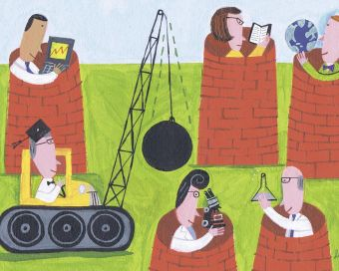

IT
Faculty
Synch
Learning
Students
Instructional Design
NIH Researcher
Thank you…and let’s continue to break out of our silos to create the best learning environments for our students!

Slide 26

Questions

