Slide 1
Cloud Readiness: Preparing for Takeoff
Steve Terry, Denison University
Debbie Carraway, NC State University
Tom Dugas, Duquesne University

Slide 2
ECAR Cloud Series
“Preparing the IT Organization for the Cloud,” will provide a field guide for higher education institutions seeking to develop and implement cloud strategies. Cloud adoption issues will be explored in-depth, allowing CIO’s, CFO’s and IT team leaders to proactively navigate decision-making and change management.
http://www.educause.edu/ecar/ecar-working-groups/cloud
An Introduction (published May 2015)
Developing Cloud-Aware Governance (published June 2015)
Transforming the IT Organization (published September 2015)
Building a Migration Plan (published January 2016)
Operationalizing the Cloud (published May 2016)
Cloud Awareness and User Support – (published August 2016)
Cloud on the Horizon - expected November 2016

Slide 3
What do we mean by Cloud Computing?
“Cloud Computing is a model for ubiquitous, convenient, on-demand network access to a shared pool of configurable resources (e.g., networks, servers, storage, applications, and services) that can be rapidly provisioned and released with minimal management effort or service provider interaction.”
National Institute of Standards and Technology (NIST)

Slide 4
Agenda
Designing IT governance to support the adoption of cloud technologies
Identifying new roles and skills necessary to integrate cloud services into your environment
Understand how to build cloud migration plans by incorporating technical and organizational processes
How to continue the cloud conversation?

Slide 5
Designing IT governance to support the adoption of cloud technologies

Slide 6
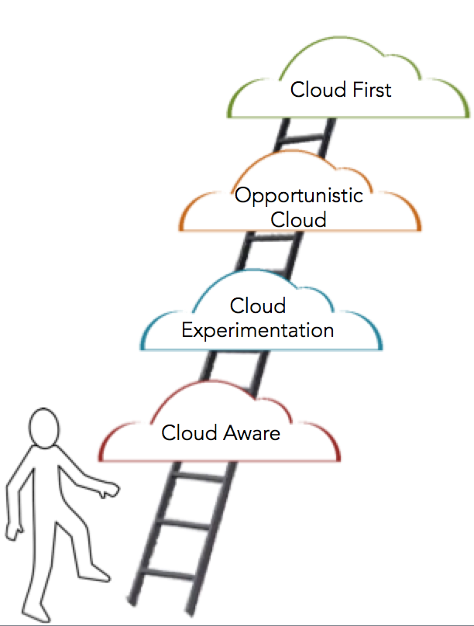
Educate the Organization on Cloud Strategies
Cloud Aware
Aware of broad cloud trends
Not yet prepared to adopt public cloud
But preparing for an eventual move
Cloud Experimentation
Learning about SaaS, PaaS and IaaS
Deploying common SaaS solutions
Testing IaaS deployments
Preparing the IT Organization for the Cloud: Transforming the IT Organization
www.educause.edu/ecar/ecar-working-groups/cloud
Notes:
Cloud aware, cloud experimentation, opportunistic cloud, cloud first

Slide 7
Educate the Organization on Cloud Strategies
Opportunistic Cloud
Seeking out cloud solutions
New services may remain on premises
Choosing cloud when benefits are seen
Cloud First
Cloud at top of decision-making chain
Cloud fulfills majority of needs
Migration planning for legacy services
Preparing the IT Organization for the Cloud: Transforming the IT Organization
www.educause.edu/ecar/ecar-working-groups/cloud
Notes:
Cloud aware, cloud experimentation, opportunistic cloud, cloud first

Slide 8
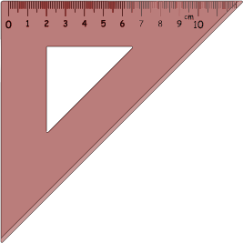
Incorporating Cloud into IT Governance
engage
right-size
ask
review
Preparing the IT Organization for the Cloud: Transforming the IT Organization
www.educause.edu/ecar/ecar-working-groups/cloud
Notes:
Engage stakeholders, right-size governance, ask the right questions, have a cloud review process

Slide 9
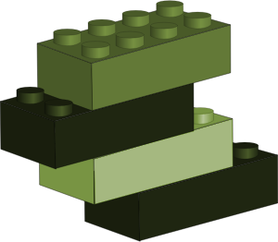
Criteria to consider as part of a
cloud review process
existing services
financial costs
staff effort
Preparing the IT Organization for the Cloud: Transforming the IT Organization
www.educause.edu/ecar/ecar-working-groups/cloud
Notes:
Review existing services, financial costs, staff effort

Slide 10
Criteria to consider as part of a
cloud review process
business process changes
exit strategy
Preparing the IT Organization for the Cloud: Transforming the IT Organization
www.educause.edu/ecar/ecar-working-groups/cloud
Notes:
Account for business process changes, exit strategy

Slide 11
Criteria to consider as part of a
cloud review process
accessibility
data sensitivity
security & compliance
Preparing the IT Organization for the Cloud: Transforming the IT Organization
www.educause.edu/ecar/ecar-working-groups/cloud
Notes:
Address accessibility, data sensitivity, and security and compliance

Slide 12
Discussion Questions
Has cloud changed your IT governance?
Would you consider your organization cloud-aware? Do they know what opportunities and challenges the cloud presents?
How does the pace of change that the cloud brings impact your decision-making processes? Are changes needed?

Slide 13
Identifying new roles and skills necessary to integrate cloud services into your environment

Slide 14
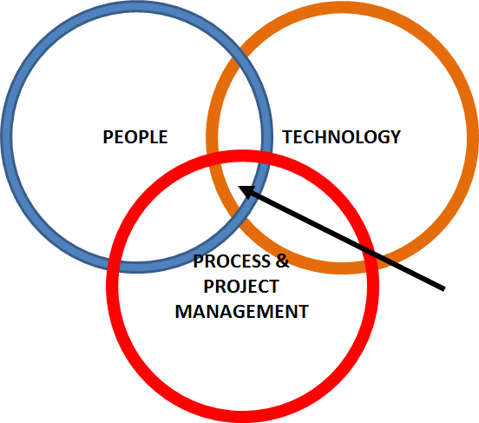
Staffing for the Cloud at the Intersection
CLOUD STAFFING SKILLS
Notes:
People, technology, process & project management, intersection of Venn diagram is cloud staffing skills

Slide 15
Evolving Roles to Support the Cloud
Business Roles
Business Analyst
IT Liaison
Product Manager
Manager of Cloud Technology Support
Vendor Management Roles:
IT Strategic Sourcing Manager
Vendor Manager
Cloud Engagement Manager
Technical Roles
Application Administrator
Cloud Architect
Emerging Technologies Analyst/Specialist
Integration Specialist
Cloudification Engineer
Data Roles:
Data Custodian
Information Security Analyst

Slide 16
Discussion Questions
Have you seen roles at your organization change to accommodate moving to the cloud?
What skills have you found are needed to support cloud computing adoption?
How do you think cloud computing will change your staffing levels? Will you lose staff? Add staff? Keep staffing the same?

Slide 17
Understand how to build cloud migration plans by incorporating technical and organizational processes

Slide 18
Cloud Migration Strategy Considerations
Operational Process: | Cloud Migration Strategy Considerations:
Supplier Management | Build new methods to manage vendor risk, contracts, and TCO assessments
Service Testing and Validation | Understand how to build test and validation plans when you don’t own the environment. Ensure resiliency with the cloud solution.
Release and Deployment Management | Cloud vendors can vary and offer vendor initiated updates or automatic servicewide updates. How does this impact your business and organization?
Incident/Problem Management | Where do your users go for support and help? How does your support team escalate tickets?

Slide 19
Cloud Migration Strategy Considerations
Technical Processes: | Cloud Migration Strategy Considerations:
Authentication and Authorization | What mechanisms are supported and what does your organization offer? (SAML, CAS, AD/ADFS, Etc.)
Integration and Interfaces | Does the cloud service need resources from systems in your data center or in other cloud solutions? If so, what ways can you build, manage and monitor the interfaces and integrations.
Updating and Patch Management | Are you responsible for updates and patch management or is that the vendor’s responsibility? How do you keep them accountable?
Data Management | Where is your data? What controls are in place? and How do you ensure protection?
Information Security | What happens in an information security breach? Who is responsible for what?

Slide 20
Discussion Questions
Have you seen cloud change the way your organizational and technical processes function?
Do you see the cloud making it easier or harder on your processes currently supporting in-house systems and functions?
Is your organization developing a cloud strategy? Were there any lessons you learned that you would share?

Slide 21
Continuing the Cloud Conversation
Educause Cloud Computing Constituent Group:
http://www.educause.edu/discuss/constituent-groups-about-information-technology-management-and-leadership/cloud-computing-constituent-group
ECAR Cloud Working Group and Cloud Resources:
http://www.educause.edu/ecar/ecar-working-groups/cloud

Slide 22
Help Us Improve and Grow
Thank you for participating
in today’s session.
We’re very interested in your feedback. Please take
a minute to fill out the session evaluation found within
the conference mobile app, or the online agenda.

Slide 23
CCCG Survey: Needing assistance with Cloud Services

Slide 24
CCCG Survey: What are some of the biggest barriers your institution faces, with regards to cloud adoption? (47 responses)
Security and Privacy (18)
Cloud Costs / Funding (16)
Business Processes Impacts (13)
Data Integration / Control (11)
IT Staffing / Personnel (10)
Network Redundancy / Speed (8)
Lack of Migration Planning (7)
CAPEX – OPEX Cost Shifts (6)
Exit Strategy / Contracts (6)
Impacts to local chargeback model (5)
Cloud Vendor readiness (5)
“misguided attempts to justify cloud using ROI”
“gaps between some categories of cloud vendors feature sets and the enterprise/distributed environment needs of higher-ed (base features are good but hard to adopt at scale)”
“The people who need to work to bridge on premise and cloud do not understand it”

Slide 25
CCCG: Survey: What are some of the successes surrounding the adoption of cloud services at your institution? (45 responses)
SaaS Implementations (43)
Ease / Speed of Deployment (10)
IaaS/PaaS- (AWS, Azure, SF) (8)
Shift in IT Resources (8)
Disaster Recovery (5)
Stability of Service (5)
End-User Happiness (2)
Reduction in Costs (2)
Increased Services to Students (2)
“Central IT's customers becoming self-sufficient by leasing virtual machines just in time from AWS”
“Great implementation of IaaS at department and research lab/group levels to provide flexibility, cost savings, agility and scale that would have been difficult in on-prem models”
“Deployment of enterprise research administration system in IaaS cloud”

