Slide 1
Security Professionals Conference 2018
Security and Privacy Professionals:
“All Hands on Deck”
Promoting Enterprise Risk Management (ERM) and
Governance, Risk and Compliance (GRC) for
Managing Cybersecurity Risks
Peter J. Murray, PhD
Chief Information Officer and
Vice President for Information Technology
Roger J. Ward, EdD, JD, MPA
Senior Vice President for Operations and Institutional Effectiveness and
Vice Dean of the Graduate School

Slide 2
This presentation leaves copyright of the content to the presenter. Unless otherwise noted in the materials, uploaded content carries the Creative Commons Attribution-NonCommercial-ShareAlike license, which grants usage to the general public with the stipulated criteria.

Slide 3


Who We Are and What We Do
Dr. Roger J. Ward
Senior Vice President for Operations Chief Information Officer and
and Institutional Effectiveness and Vice President for Information
Vice Dean of the Graduate School Technology
ERM, Accountability, Compliance IT GRC, IT Security & Compliance
Dr. Peter J. Murray
Notes:
ROGER AND PETER INTRODUCE THEMSELVES
Dr. Roger J. Ward is the senior vice president for operations and institutional effectiveness and vice dean of the Graduate School at the University of Maryland, Baltimore (UMB). As CAO and vice president, Dr. Ward directs a portfolio of departments and initiatives that promote institutional effectiveness and assure accountability. He has primary responsibility for strategic planning, enterprise risk management, and institutional research.
Dr. Peter J. Murray is the Chief Information Officer and Vice President for Information Technology for the University of Maryland, Baltimore (UMB). Dr. Murray is responsible for overseeing and coordinating campus-wide information technology planning, including IT risk and IT security planning. He has served on the Educause IT Governance, Risk and Compliance (GRC) Program Advisory Committee and is a past co-chair of the Higher Education Information Security Council (HEISC).

Slide 4
Presentation Roadmap
About UMB
Scope and scale of cybersecurity threat
Enterprise approach to managing the cybersecurity threat
Enterprise Risk Management (ERM)
Governance, Risk, and Compliance Framework (GRC)
Lessons learned
Takeaways
Notes:
ROGER’S SLIDE

Slide 5


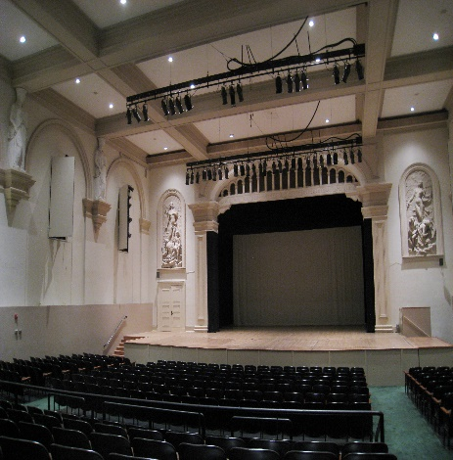



The official travel website for Baltimore:
http://baltimore.org/
Notes:
ROGER’S SLIDE
On behalf of the University of Maryland, Baltimore, welcome to Baltimore.
It's a city that has something for everyone.
For example, if you're major league baseball fan, the Baltimore Orioles are playing the Toronto Blue Jays tonight at 7:05PM.
On the other hand, if you're more into music than sports, the Peabody Wind Ensemble in playing tonight at 7:30 p.m. at the Friedberg Concert Hall.
Others of you may just want to enjoy the Baltimore Harbor and enjoy the city's many fine dining options.
The official travel website for Baltimore, http://baltimore.org/ is a good source for things to do.

Slide 6
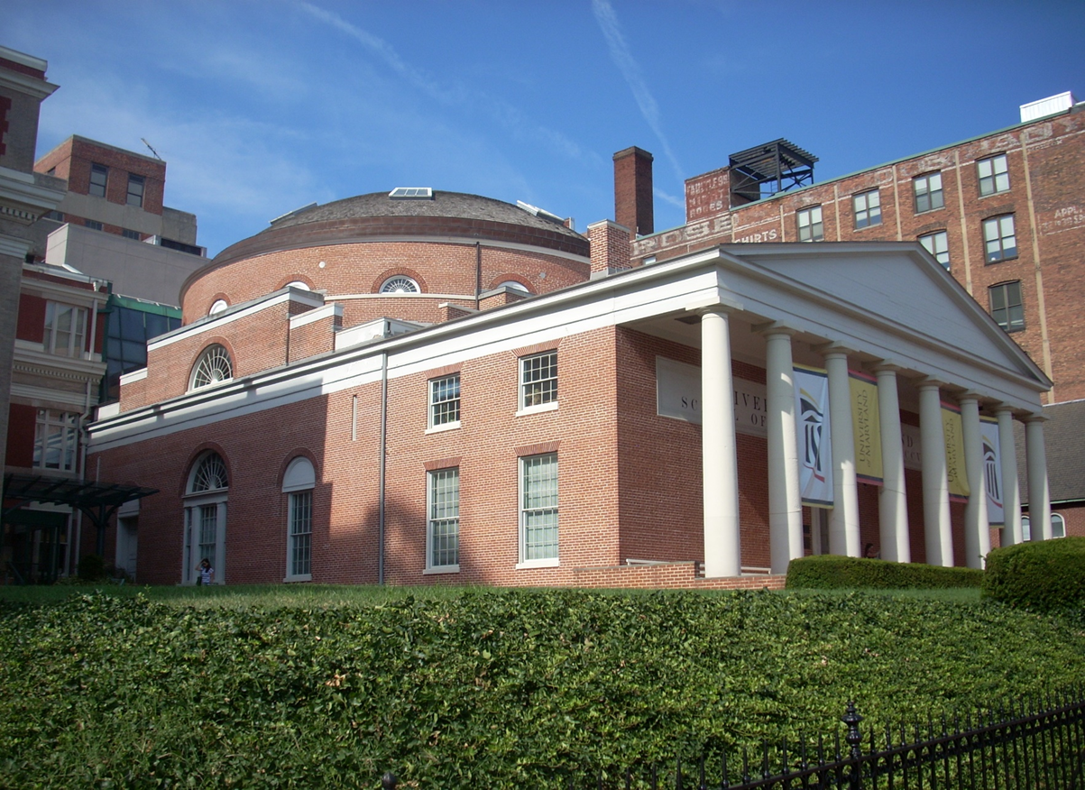
About UMB
UMB is the founding campus (1807) of the University System of Maryland
Mission: To improve the human condition and serve the public good of Maryland and society at-large through education, research, clinical care and service
Schools: Dentistry, Graduate, Law, Medicine, Nursing, Pharmacy & Social Work
Students: 6,703
  Graduate and Professional: 86%
  Undergraduate: 14%
  Full-time: 77%; Part-time: 23%
Employees (includes faculty): 7,360
  Full-time: 71%; Part-time: 29%
  Faculty: 2,839
Annual Budget: ~$1B
Grants and Contracts: ~$556k
Notes:
ROGER’S SLIDE

Slide 7

An Academic Health, Law and Human Services University
Education, Research and Patient Care
Protected Health Information
Personally Identifiable Information
Confidential Research, Business and Academic Data
Notes:
ROGER’S SLIDE
UMB enrolls 6,700 students in six nationally ranked professional schools — dentistry, law, medicine, nursing, pharmacy, and social work — and an interdisciplinary Graduate School.
The University offers 62 doctoral, master’s, baccalaureate, and certificate programs and confers most of the professional practice doctoral degrees awarded in Maryland.
UMB is a thriving academic health center combining cutting-edge biomedical research and exceptional patient care. UMB’s extramural funding totaled $556 million in FY 2017, and each tenured/tenure-track faculty member brings over $1 million in research grants, on average, into UMB every year.
The University of Maryland BioPark, Baltimore’s biggest biotechnology cluster, fuels the commercialization of new drugs, treatments, and devices, giving 900 scientists and entrepreneurs the space to create and collaborate.
We're also proud of our Global Health Initiatives, with sites around the world
The security of all of these activities and information – makes cybersecurity in health-related contexts more than just an abstract matter to us.

Slide 8
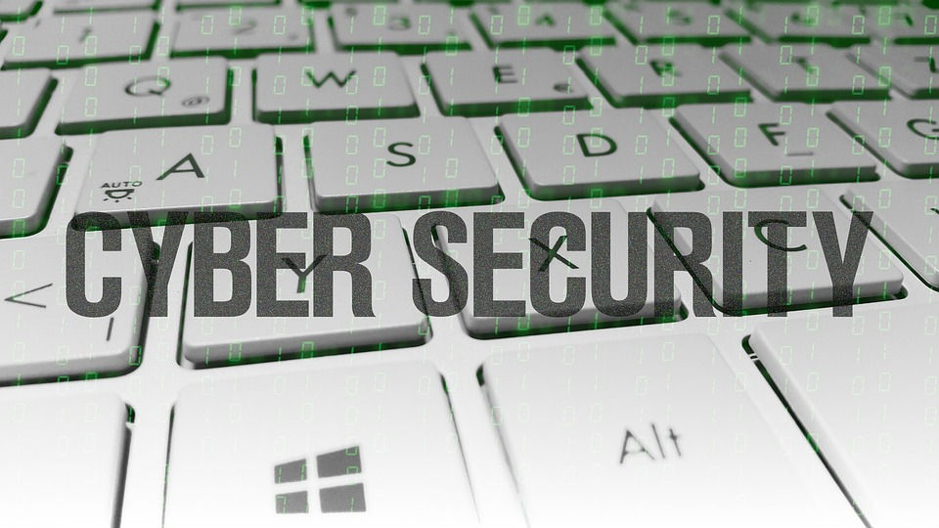
So Why Are We Giving This Presentation
What it Means to the University
It is critically important to us; an institutional priority
It is strategic to the institution since it affects all of the missions of
the institution: Education, Research, Clinical Care
It is a key element in our IT GRC and ERM programs
It is not "just another worry," one area (out of many) that we are ultimately responsible for managing
Notes:
ROGER’S SLIDE
Cybersecurity today
Critical institutional priority
IT Security Program is Strategic to the institution
Affects the Missions of the institution: Education, Research, Clinical Care
Touches all areas of the institution
IT Security Risks must be included as a key element in an enterprise risk management program
Cybersecurity is not "just another worry," one area (out of many) that we are ultimately responsible for
Cybersecurity requires “all hands on deck”, including individuals from all levels of the University

Slide 9

Cyber Attacks: Scale & Scope in Higher Education
Higher education provides a treasure chest of valuable data for cyber attackers
Over 24 million records have been breached in higher education institutions since 2005; over 8 million since 2015¹
Higher education was the 3rd most breached sector, accounting for 10% of all data breaches reported in 2015²
1 Privacy Rights Clearinghouse, Data Breaches
2 Symantec Internet Security Threat Report, Vol. 20, April 2015
Notes:
PETER’S SLIDE
Higher education provides a treasure chest of high value in formation for cyber attackers. With everything from Social Security numbers and medical records to financial data and intellectual property within a single institution, it’s imperative that institutions protect critical data by anticipating, recognizing, and mitigating attacks.
According to an EdTech magazine report, 1.35 million personal identities were exposed to hackers in the education sector in 2015.
Higher education accounts for 17 percent of all data breaches where personal information is stolen, with only the medical sector being victimized at a higher rate.
Data Breach 101: Cyber Security Issues in Higher Education, by Carlos Soto in March 2016 wrote above statement
since 2005, higher education institutions have been the victim of 539 breaches involving nearly 13 million known records. (Charles Harris and Laura Hammargen, in University Business, September 2016)

Slide 10
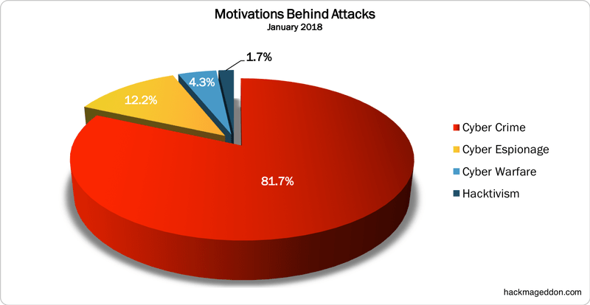
Cyber crime damage costs to hit $6 trillion annually by 2021¹
The average cost of a data breach for US companies is $217 for each compromised record ($225 for higher education) and the total average cost is $6.5 million²
1 Steve Morgan, CSO from IDG, Cybersecurity Business Report, Top 5 Cybersecurity facts, figures and statistics for 2018, January 2018
2 Ponemon Institute Research Report, 2015 Cost of Data Breach Study: United States, May 2015
Notes:
PETER’S SLIDE
This beginning of 2018 opens exactly the same way as 2017. Cyber Crime opens the new year on top of the Motivations Behind Attacks chart with 81.7% (it was 84.6% in December 2017). Cyber Espionage grows to 12.2% from 9.9%. It is interesting to notice also the 4.3 achieved by Cyber Warfare (it was 1.1% in December) and due by the wave of DDoS attacks against Dutch banks and institutions. from 13.1%. The chart is closed by Hacktivism with a tiny 1.7% (it was 4.4% in December.
Cyber crime damage costs to hit $6 trillion annually by 2021.
Cybersecurity spending to exceed $1 trillion from 2017 to 2021
Cyber crime will more than triple the number of unfilled cybersecurity jobs, which is predicted to reach 3.5 million by 2021.
Human attack surface to reach 6 billion people by 2022.
Global ransomware damage costs are predicted to exceed $5 billion in 2017. That's up from $325 million in 2015 — a 15X increase in two years and expected to worsen. Ransomware attacks on healthcare organizations — the No. 1 cyber-attacked industry — will quadruple by 2020
Steve Morgan, from CSO from IDG in his Cybersecurity Business Report , January 23, 2018, “Top 5 cybersecurity facts, figures and statistics for 2018”
The financial consequence of a cyber attack is worsening
According to the 2015 Cost of Data Breach Study conducted by Ponemon Institute, the average cost of a data breach for US companies is $217 for each compromised record ($225 for higher education) and the total average cost is $6.5 million. (Charles Harris and Laura Hammargen, in University Business, September 2016)
Malware and Web-based attacks are the two most costly attack types.

Slide 11
Evolution of the Cyber Security and
Threat Environment
INTRUSION DETECTION AND PREVENTION
Malicious
Connection
Attempts
UMB
Intrusion Detection/
Prevention
System
Blocked at Our Network Gateway to the Internet
Over 20 Million Per Day!!!
Notes:
PETER’S SLIDE
We are not immune….
There are over 20 million attempts to get unauthorized access to UMB systems every day (as logged by our intrusion prevention system)

Slide 12
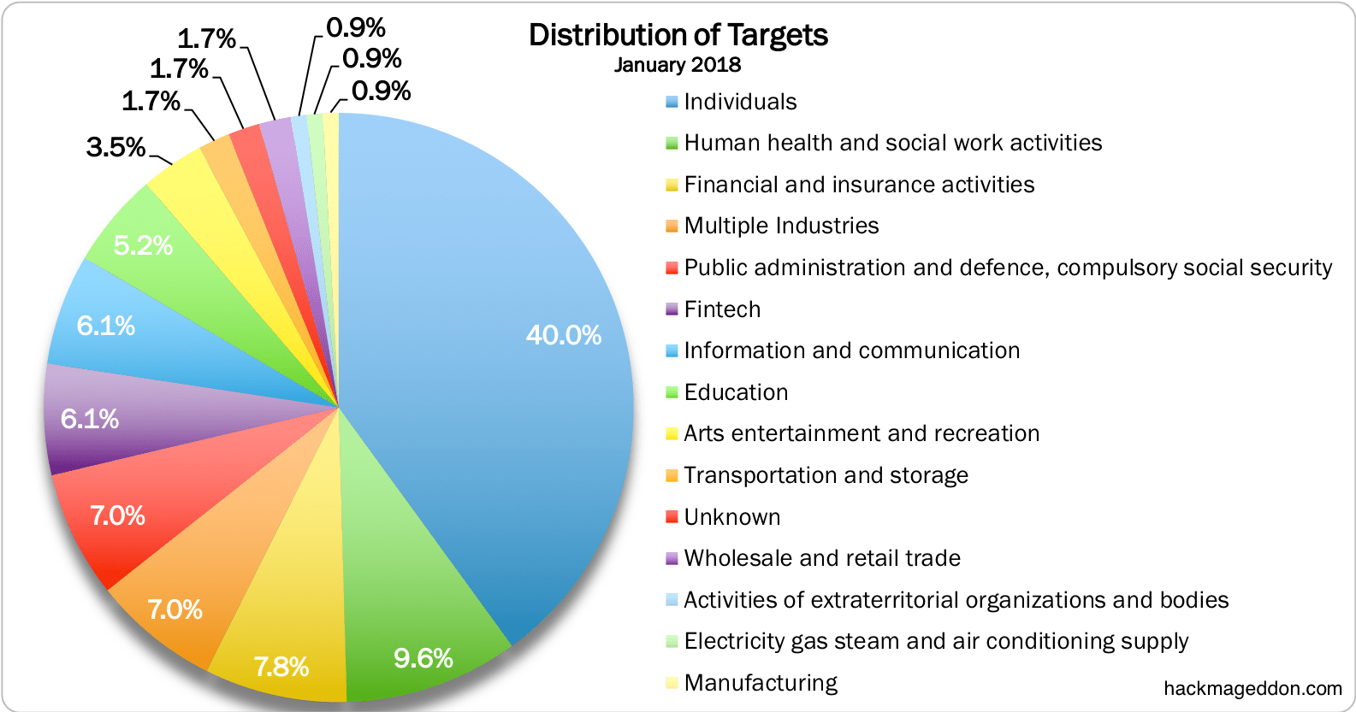
Single individuals lead with 40%!
Notes:
PETER’S SLIDE
Focus on technology --- yes, and also focus on individuals, which means policy and education
And in the next chart (the Distribution of Targets) you may notice the new taxonomy. Similarly to December, single individuals lead the Distribution of Targets chart with 40% (it was 36.3% in December). A direct comparison with the other targets is not completely possible even if ‘Human health and social work activities’ rank at number two with 9.6%, similarly to what happened in December when the same position was taken by healthcare with 11%.

Slide 13

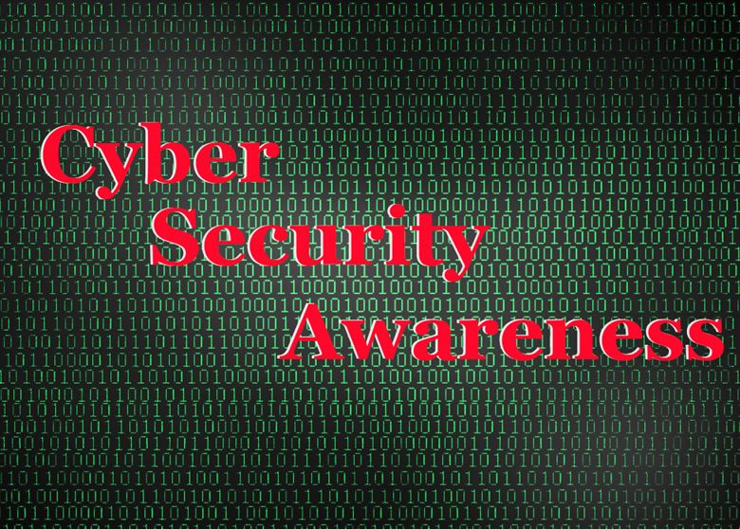
Raising Awareness of Basic Cybersecurity Hygiene
Malicious emails
Email phishing, malware
Incoming email, 20% “clean”
Individuals are targets!!
1 Educause Higher Education Security Council survey results, 2014.
Nearly 1/3 of breaches are the result of “unintentional disclosure”¹
Preventable!!
Notes:
PETER’S SLIDE
What makes these breaches more alarming is that many of them are easily preventable. According to the same EdTech article, nearly a third of these breaches, 30 percent, were the result of “unintentional disclosure” like phishing attacks, improper use of social media, and so forth. Only 36 percent were the result of actual hacking.
Raising awareness of basic cybersecurity hygiene among the full spectrum of IT users: staff, faculty and students.
Symantec’s 2017 Internet Security Threat Report
Malicious emails were the weapon of choice for a wide range
of cyber attacks during 2016, used by everyone from state sponsored cyber espionage groups to mass-mailing ransomware gangs. One in 131 emails sent were malicious, the highest rate in five years.

Slide 14
Potential Impact of Cyber Attacks
Reputation
May harm the University’s reputation in the eyes of alumni, students, partners, businesses, and government agencies
Legal
May leave the University in violation of laws or contract requirements
Risk of prosecution, financial penalties, or withdrawal of existing and future funding
Economic
May undermine the University’s ability to capitalize on potential intellectual property or knowledge transfer
Operational
May disrupt normal operations and result in significant remedial cost
Notes:
ROGER’S SLIDE

Slide 15

Cybersecurity and Compliance
Overwhelming amount of work for IT security staff to manage risks, identify threats, prevent attacks, address vulnerabilities, and protect data assets
Cybersecurity requires “all hands on deck”, including individuals from all areas and levels of the University
Notes:
ROGER’S SLIDE
Overwhelming amount of work for IT security staff to manage risks, identify threats, prevent attacks, address vulnerabilities, and
protect data assets

Slide 16




GRC and ERM Frameworks
Governance, Risk, and Compliance Framework
  A structure that an institution uses for governance, risk and
compliance initiatives
  A means for establishing governance, identifying and assessing
  risks, and achieving compliance
  Integrated, collaborative approach for producing desired
  results. It breaks down silos so that a single united solution
  can be implemented
Enterprise, Risk, Management Framework
  A method and process for minimizing unexpected volatility
through the assessment of risks across every function
  Includes identifying and evaluating risks, and developing
  mitigation strategies
  Shares the same end goal as GRC: the continued achievement
of the institution’s goals and objectives
Notes:
ROGER’S SLIDE
Governance, Risk and Compliance
GRC is really a philosophy and a framework for communicating around governance and compliance issues. The traditional approach involves classifying GRC components as their own sets of processes. This means each component –risk, compliance, and each governance function, such as audit, IT security, and policy management – is treated as its own silo, with its own subject-matter experts, and managers. More recently, GRC programs have begun to diverge from the traditional siloed approach. An enterprise approach (“eGRC”) keeps the overall program more in line with enterprise risk management solutions, which aim to break down silos and eliminate redundancies and other inefficiencies.
Enterprise Risk Management
The objective of ERM is to minimize the unexpected volatility. Through adoption of an ERM framework and process, institutions are freed up to look at the risks worth taking.
Enterprise risk management (ERM) has matured as a discipline within higher education.
Colleges and universities are subject to risks to their physical assets, people assets, and cyber assets.
The impact of risks can be strategic, operational, legal, financial, or reputational. Information technology
on campus, especially enterprise systems and information security, is emerging as an important area
for risk assessment and treatment. Cloud computing, mobile devices, and social media present new
challenges and opportunities.
Enterprise risk management, or ERM, is a business discipline that shares the same end goal as GRC: the continued achievement of the institution’s goals and objectives. ERM’s main distinction from GRC is the fact that it encompasses all areas of organizational exposure to risk (financial, operational, reporting, compliance, governance, strategic, reputational, etc.).
Enterprise risk management addresses every function, including governance and compliance, and boils it down to a common framework approach. This common framework includes the identification and assessment of a series of goals, requirements, and risks, which are the common denominator of every organizational silo. It then helps document mitigation strategies and lets the subject matter expert monitor their effectiveness. By doing this, ERM programs encourage the development of an enterprise-wide risk culture. Some risks have cross-functional implications, which means that certain mitigation activities can have benefits for more than one department.
How many of you have a Governance, Risk and Compliance program at your institution? An IT GRC program that helps support your Cybersecurity program?
How many of you have an Enterprise Risk Management program at your institution?

Slide 17

Enterprise Risk Management (ERM)
A RISK is any issue that impacts an organization's ability to meet its objectives
ERM is a senior leadership driven initiative that seeks to integrate risk management practices throughout the organization in order to address uncertainty and risk while enhancing the ability to achieve organizational objectives (COSO, 2004, p. 16; Hoyt & Liebenberg, 2003, p. 37)
Notes:
ROGER’S SLIDE
Overview
Enterprise risk management (ERM) is continuing to mature and be implemented in higher education institutions.
In 2003, Felix Kloman, founder and editor of Risk Management Reports, said that in the future institutions will look at risks affecting the whole of an organization and they will be enterprise-wide, integrated and holistic. ¹
In 2013, Janice M. Abraham, President and CEO of United Educators, says the future is here for enterprise risk management. ¹
Colleges and universities are assessing risks associated with physical assets, people assets, and cyber assets.
¹ “Good Risk Management Is Good Governance” an article excerpted from Risk Management: An Accountability Guide for University and College Boards (AGB Press, 2013), by Janice M. Abraham.
Sponsored and led by the President;
It is a process effected by an organization’s leadership;
Developed and managed at the ‘enterprise’ level with all key academic and business areas included;
Designed to identify and mitigate risks that would impact strategic objectives;
Provides a framework for determining risk tolerance, developing mitigating strategies, and allocating resources.
From your perspective, what is ERM?
Enterprise-wide risks
Led and supported by the President, Senior Leadership
Process rather than a project
Only those areas and items that can’t be addressed by the operating or capital budget.
How does it differ from enterprise IT risk management?
Which focuses on IT only
What are your experiences and lessons learned with ERM?
Eg., Focus on key risks
What would your recommendations be to university leaders who are about to implement ERM at their institutions?
What should they consider, what are some guidelines and expectations?
Initially, low level operational items
Eventually, as the process develops, more strategic items
The process goes through cycles
What would you recommend to a CISO or CIO regarding their role with ERM?
How do they get the IT risks into the ERM process and mitigation activities?
How do they get those priority risks that keep them up at night on the radar of the ERM executive committee?
How does ERM differ between large and small institutions?
What recommendations would you have for those CISOs work in a university where IT is distributed across the institution and for those CIOs that don’t sit at the executive table?
How do they get enterprise-wide buy-in to mitigate risks?
Closing words of wisdom for the audience?
From your perspective, what is ERM and why is it important? What are some examples of
enterprise-wide risks?
2. How does it differ from Enterprise IT Risk Management (which focuses on IT only)?
3. What are your experiences and lessons learned with ERM?
a. E.g., focus on key risks
4. What would your recommendations be to university leaders who are about to implement ERM
at their institutions?
a. What should they consider? What are some guidelines and expectations?
5. What would you recommend to a CISO or CIO regarding their role with ERM?
a. How do they get the IT risks into the ERM process and mitigation activities?
b. How do they get those priority risks that keep them up at night on the radar of the ERM
executive committee?
6. How does ERM differ between large and small institutions? Private v. state?
a. What recommendations would you have for those CISOs working in a university where
IT is distributed across the institution and for those CIOs that don’t sit at the executive
table?
b. How do they get enterprise-wide buy-in to mitigate risks?
7. What was the impetus or how did your institution form its ERM? (panelists)
8. Executive support? Sponsorship?
9. Who chairs ERM?
10. Membership representation?
11. What are some of the key initiatives? Current issues?
12. What are the costs involved campus-wide?
13. What if a campus doesn’t have a “risk officer” or an ERM process?
14. Who are the players on campus with respect to risk management (e.g., risk officer, legal, CFO,
public safety, emergency managers, environmental health and safety, athletics, student affairs,
etc.)
15. How do you get IT risks into the discussions about enterprise risks? How do you position the
protection of “cyber assets” alongside risks to “people” and “facilities” (i.e., an “all-hazards”
approach)
16. What about decisions (or risks) to purchasing and implementing major enterprise systems (i.e.,
student, financial, human resources, learning management, research, etc.) that might include
options of community source, cloud-sourced, or commercial products and services?
17. Closing words of wisdom for the audience?

Slide 18
Enterprise Risk Management (ERM)
It is a process initiated and effected by an organization’s leadership
Developed and managed at the ‘enterprise’ as opposed to the unit or operational level
Designed to identify and mitigate risks that would impact strategic objectives, and
Provides a framework for determining risk tolerance, developing mitigating strategies, and allocating resources
Notes:
ROGER’S SLIDE
Overview
Enterprise risk management (ERM) is continuing to mature and be implemented in higher education institutions.
In 2003, Felix Kloman, founder and editor of Risk Management Reports, said that in the future institutions will look at risks affecting the whole of an organization and they will be enterprise-wide, integrated and holistic. ¹
In 2013, Janice M. Abraham, President and CEO of United Educators, says the future is here for enterprise risk management. ¹
Colleges and universities are assessing risks associated with physical assets, people assets, and cyber assets.
¹ “Good Risk Management Is Good Governance” an article excerpted from Risk Management: An Accountability Guide for University and College Boards (AGB Press, 2013), by Janice M. Abraham.
Sponsored and led by the President;
It is a process effected by an organization’s leadership;
Developed and managed at the ‘enterprise’ level with all key academic and business areas included;
Designed to identify and mitigate risks that would impact strategic objectives;
Provides a framework for determining risk tolerance, developing mitigating strategies, and allocating resources.
From your perspective, what is ERM?
Enterprise-wide risks
Led and supported by the President, Senior Leadership
Process rather than a project
Only those areas and items that can’t be addressed by the operating or capital budget.
How does it differ from enterprise IT risk management?
Which focuses on IT only
What are your experiences and lessons learned with ERM?
Eg., Focus on key risks
What would your recommendations be to university leaders who are about to implement ERM at their institutions?
What should they consider, what are some guidelines and expectations?
Initially, low level operational items
Eventually, as the process develops, more strategic items
The process goes through cycles
What would you recommend to a CISO or CIO regarding their role with ERM?
How do they get the IT risks into the ERM process and mitigation activities?
How do they get those priority risks that keep them up at night on the radar of the ERM executive committee?
How does ERM differ between large and small institutions?
What recommendations would you have for those CISOs work in a university where IT is distributed across the institution and for those CIOs that don’t sit at the executive table?
How do they get enterprise-wide buy-in to mitigate risks?
Closing words of wisdom for the audience?
From your perspective, what is ERM and why is it important? What are some examples of
enterprise-wide risks?
2. How does it differ from Enterprise IT Risk Management (which focuses on IT only)?
3. What are your experiences and lessons learned with ERM?
a. E.g., focus on key risks
4. What would your recommendations be to university leaders who are about to implement ERM
at their institutions?
a. What should they consider? What are some guidelines and expectations?
5. What would you recommend to a CISO or CIO regarding their role with ERM?
a. How do they get the IT risks into the ERM process and mitigation activities?
b. How do they get those priority risks that keep them up at night on the radar of the ERM
executive committee?
6. How does ERM differ between large and small institutions? Private v. state?
a. What recommendations would you have for those CISOs working in a university where
IT is distributed across the institution and for those CIOs that don’t sit at the executive
table?
b. How do they get enterprise-wide buy-in to mitigate risks?
7. What was the impetus or how did your institution form its ERM? (panelists)
8. Executive support? Sponsorship?
9. Who chairs ERM?
10. Membership representation?
11. What are some of the key initiatives? Current issues?
12. What are the costs involved campus-wide?
13. What if a campus doesn’t have a “risk officer” or an ERM process?
14. Who are the players on campus with respect to risk management (e.g., risk officer, legal, CFO,
public safety, emergency managers, environmental health and safety, athletics, student affairs,
etc.)
15. How do you get IT risks into the discussions about enterprise risks? How do you position the
protection of “cyber assets” alongside risks to “people” and “facilities” (i.e., an “all-hazards”
approach)
16. What about decisions (or risks) to purchasing and implementing major enterprise systems (i.e.,
student, financial, human resources, learning management, research, etc.) that might include
options of community source, cloud-sourced, or commercial products and services?
17. Closing words of wisdom for the audience?

Slide 19
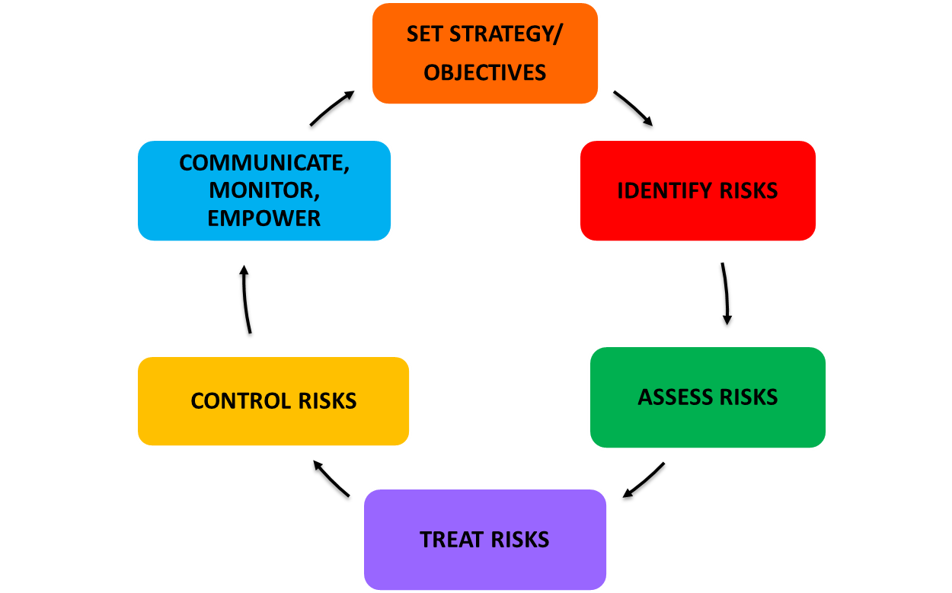
The ERM Cycle
Notes:
ROGER’S SLIDE
Overview
Enterprise risk management (ERM) is continuing to mature and be implemented in higher education institutions.
In 2003, Felix Kloman, founder and editor of Risk Management Reports, said that in the future institutions will look at risks affecting the whole of an organization and they will be enterprise-wide, integrated and holistic. ¹
In 2013, Janice M. Abraham, President and CEO of United Educators, says the future is here for enterprise risk management. ¹
Colleges and universities are assessing risks associated with physical assets, people assets, and cyber assets.
¹ “Good Risk Management Is Good Governance” an article excerpted from Risk Management: An Accountability Guide for University and College Boards (AGB Press, 2013), by Janice M. Abraham.
Sponsored and led by the President;
It is a process effected by an organization’s leadership;
Developed and managed at the ‘enterprise’ level with all key academic and business areas included;
Designed to identify and mitigate risks that would impact strategic objectives;
Provides a framework for determining risk tolerance, developing mitigating strategies, and allocating resources.
From your perspective, what is ERM?
Enterprise-wide risks
Led and supported by the President, Senior Leadership
Process rather than a project
Only those areas and items that can’t be addressed by the operating or capital budget.
How does it differ from enterprise IT risk management?
Which focuses on IT only
What are your experiences and lessons learned with ERM?
Eg., Focus on key risks
What would your recommendations be to university leaders who are about to implement ERM at their institutions?
What should they consider, what are some guidelines and expectations?
Initially, low level operational items
Eventually, as the process develops, more strategic items
The process goes through cycles
What would you recommend to a CISO or CIO regarding their role with ERM?
How do they get the IT risks into the ERM process and mitigation activities?
How do they get those priority risks that keep them up at night on the radar of the ERM executive committee?
How does ERM differ between large and small institutions?
What recommendations would you have for those CISOs work in a university where IT is distributed across the institution and for those CIOs that don’t sit at the executive table?
How do they get enterprise-wide buy-in to mitigate risks?
Closing words of wisdom for the audience?
From your perspective, what is ERM and why is it important? What are some examples of
enterprise-wide risks?
2. How does it differ from Enterprise IT Risk Management (which focuses on IT only)?
3. What are your experiences and lessons learned with ERM?
a. E.g., focus on key risks
4. What would your recommendations be to university leaders who are about to implement ERM
at their institutions?
a. What should they consider? What are some guidelines and expectations?
5. What would you recommend to a CISO or CIO regarding their role with ERM?
a. How do they get the IT risks into the ERM process and mitigation activities?
b. How do they get those priority risks that keep them up at night on the radar of the ERM
executive committee?
6. How does ERM differ between large and small institutions? Private v. state?
a. What recommendations would you have for those CISOs working in a university where
IT is distributed across the institution and for those CIOs that don’t sit at the executive
table?
b. How do they get enterprise-wide buy-in to mitigate risks?
7. What was the impetus or how did your institution form its ERM? (panelists)
8. Executive support? Sponsorship?
9. Who chairs ERM?
10. Membership representation?
11. What are some of the key initiatives? Current issues?
12. What are the costs involved campus-wide?
13. What if a campus doesn’t have a “risk officer” or an ERM process?
14. Who are the players on campus with respect to risk management (e.g., risk officer, legal, CFO,
public safety, emergency managers, environmental health and safety, athletics, student affairs,
etc.)
15. How do you get IT risks into the discussions about enterprise risks? How do you position the
protection of “cyber assets” alongside risks to “people” and “facilities” (i.e., an “all-hazards”
approach)
16. What about decisions (or risks) to purchasing and implementing major enterprise systems (i.e.,
student, financial, human resources, learning management, research, etc.) that might include
options of community source, cloud-sourced, or commercial products and services?
17. Closing words of wisdom for the audience?

Slide 20
The Benefits of ERM
Improves management of known risks that may prevent the organization from accomplishing its mission and goals
Reduces duplication of effort on key activities across operational units
Enhances the coordination of activities and communication across operational units
Improves regulatory compliance
Reduces operational losses and surprises
Integrates risk management with business planning and strategy setting
Protects reputation and brand
Creates a risk aware culture
Notes:
ROGER’S SLIDE
Overview
Enterprise risk management (ERM) is continuing to mature and be implemented in higher education institutions.
In 2003, Felix Kloman, founder and editor of Risk Management Reports, said that in the future institutions will look at risks affecting the whole of an organization and they will be enterprise-wide, integrated and holistic. ¹
In 2013, Janice M. Abraham, President and CEO of United Educators, says the future is here for enterprise risk management. ¹
Colleges and universities are assessing risks associated with physical assets, people assets, and cyber assets.
¹ “Good Risk Management Is Good Governance” an article excerpted from Risk Management: An Accountability Guide for University and College Boards (AGB Press, 2013), by Janice M. Abraham.
Sponsored and led by the President;
It is a process effected by an organization’s leadership;
Developed and managed at the ‘enterprise’ level with all key academic and business areas included;
Designed to identify and mitigate risks that would impact strategic objectives;
Provides a framework for determining risk tolerance, developing mitigating strategies, and allocating resources.
From your perspective, what is ERM?
Enterprise-wide risks
Led and supported by the President, Senior Leadership
Process rather than a project
Only those areas and items that can’t be addressed by the operating or capital budget.
How does it differ from enterprise IT risk management?
Which focuses on IT only
What are your experiences and lessons learned with ERM?
Eg., Focus on key risks
What would your recommendations be to university leaders who are about to implement ERM at their institutions?
What should they consider, what are some guidelines and expectations?
Initially, low level operational items
Eventually, as the process develops, more strategic items
The process goes through cycles
What would you recommend to a CISO or CIO regarding their role with ERM?
How do they get the IT risks into the ERM process and mitigation activities?
How do they get those priority risks that keep them up at night on the radar of the ERM executive committee?
How does ERM differ between large and small institutions?
What recommendations would you have for those CISOs work in a university where IT is distributed across the institution and for those CIOs that don’t sit at the executive table?
How do they get enterprise-wide buy-in to mitigate risks?
Closing words of wisdom for the audience?
From your perspective, what is ERM and why is it important? What are some examples of
enterprise-wide risks?
2. How does it differ from Enterprise IT Risk Management (which focuses on IT only)?
3. What are your experiences and lessons learned with ERM?
a. E.g., focus on key risks
4. What would your recommendations be to university leaders who are about to implement ERM
at their institutions?
a. What should they consider? What are some guidelines and expectations?
5. What would you recommend to a CISO or CIO regarding their role with ERM?
a. How do they get the IT risks into the ERM process and mitigation activities?
b. How do they get those priority risks that keep them up at night on the radar of the ERM
executive committee?
6. How does ERM differ between large and small institutions? Private v. state?
a. What recommendations would you have for those CISOs working in a university where
IT is distributed across the institution and for those CIOs that don’t sit at the executive
table?
b. How do they get enterprise-wide buy-in to mitigate risks?
7. What was the impetus or how did your institution form its ERM? (panelists)
8. Executive support? Sponsorship?
9. Who chairs ERM?
10. Membership representation?
11. What are some of the key initiatives? Current issues?
12. What are the costs involved campus-wide?
13. What if a campus doesn’t have a “risk officer” or an ERM process?
14. Who are the players on campus with respect to risk management (e.g., risk officer, legal, CFO,
public safety, emergency managers, environmental health and safety, athletics, student affairs,
etc.)
15. How do you get IT risks into the discussions about enterprise risks? How do you position the
protection of “cyber assets” alongside risks to “people” and “facilities” (i.e., an “all-hazards”
approach)
16. What about decisions (or risks) to purchasing and implementing major enterprise systems (i.e.,
student, financial, human resources, learning management, research, etc.) that might include
options of community source, cloud-sourced, or commercial products and services?
17. Closing words of wisdom for the audience?

Slide 21
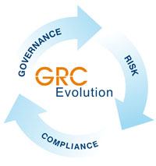
IT GRC Framework
Governance, Risk, and Compliance (GRC) Framework:
  A framework for the leadership, organization, and operation of the institution's IT areas to ensure that those areas support and enable the institution's strategic objectives. (Joanna Grama and Rodney Peterson)¹
  IT GRC programs align institutional activities with larger institutional goals (i.e., governance) and allow the identification of challenges and opportunities (i.e., risk), and when internal requirements and external mandates are lined up (i.e., compliance), institutional activities have the best chance for success—especially in stormy weather or where danger lurks. (Diana Oblinger)¹
1 Joanna Lyn Grama and Rodney Peterson. Governance, Risk, and Compliance: Why Now? Educause Review, Vol.48, no.6 (November/December 2013)
Notes:
PETER’S SLIDE
Governance, risk, and compliance (GRC) programs intend to develop a framework for the leadership, organization, and operation of the institution's IT areas to ensure that those areas support and enable the institution's strategic objectives. (Educause: Grama and Peterson)
As EDUCAUSE President and CEO Diana Oblinger notes, GRC programs are about "getting your ducks in a row." GRC programs align institutional activities with the larger institutional goals (i.e., governance) and allow the identification of challenges and opportunities (i.e., risk). When internal requirements and external mandates are lined up (i.e., compliance), institutional activities have the best chance for success—especially in stormy weather or where danger lurks.
IT GRC Programs — Why Now?
The stakes are high for the effective operation of higher education IT organizations. IT GRC
programs help level the playing field.
The EDUCAUSE IT GRC program provides resources that help
you define and implement IT governance, risk, and compliance
(GRC) activities on your campus.
GRC issues increasingly
pervade higher education
information technology. As
institutional investment in IT and
reliance on information systems
have grown, so has the need for
reliable structures and
measures to ensure success
and minimize failure.
IT GRC programs develop a
framework for the leadership,
organization, and operation of
an institution's IT programs.
This framework can be used by IT staff to ensure that their
programs support and enable the institution's strategic objectives.
A member advisory board, member working groups, and
representatives from complementary organizations advise
EDUCAUSE in the development of best practices, toolkits,
and case studies.
An ECAR research study benchmarks how higher
education institutions are approaching IT GRC practices.
(pictured, right: a snapshot of the ECAR IT GRC
infographic)
A discussion group provides a community forum for IT
GRC topics.
Additional resources from NACUA have been made
available to EDUCAUSE members through the
organizations' collaboration on IT GRC.
Resources
IT Risk Register, a sortable checklist that identifiescommon strategic IT risks and catalogues those risks
according to common risk types and IT domains
Digital Capabilities in Higher Education 2016 IT
Governance Risk and Compliance
IT Governance Toolkit, resources to help you design a
framework for IT governance at your institution
Higher Education IT Governance Checklist
Risk Management Basics, a quick overview of the three
basic steps of risk management: identify and assess,
monitor, and response
Thinking about IT Risk Strategically, IT leaders at two
institutions explain how they use the risk register to couch
risks in terms of their impact on an institution's mission or
goals
IT GRC Advisory Board resources to help you define and
implement campus IT GRC activities:
Understanding IT GRC in Higher Education: IT
Governance
Understanding IT GRC in Higher Education: IT
Risk
Understanding IT GRC in Higher Education: IT
Compliance
EDUCAUSE Library resources:
Compliance
IT Governance
Risk Management
NACUA Resources (complimentary for EDUCAUSE
members):
Developing a Comprehensive Privacy Program:
A Step-by-Step Guide

Slide 22
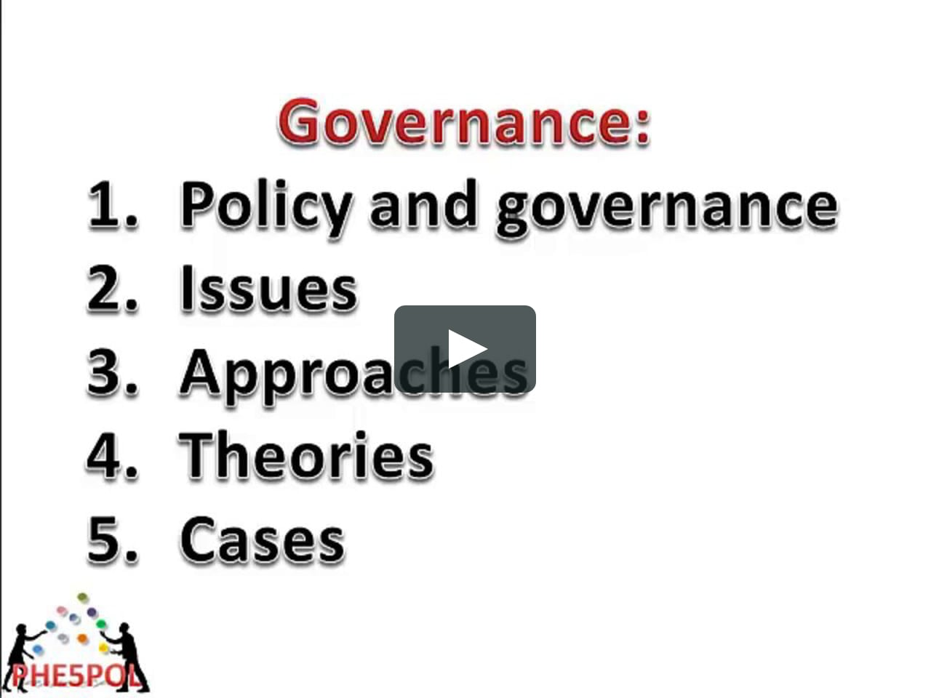

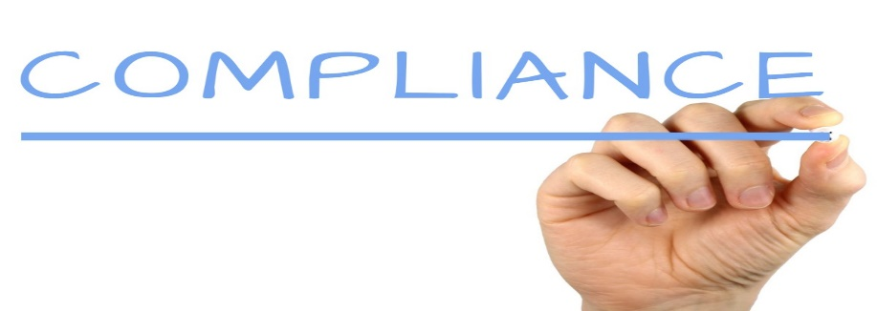
IT GRC in Higher Education
  Only 56% of all H.E. institutions have IT governance in place¹
  Only 2 out of 5 institutions indicate that they have a process for reviewing IT compliance practices, and only 1 out of 5 indicate that they have an adequate budget devoted to IT compliance¹
    81% of institutions do not include IT risk in their institution’s strategic plan. While information security was ranked the highest by institutions as an IT risk, there was a gap between its importance and the effectiveness in addressing this IT risk¹
1 Bichsel, Jacqueline, and Patrick Feehan. Getting Your Ducks in A Row: IT Governance, Risk, and Compliance Programs in Higher Education.
Research report. Louisville, CO: ECAR, June 2014
Notes:
PETER’S SLIDE
Governance
Engaging the campus
At its core, a governance program ensures that all institutional activities are aligned with the institution's strategic plan goals. For higher education IT organizations, IT governance means ensuring that the campus IT strategy is aligned with the institution's strategic plan. Information technology thus becomes a strategic partner in the institutional mission.
Question: Does your institution have a formal process for aligning your IT goals with your institution’s strategic plan goals? Yes/No
Question: If so, does it identify top-level IT goals, assign responsibilities for meeting those goals, and assess the results within the context of the institutional strategic plan? Yes/No
Risk
Within the IT organization: IT risk management refers to the process of identifying risk, assessing risk, and prioritization of the major IT risks associated with the organization’s key objectives.
Once the risks have been prioritized, the organization proceeds with taking steps to reduce risk to acceptable levels, or in some cases, to assume the identified risk.
This typically means developing policies, procedures and action items (projects) to engage changes to existing systems, and integrating risk mitigation strategies into the life cycle for new systems.
The process includes monitoring risk mitigation activities to ensure that the risk has been reduced.
Enterprise IT risk management helps an institution identify the risks that it faces with regard to its IT resources and systems and affirmatively address those risks in a way that satisfies its overall goals. Enterprise IT risk management programs move beyond information security risks and look at the strategic, financial, legal, operational, and reputational risks inherent in operating IT systems.
Enterprise IT risk management programs move beyond information systems and security risks associated with the IT organization.
Institutional focus, not unit-specific. An alignment with an institution’s broader strategic goals
Aligns and prioritizes activities to address the identified IT risks that impact
university-wide academic and business operations
These are IT risks that have a substantial financial impact, lead to lost
productivity, a distraction from institutional goals, cause negative publicity, affect institutional reputation, etc.
Enterprise IT risk management strategies help protect the institution so that it can achieve its strategic goals.
Enterprise IT risk management requires collaboration between IT and the other academic and business areas of the university...it will not be effective if it is just an IT organization activity.
One question to ask in identifying these enterprise IT risks is: What are the IT risks that would cause the university to fail to achieve its institutional goals and operational excellence?
Question: Do you feel that your institutional leadership appreciates that Cybersecurity risks, if not addressed as an institutional priority, can have negative consequences on the reputation, legal, economic and operational aspects of the institution?
Compliance
IT security compliance addresses policies and procedures for complying with
audit requirements, laws and regulations.
An enterprise compliance program is generally defined as a formal program that specifies the organizational activities designed to help prevent and detect violations of applicable laws and regulations. For higher education IT organizations, compliance means ensuring that the institution's IT resources and systems are operated in a way that meets the laws and regulations impacting those systems and that also complies with institutional policy.
Increased regulatory requirements and renewed enforcement efforts that scrutinize college and university practices are a sign of the times. Ironically, legislative, regulatory, and contractual compliance issues are burdening colleges and universities at the same time that higher education institutions are under increased pressure to reduce costs. To add to this complexity, IT security compliance may be but one element of a multifaceted institutional compliance program.
Does your institution have an effective IT security compliance program and an enterprise compliance program?

Slide 23
IT GRC and Cybersecurity at UMB
Cybersecurity Collaborative
A multi-organizational structure facilitates information sharing and coordination of effort between schools, departments, clinics, and the hospital
Aligned with the institution's strategic plan and a key area in the institution’s enterprise risk management program
An integrated and collaborative governance model has been established that includes an executive committee and an IT Leaders group
An Information Security Working Group identifies information security risks, and works collaboratively to address IT security compliance with internal requirements and external mandates that include audit requirements, laws and regulations
Notes:
PETER’S SLIDE

Slide 24
IT GRC and Cybersecurity at UMB
Enterprise Model: Cybersecurity Collaborative
UM Medicine IT Network
UMB Information Security
UMB
Enterprise Services
Central Offices
Dental
Law
Pharmacy
Grad
Nursing
SSW
Clinics
Information Security Working Group
Medicine
Hospital
Notes:
PETER’S SLIDE

Slide 25
Primary Objectives of the
Cybersecurity Collaborative
Identify, assess, and report on any information security risk or vulnerability
Define common areas of risk as they relate to information security at appropriate operational intersections
Share effective information security strategies
Share technology solutions and technical knowledge
Collaborate on the improvement and enforcement of information security policies
Develop a global communication strategy to promote and expand information security awareness
Collaborate on the improvement and strengthening of information security policies, practices, and solutions, and ensure coverage and compliance across the enterprise
Notes:
PETER’S SLIDE

Slide 26
GRC Cybersecurity Framework at UMB
Information Security Working Group
Executive Leadership
IT Leaders
Risk Assessment Plan
Policy Development and Review
Security Awareness and Education
Execution of Assessment Plan
Compliance and Monitoring
Notes:
PETER’S SLIDE

Slide 27
Success Indicators: Two Reasons Why the UMB GRC Cybersecurity Framework is Working So Well
We are taking an enterprise approach to information security, which means active participation, resource commitment and prioritization by each area represented in the cybersecurity collaborative
And,
It is not just an activity that we are working on as time permits or in response to an event. It has become an integral part of the UMB culture, UMB Strategic Plan, the ERM program, and academic and business processes
Notes:
PETER’S SLIDE

Slide 28
UMB IT GRC and ERM Experience
Our Principles and Approach
Collaboration across the enterprise
Added visibility and value to IT Security
President
SAW 3
UMB Executive Committee
SAW 1
SAW 2
SAW 4
SAW 5
Notes:
ROGER’S SLIDE

Slide 29
UMB IT GRC and ERM Experience
What We Have Learned
First cycle will identify mostly operational risks
Leadership must make a conscious effort to identify strategic risks
Strategic plan may provide a useful framework for evaluating risks and determining priority
The ERM process is just as important as the product
Sustaining funding for the program is a challenge
It’s a process not a project
Must be mindful of process fatigue; affects leaders more than participants
And influences an important positive change as the institution moves from IT Security GRC to an enterprise program of governance, risk, management and compliance
Notes:
ROGER’S SLIDE

Slide 30
Value of Using GRC and ERM Frameworks
The ERM program and structure at the University of Maryland Baltimore:
  Adds visibility and value to the Cybersecurity program
  Facilitates communication and collaboration across the enterprise
  Changes the culture to be more Cybersecurity aware
Cybersecurity can’t be addressed in silos, and just by the IT organization
Cybersecurity is only as strong as the weakest link in the institution
Using GRC and ERM frameworks make it an enterprise-wide program
It has to be viewed as an enterprise issue since it impacts all missions of the institution
Notes:
PETER’S SLIDE
Notes: Points to make:
Cybersecurity has evolved to be a significant priority activity…IT security is much bigger and more important than ever
Growing amount of work and demand to keep institutional data assets secure
It is an institutional issue.. not just an IT activity/issue
Can’t address IT security in silos…a cybersecurity program is only as strong as the weakest link in the institution
It is an awareness, institutional cultural issue
Has to be viewed as an enterprise issue…it affects the missions of the institution.
A breach can affect an institution’s reputation, have legal consequences, have a
financial impact, and disrupt normal operations
GRC and ERM focus on institutional goals, plans, and strategy
Cybersecurity must be a key element in GRC and ERM programs
GRC and ERM programs are sponsored and supported by institutional senior leaders
The ERM structure at the University of Maryland Baltimore is sponsored by the President, has an Executive Committee, an ERM Steering Committee, and subject area workgroups, including IT systems and Cybersecurity.
It includes Cybersecurity as a critical area
It adds visibility and value to IT systems and Cybersecurity
It facilitates communication and collaboration across the enterprise
It facilitates changing the culture to be more Cybersecurity aware

Slide 31
If You Don’t Have a GRC and ERM Program at Your Institution…
Some key things you can do:
Keep reminding institutional leadership of the potential impact of not addressing cybersecurity risks…keep the risks visible and in the forefront
Use Educause and other resources to point out what can happen, and what has happened, at other institutions when risks aren’t addressed
Take advantage of the public consciousness regarding Cybersecurity and the constant news of organizations experiencing breaches
Tie the message to how unattended risks at your institution could lead to a breach that would impact the reputation, finances, legal aspects as well as the operations of the institution
Notes:
PETER’S SLIDE
Notes: Points to make:
Be a voice, an influencer, help shape the culture
Keep voicing the risks
Remind institutional leadership of the negative impacts of not addressing these risks
Tie the message to the missions of the institution
Communicate that strategic plans and goals cannot be achieved if risks aren’t appreciated and the potential impact to institutional reputation, finances, legal and operations
Express to senior leaders that Cybersecurity needs to be treated like Physical Security
Take advantage of the public consciousness regarding Cybersecurity and the constant news of organizations and companies experiencing breaches
Use Educause and other resources to point out that when risks aren’t addressed at an institutional level, there is a greater chance for the Cybersecurity program to be IT focused, underfunded, not capable of addressing all of the vulnerabilities
You, as an individual who manages Cybersecurity activities, are a critical resource to your institution.
You need to feel empowered to communicate Cybersecurity risks and issues…senior leadership will listen if you express Cybersecurity issues…keep the issues visible and continually in the forefront
Senior leadership doesn’t know what they don’t know…they won’t pay attention unless they know about the Cybersecurity issues, risks and vulnerabilities
A growing awareness across the institutional community will help change the culture and be an issue that all levels of the institution will appreciate
Communicate and inform…and know your audience. Don’t focus on IT and Cybersecurity jargon, use the right language so that all constituencies will understand how Cybersecurity links to and can affect strategic plans, goals and missions of the institution
You are a key contributor to your institution’s Cybersecurity program
Make a difference…keep the conversation going…be a leader in informing and educating your colleagues, supervisors, stakeholders and institutional leaders
Try to step out of your comfort zone and don’t just focus on the task at hand… raise your hand when there is an issue…don’t be silent
Identity barriers to a successful Cybersecurity program, be persistent in telling supervisors and senior leaders what these issues are
Communicate how these issues and barriers will impact institution success is they aren’t addressed
GRC and ERM programs are institutional programs. Cybersecurity has to be linked to these institutional programs and be a key element
An effective Cybersecurity program influences positive change as the institution moves from a specific IT security program to a Cybersecurity program that intersects and interfaces with all areas of the institution and it is a critical institutional process just like ERM and GRC.
You are extremely valuable to your institution and to your institution’s Cybersecurity program…so please engage your community and mention to anybody and everybody at your institution, that an effective Cybersecurity program requires “All Hands on Deck”
Be an influencer in creating a risk aware culture throughout the enterprise.

Slide 32
Educause Resources
IT Governance
IT Governance Toolkit
Higher Education IT Governance Checklist
IT Governance, Risk, and Compliance in Higher Education
IT Risk Management
Thinking about IT Risk Strategically
IT Risk Register
Understanding IT GRC in Higher Education: IT Risk
Risk Management Basics
IT Compliance
Understanding IT GRC in Higher Education: IT Risk
Higher Education Compliance Matrix
New Federal Data Protection Requirements Impact Higher Education Institutions
Notes:
PETER’S SLIDE
IT GRC Programs — Why Now?
The stakes are high for the effective operation of higher education IT organizations. IT GRC
programs help level the playing field.
The EDUCAUSE IT GRC program provides resources that help
you define and implement IT governance, risk, and compliance
(GRC) activities on your campus.
GRC issues increasingly
pervade higher education
information technology. As
institutional investment in IT and
reliance on information systems
have grown, so has the need for
reliable structures and
measures to ensure success
and minimize failure.
IT GRC programs develop a
framework for the leadership,
organization, and operation of
an institution's IT programs.
This framework can be used by IT staff to ensure that their
programs support and enable the institution's strategic objectives.
A member advisory board, member working groups, and
representatives from complementary organizations advise
EDUCAUSE in the development of best practices, toolkits,
and case studies.
An ECAR research study benchmarks how higher
education institutions are approaching IT GRC practices.
(pictured, right: a snapshot of the ECAR IT GRC
infographic)
A discussion group provides a community forum for IT
GRC topics.
Additional resources from NACUA have been made
available to EDUCAUSE members through the
organizations' collaboration on IT GRC.
Resources
IT Risk Register, a sortable checklist that identifiescommon strategic IT risks and catalogues those risks
according to common risk types and IT domains
Digital Capabilities in Higher Education 2016 IT
Governance Risk and Compliance
IT Governance Toolkit, resources to help you design a
framework for IT governance at your institution
Higher Education IT Governance Checklist
Risk Management Basics, a quick overview of the three
basic steps of risk management: identify and assess,
monitor, and response
Thinking about IT Risk Strategically, IT leaders at two
institutions explain how they use the risk register to couch
risks in terms of their impact on an institution's mission or
goals
IT GRC Advisory Board resources to help you define and
implement campus IT GRC activities:
Understanding IT GRC in Higher Education: IT
Governance
Understanding IT GRC in Higher Education: IT
Risk
Understanding IT GRC in Higher Education: IT
Compliance
EDUCAUSE Library resources:
Compliance
IT Governance
Risk Management
NACUA Resources (complimentary for EDUCAUSE
members):
Developing a Comprehensive Privacy Program:
A Step-by-Step Guide

Slide 33
Presentation Take-Aways
Cybersecurity is an enterprise-wide issue and activity
Strengthened by GRC and ERM frameworks and programs
It needs to be aligned with the institutional strategic plan, goals and objectives
Cybersecurity awareness across the institutional community will help change the culture and be an issue that all levels of the institution will appreciate
It requires engaging your community and communicating to anybody and everybody that cybersecurity is a strategic risk and requires “All Hands on Deck” for an information security program to be successful
Notes:
ROGER’S SLIDE
Leverage GRC and ERM programs if you have them
GRC and ERM programs are institutional programs. Cybersecurity has to be linked to these institutional programs and be a key element
An effective Cybersecurity program influences positive change as the institution moves from a specific IT security program to a Cybersecurity program that intersects and interfaces with all areas of the institution and it is a critical institutional process just like ERM and GRC.
Be a voice, an influencer, help shape the culture
Keep voicing the risks
Remind institutional leadership of the negative impacts of not addressing these risks
Tie the message to the missions of the institution
Use Educause and other resources to point out that when risks aren’t addressed at an institutional level, there is a greater chance for the Cybersecurity program to be IT focused, underfunded, not capable of addressing all of the vulnerabilities
You need to feel empowered to communicate Cybersecurity risks and issues…senior leadership will listen if you express Cybersecurity issues…keep the issues visible and continually in the forefront
Senior leadership doesn’t know what they don’t know…they won’t pay attention unless they know about the Cybersecurity issues, risks and vulnerabilities
A growing awareness across the institutional community will help change the culture and be an issue that all levels of the institution will appreciate
Make a difference…keep the conversation going…be a leader in informing and educating your colleagues, supervisors, stakeholders and institutional leaders
Try to step out of your comfort zone and don’t just focus on the task at hand… raise your hand when there is an issue…don’t be silent
You are extremely valuable to your institution and to your institution’s Cybersecurity program…so please engage your community and mention to anybody and everybody at your institution, that an effective Cybersecurity program requires “All Hands on Deck”

Slide 34
Questions?

